Slide 1
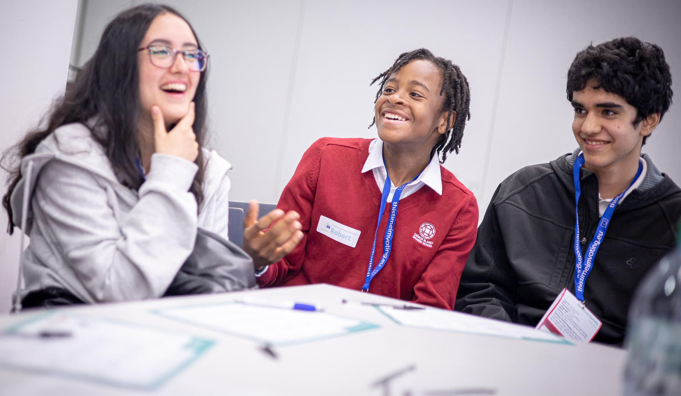

JUNIOR AMBASSADORS INTRODUCTION

Slide 2
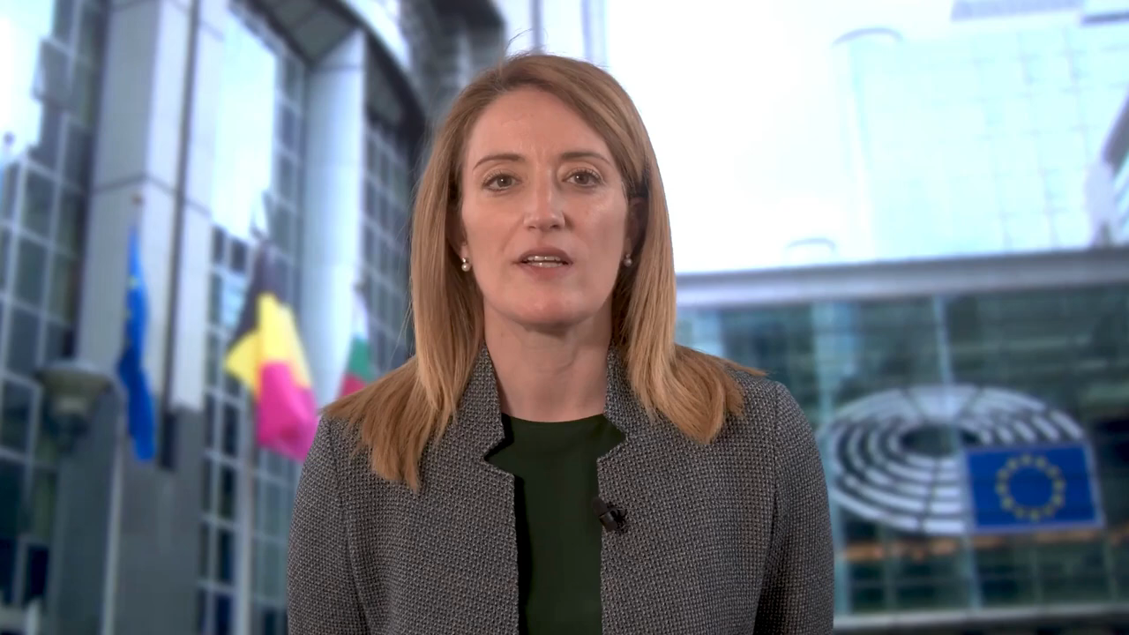
ROBERTA METSOLA
THE PRESIDENT OF THE EUROPEAN PARLIAMENT WELCOMES YOU
Notes:
QE school video, to use if time.

Slide 3
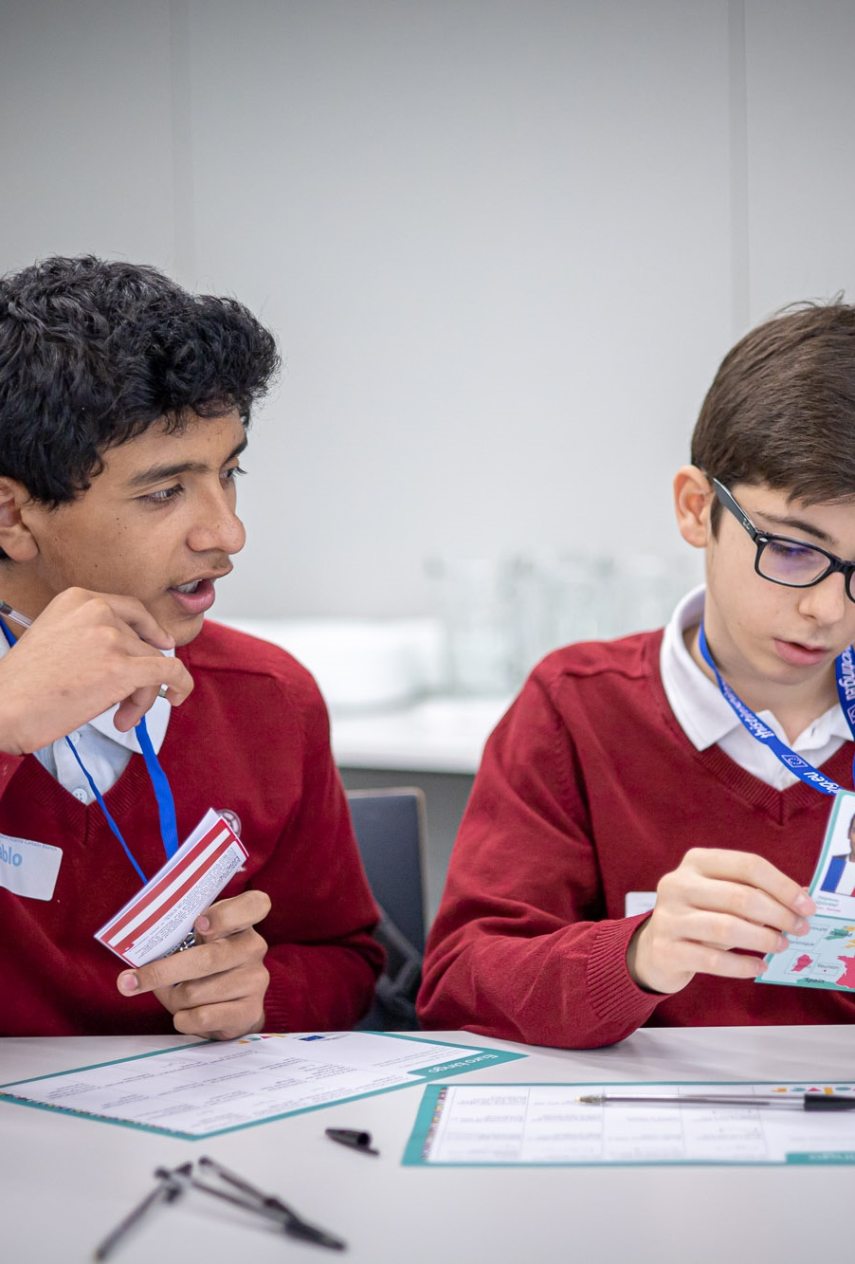
CRITERIA
Appoint Junior and Senior Ambassadors
Create an Info Point
Celebrate Europe Day
Book an educational programme offered by the European Parliament
Share European culture
Promote democratic engagement
Share your experiences through epas.org.uk and social media

Slide 4
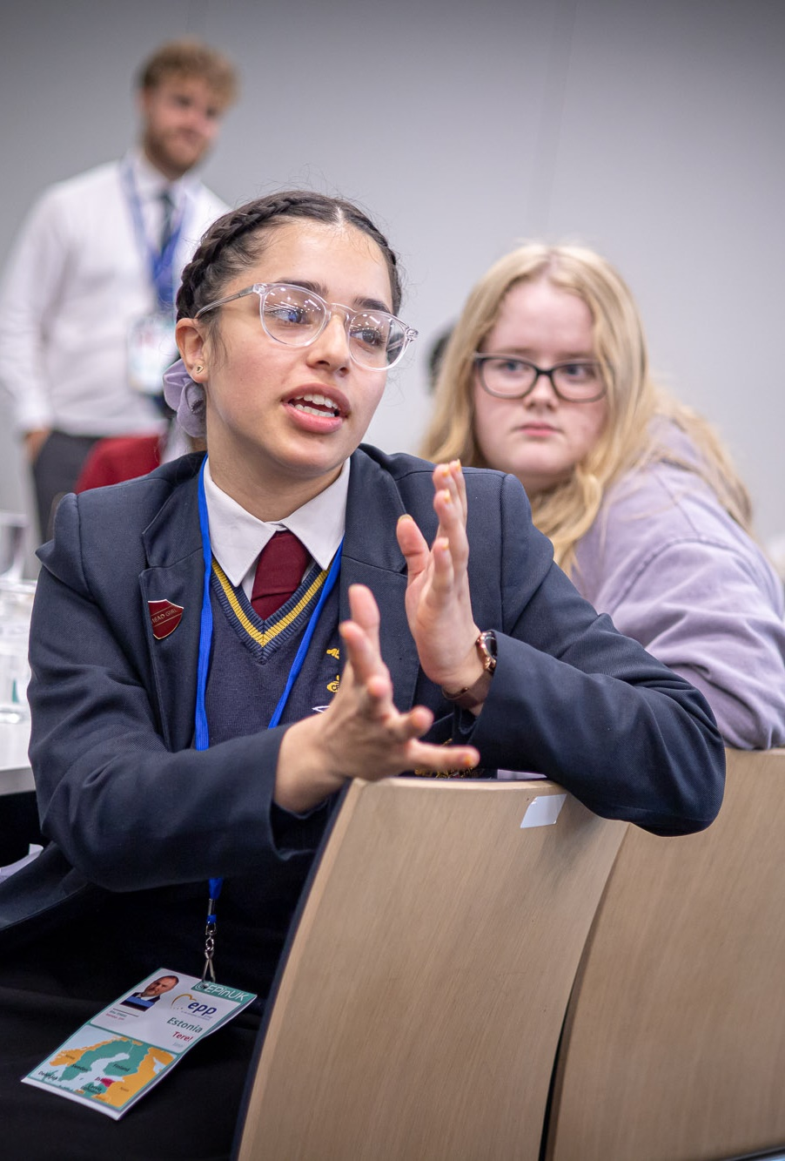
AMBASSADORS
Senior Ambassador
Team of Junior Ambassadors
Member(s) of staff
Students leading events
Team of Junior Ambassadors
Europe Day Event
LUX Prize screening
Events run by students
Team of Junior Ambassadors
EU InfoPoint

Slide 5

WHAT ACTIVITIES WOULD YOU LIKE TO RUN?

Slide 6

EUROPEAN PARLIAMENT
JUST A FEW OF THE WAYS IT AFFECTS OUR LIVES
Notes:
Although we are not citizens, the EU still has a big impact on all these areas, so they could be the inspiration or focus for a project that your JAs could run.

Slide 7
SOME EVENTS YOU COULD MARK
European Day of Remembrance for Victims of All Totalitarian and Authoritarian Regimes
Constitution Day of Slovakia
Independence Day in Malta
Multilingualism Day at the European Parliament
European Day of Languages
Cyprus Independence Day
German Unity Day
European Day against the Death Penalty
National Day of Spain
National Day of Austria
Independence Day in the Czech Republic
Saint Andrew's Day
Armistice Day (end of WW1)
Independence Day in Latvia
International Day for the Elimination of Violence against Women
Great Union Day in Romania
Independence Day in Finland
Human Rights Day
Holocaust Remembrance Day
Data Protection Day
Day of the Restoration of the State of Lithuania
Independence Day in Estonia
Saint David's Day
Liberation Day in Bulgaria
International Women's Day
National Day of Hungary
National Day of Ireland; Saint Patrick's Day
Celebration of the Greek Revolution
Saint George's Day
King's Day in the Netherlands
Labour Day; May Day
World Press Freedom Day; Constitution Day in Poland
Europe Day
International Day against Homophobia
Croatian Statehood Day
Republic Day of Italy
Denmark's Constitution Day
National Day of Sweden
European Parliament elections
Portugal Day
National Day of Luxembourg
Statehood Day in Slovenia
National Day of France
National Day of Belgium

Slide 8
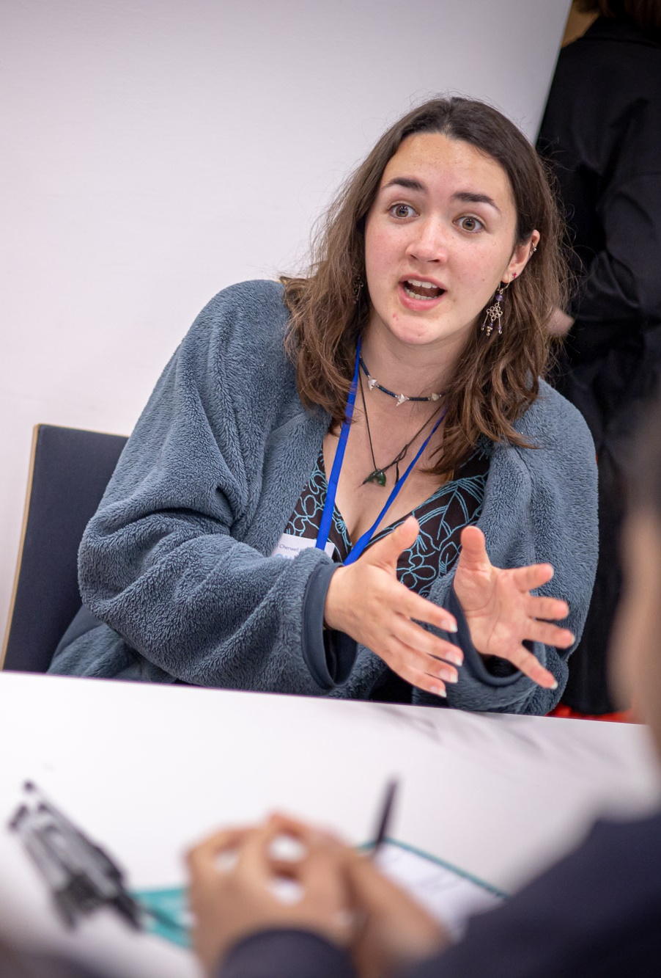
EPAS ROLES
Within your projects you could take on lots of different roles:
Project Manager: keeping everyone on track
Publicity and design: making posters and flyers
Social media: letting people know what’s going on online
Photographer/videographer: document what is going on
Staff liaison: make sure you get all the permissions and support you need

Slide 9
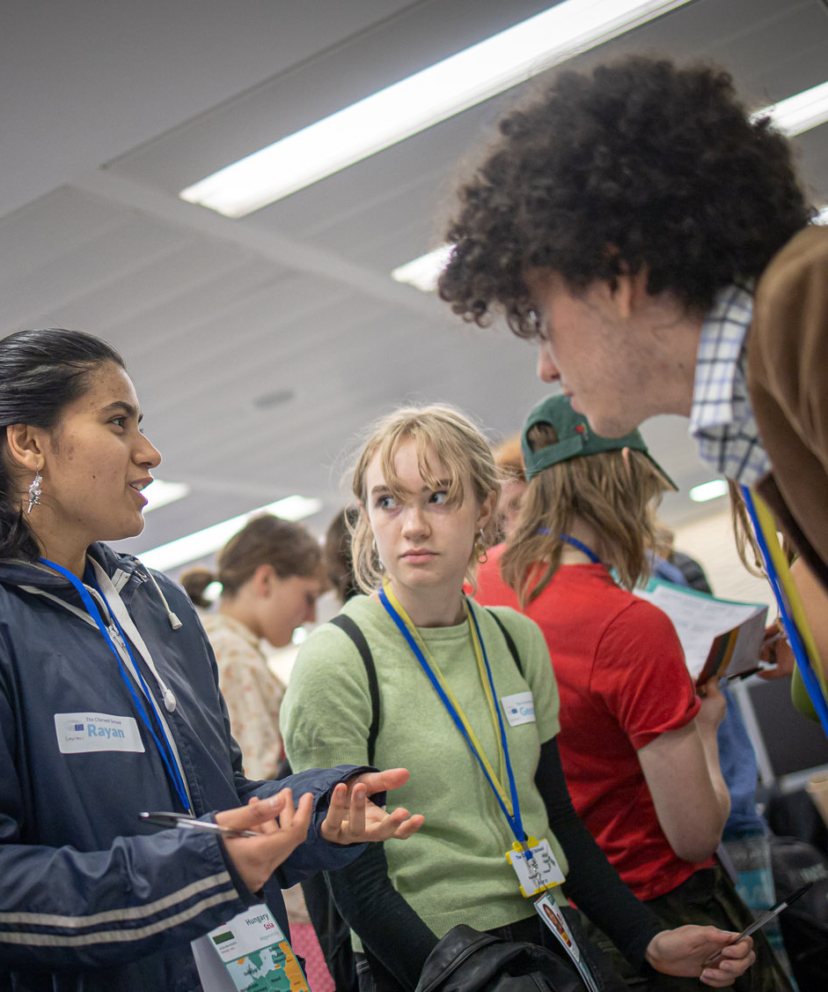
PLANNING YOUR EVENT
Break it down into small steps: the smaller the better, for example:
Just some of the steps required to ‘Show a French Film’
  Book the school hall
    Work out a date the hall is free
  Choose a film
    Make sure it has subtitles
    Make sure the film is appropriate
    Make sure you have permission to show it
  Advertise
    Design posters
    Put up posters
    Sell tickets
  On the day
    Check the speakers
    Bring the film
    Put out chairs
    Bag up popcorn

