Slide 1

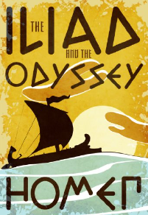
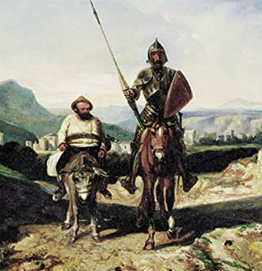
WHAT HAS EUROPE GOT TO DO WITH
ENGLISH
Europe has been a major influence on English literature throughout history. The dramatic style of tragedy originated in Ancient Greece over 2500 years ago. The first modern novel, Don Quixote, was written by a Spanish author (Cervantes). And the sonnet was first developed in Renaissance Italy and championed by Petrarch in the 1300s.
Discussion question: the sonnet and tragedies were particularly influential on a great English literary figure – who was he? Which other European authors/playwrights can you name?

Slide 2
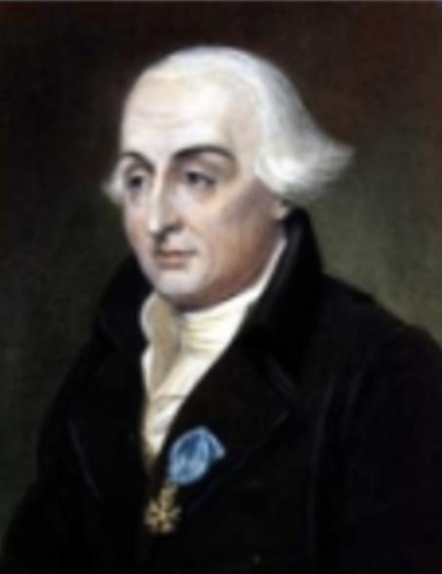
WHAT HAS EUROPE GOT TO DO WITH
MATHS
Joseph-Louis Lagrange (1736 – 1813) was a true European: born in Italy, he worked in Germany, before eventually becoming a French citizen. He was responsible for many mathematical innovations, including the decimalisation of weights and measures, and the French currency (1795).British currency was finally decimalised in 1971. Before that, £1 was equal to 20 shillings, and one shilling was equal to 12 pence.
Discussion question: which of the following two problems is easier? 1) What is 20% off a price of 2 pounds 14 shillings and 6 pence (old money)? 2) What is 20% off a price of £2.75 (new money)?

Slide 3
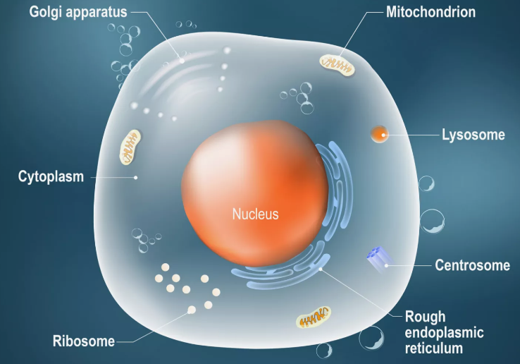
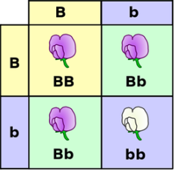
WHAT HAS EUROPE GOT TO DO WITH
BIOLOGY
Joachim Hämmerling was a Danish-German biologist born in 1901 who pioneered the research of animal and plant cells. In an experiment using acetabularia he was able to determine the location of genetic information in a cell – the nucleus.
Gregor Mendel, an Austrian biologist, was also a pioneer in the investigation of genetic information and inheritance in organisms, giving evidence for dominant and recessive traits.
Discussion Question: can you name 3 common traits passed down through inheritance?

Slide 4
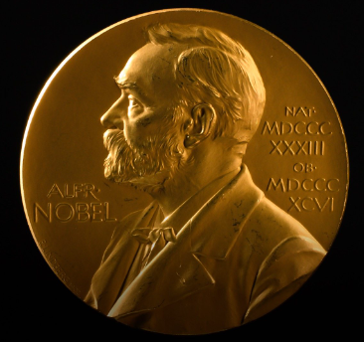
WHAT HAS EUROPE GOT TO DO WITH
CHEMISTRY
Amedeo Avogadro was an Italian chemist who was the first person to distinguish between individual atoms and molecules. He was also the first person to propose that any gas at the same temperature contains the same number of particles in a set volume. When this number was discovered, it was named in his honour: Avogadro's constant.
Alfred Nobel was a Swedish chemist who invented dynamite and also made major leaps in many other areas of science, holding 355 patents in his life. He used some of the profits from his work to establish the Nobel Prize.
Discussion Question: what is Avogadro’s Constant? What is the Nobel Prize? In which disciplines are Nobel Prizes awarded?

Slide 5
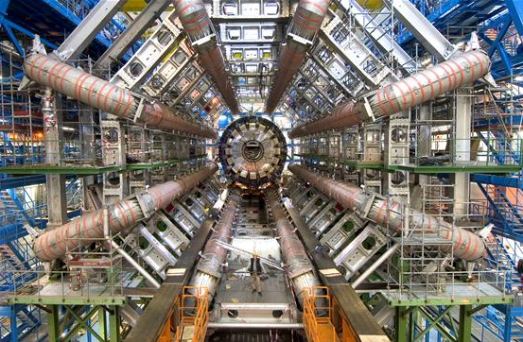

WHAT HAS EUROPE GOT TO DO WITH
PHYSICS
The European Organisation for Nuclear Research, known as CERN, has been at the forefront of particle physics since 1954. Based in Geneva, Switzerland, it is home to a number of particle accelerators. Over the years it has discovered many new subatomic particles, including the famous Higgs boson in 2012.
The need for scientists to share data over a wide range of locations also led a researcher at CERN, Sir Tim Berners-Lee, to invent the first HTTP server in 1989. This quickly spread beyond CERN to become the World Wide Web.
Discussion question: which particles make up the atom? What makes up those particles?

Slide 6
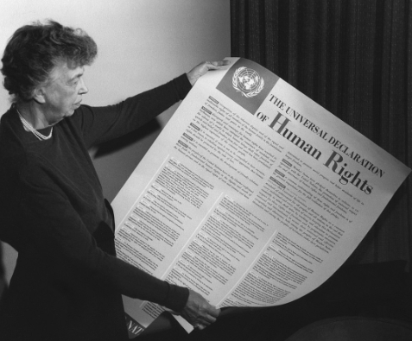

WHAT HAS EUROPE GOT TO DO WITH
PDP
At the centre of everything the EU does, there are the six core European values:
RESPECT FOR HUMAN DIGNITY – Everyone must be respected FREEDOM – People should be allowed to do and say what they want DEMOCRACY – People have the right to choose who governs them EQUALITY – Everyone enjoys the same rights regardless of who they are RULE OF LAW – Laws are designed to protect people and are applied to everyone RESPECT FOR HUMAN RIGHTS – Everyone should enjoy basic rights that no person or government can deny them
These are also essential British values.
Discussion question: are there any values you believe should be added to this list to make a better society? Are there any values that should applied better?

Slide 7
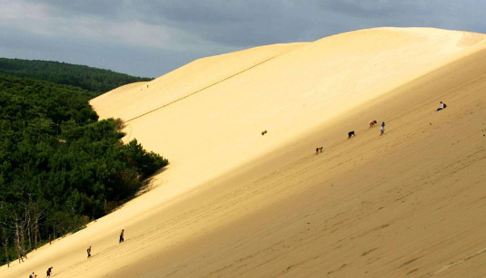
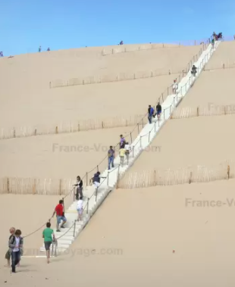

WHAT HAS EUROPE GOT TO DO WITH
GEOGRAPHY
Europe is the second smallest continent in the world, covering an estimated 10.18${km}^{2}$, being 2% of the Earth's surface. It is located in the westernmost part of Eurasia. It contains the world's smallest country, Vatican City, and has an overall population of 746.4 million people. Between human and natural landmarks, over 400 areas in Europe are classed as UNESCO World Heritage Sites, telling a rich and varied story of history and natural wonders.
Discussion question: where in Europe would you most like to visit and why? What is Europe’s most interesting natural feature? (The pictures show the Dune du Pilat, Europe’s largest sand dune at over 100m high!)

Slide 8
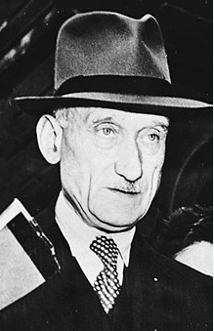

WHAT HAS EUROPE GOT TO DO WITH
HISTORY
Europe Day is celebrated to commemorate the Schuman Declaration on 9th May 1950. Robert Schuman was a French politician who proposed the establishment of a European organisation to govern the production of coal and steel. Having seen the countries of Europe fight two world wars in his lifetime, he felt it was not enough for there just to be a peace treaty between France and Germany. His idea was for the countries of Europe to share the governance of their resources to make war between them a practical impossibility. Over time, these organisations became the European Union.
Discussion question: why do you think Schuman chose 9th May 1950? (Think back to an event that happened 5 years before this.) What lessons do you think Schuman and other politicians had learnt from the experience of the Treaty of Versailles?

Slide 9
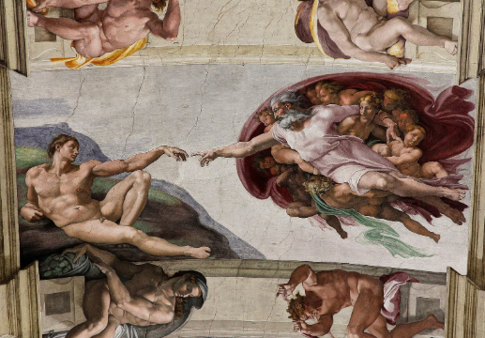
WHAT HAS EUROPE GOT TO DO WITH
RS
Religious beliefs in Europe go all the way back to the Bronze and Iron Age, when the earliest monotheistic religions developed. Religion has made a large impact on forming Europe’s art, culture, philosophy and law. Freedom of religion is a fundamental human right, championed by all European countries. The largest religion in Europe is Christianity, but there are a huge range of religions practised across the continent.
Discussion question: how do you think religion has affected the culture of societies across Europe?

Slide 10
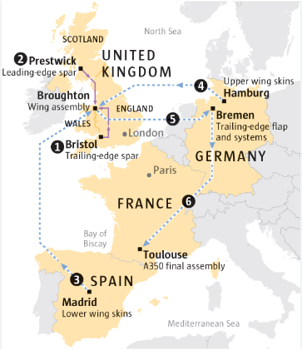

WHAT HAS EUROPE GOT TO DO WITH
BUSINESS STUDIES
Airbus is one of the largest aircraft manufacturers in the world and an example of a truly pan-European firm. It has factories that build different parts of its planes in France, Spain, Germany and three different locations in Britain. The Airbus A380 is the world’s largest civilian passenger plane and requires 4 million different parts from 1500 different suppliers, operating on a very tight “just-in-time” delivery model.
Discussion question: Airbus formed out of a merger of various national aeroplane manufacturers – why do you think it was necessary to do this? What is “just-in-time” delivery and why do you think Airbus employ this model?

Slide 11
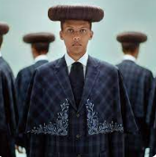
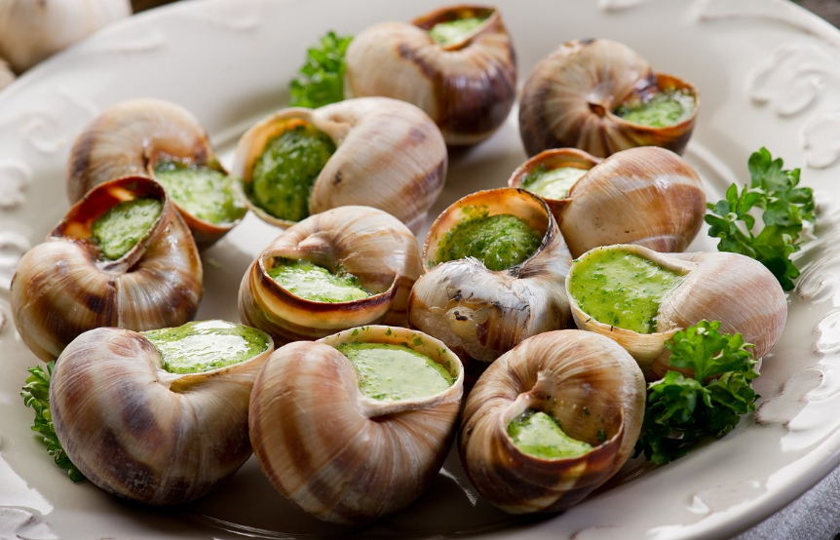
WHAT HAS EUROPE GOT TO DO WITH
FRENCH
French culture has had a huge influence across Europe, in areas as diverse as music, art, film, food and fashion.
The range of French musical styles is enormous, from the groundbreaking classical works of Claude Debussy to Stromae’s 'Alors on danse’, which reached number 1 in 22 countries.
French cuisine ranges from the universally-accepted deliciousness of the patisserie, to the somewhat more controversial escargots! Even the idea of the restaurant was invented in France with the first restaurant opening in 1765.
France’s appreciation for fashion developed out of the textile trade in the 17th century, and many of the world’s leading fashion houses are based in Paris today.
Discussion question: what are escargots and what do you think of eating them? Which French fashion houses can you name – which is your favourite?

Slide 12
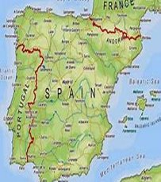
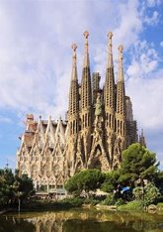

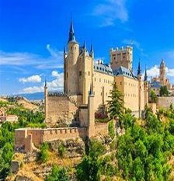

WHAT HAS EUROPE GOT TO DO WITH
SPANISH
Spain is the largest and sunniest country in Southern Europe and has been a member of the European Union since 1986. Spain’s government often relies on the EU when making decisions about its relationships with other countries and the country is firmly pro-European. Spain is a very popular tourist destination as it is often warm, sunny and has a long expanse of coastline on the Mediterranean Sea. Other reasons for its popularity are that it has stunning natural beauty, in the form of mountains and beaches, and it is a very traditional country with a fascinating culture, including bullfighting, Flamenco music and dancing, foods such as churros or paella, and places to visit like Barcelona Cathedral or one of hundreds of castles.
Discussion question: if you won a free holiday to any part of Spain right now, where would you go and what would you do?

Slide 13
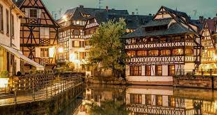
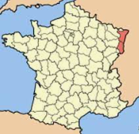
WHAT HAS EUROPE GOT TO DO WITH
GERMAN
The German language has many different dialects, because Germanic people lived in many areas of Europe long before the modern state of Germany existed. One such dialect is Alsatian, spoken in the eastern French region of Alsace. Here are some words in Alsatian, can you guess what they mean:
Güata Tàg
Willkumme
Kannst dü Englisch redde?
Or’var (this last one is taken from a language other than German)
Discussion question: the European Union aims to support minority languages like Alsatian – is it right to do so?

Slide 14
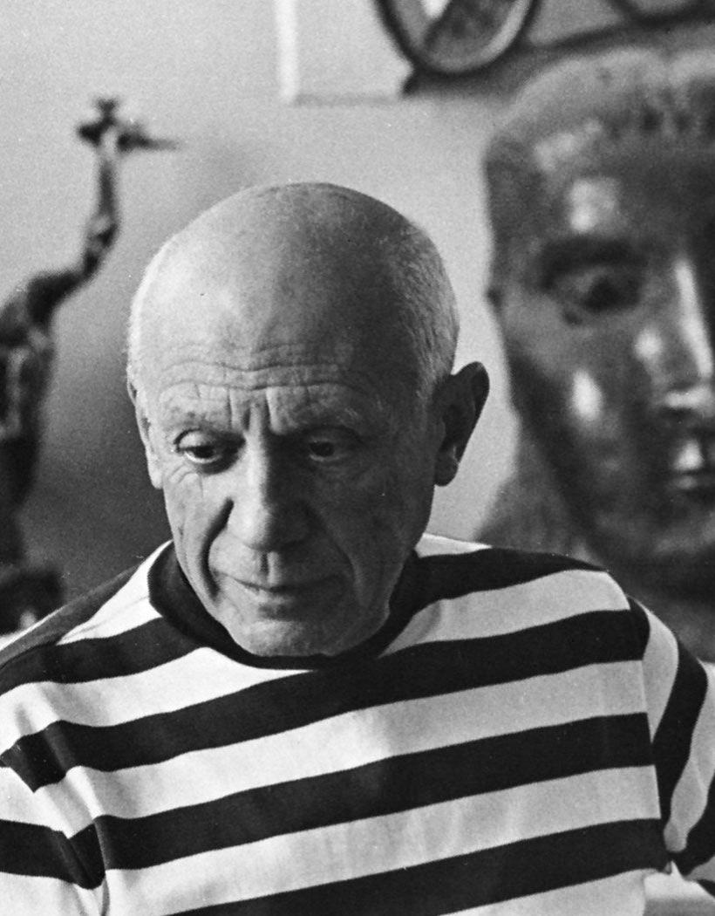
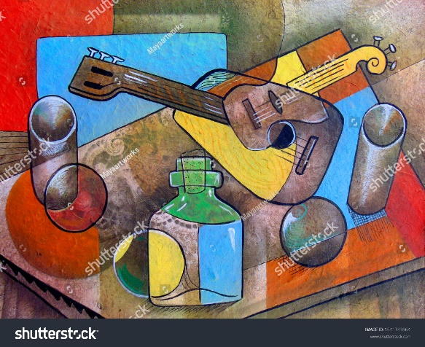
WHAT HAS EUROPE GOT TO DO WITH
ART
Pablo Picasso was a Spanish painter, sculptor, and print maker. He was one of the best-known artists of the 20th century and remains very influential to this day with paintings such as his Self Portrait, 1901. He was also a strong European and lived in France for most of his life.
Picasso co-founded the Cubist movement, a revolutionary new approach to representing reality where artists brought together different views of subjects in the same picture, making the painting appear fragmented and abstracted.
Discussion question: describe the colours and the forms used in the picture shown; how influential do you think Picasso is on more modern forms of art you have seen?
Challenge: create a Picasso WITSO ( in the style of) piece of Picasso.

Slide 15
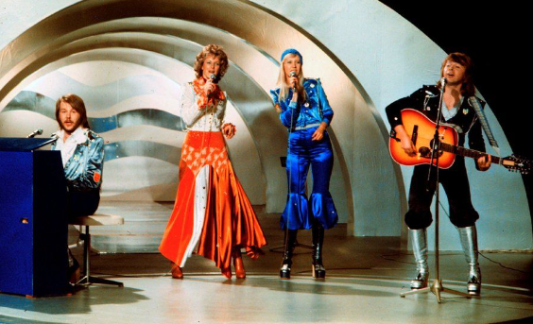
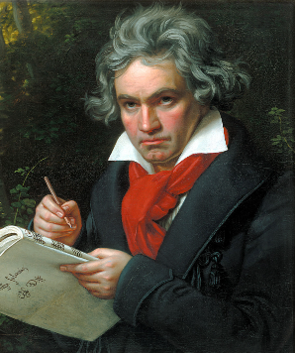
WHAT HAS EUROPE GOT TO DO WITH
MUSIC
From 2014 to 2020, the European Parliament spent €98 million on helping over 130 music projects across the continent, as part of the Creative Europe programme. In 2015, the European Parliament also introduced the Music Moves Europe initiative in 2015, whose aim is to provide a 'backbone' for helping support music projects in the future. Every year, the Music Moves Europe Talent Awards vote on some of the best up-and-coming contemporary artists and awards prizes of up to €10,000.
Discussion question: which European composers can you name? Is the Eurovision song contest a good idea or a bad idea for the development of new musical talent?

Slide 16
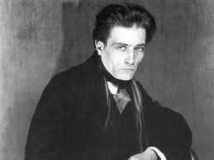
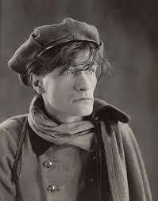
WHAT HAS EUROPE GOT TO DO WITH
DRAMA
Antonin Artaud (1896 - 1948) was a French dramatist, known for his avant-garde theatrical style that consisted of components meant to shock audiences. One of his core beliefs was that drama is integral to a healthy and diverse society and not only serves as an act of entertainment, but also breaks down language barriers between people from different cultures. Artaud’s work has influenced many later 20th century playwrights, including Samuel Beckett.
Discussion question: can you name a European actor? What was their best role and why?

Slide 17
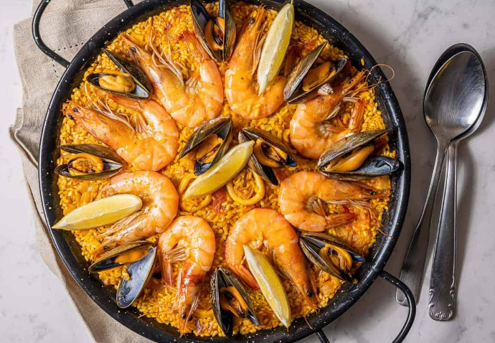
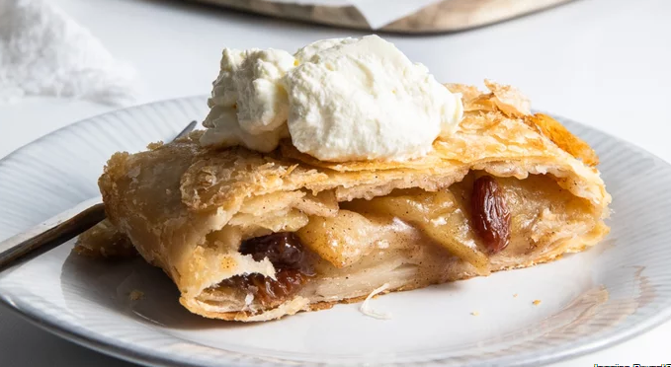
WHAT HAS EUROPE GOT TO DO WITH
FOOD TECH
Food Technology is an emerging market in Europe (compared to more developed markets in the USA and Asia), but it is a fast-growing field due to the huge importance of food to health.
Food is also the second largest consumer spending category in Europe.
Food Technology in Europe has seen considerable advances in precision farming techniques, tech driven waste management solutions and biotech.
And Europe has one of the most diverse food cultures in the world!
Discussion questions: how can technology in food be used to improve health? What is your favourite European dish? What ingredients does it require?

Slide 18
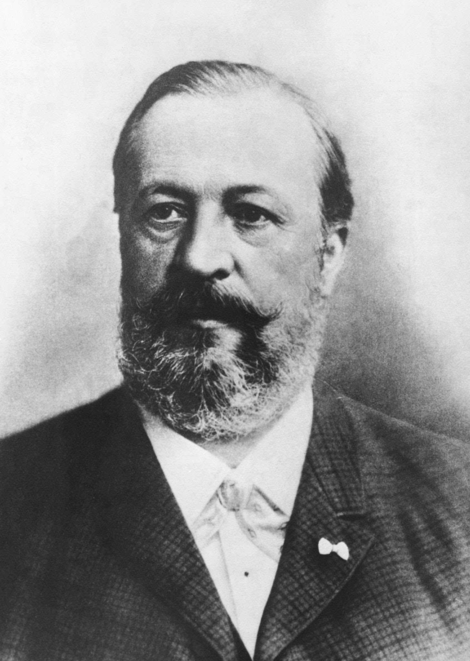
WHAT HAS EUROPE GOT TO DO WITH
D & T
Nicolaus Otto (1832-1891) was a German-born engineer who revolutionised motor engineering. He designed the first ever internal combustion engine (ICE) in 1861, where petroleum gas is used to fuel engines, being the first to move away from coal-powered steam engines. His work was shared with many car manufacturers across Europe (e.g. Peugeot in France and Tatra in Czech Republic). The work done by Otto in combustion engines is still used today in the creation of vehicle powertrains.
Discussion question: what does the term “combustion” mean in ICE? Why did ICEs take over from steam engines as a means of powering motor vehicles?

Slide 19
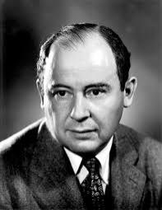
WHAT HAS EUROPE GOT TO DO WITH
COMPUTER SCIENCE
John von Neumann (1903-57) was a physicist, mathematician, computer scientist and engineer born in Budapest. He had a remarkable memory and mathematical reasoning, having been able to divide 8-digit numbers by the age of six. He is best known for his development of the von Neumann architecture for computers in 1945, which is the design most computers use today.
Discussion question: what impact do you think Europe has had on computing? Who deserves more credit for the development of computers: Alan Turing or John von Neumann?

Slide 20
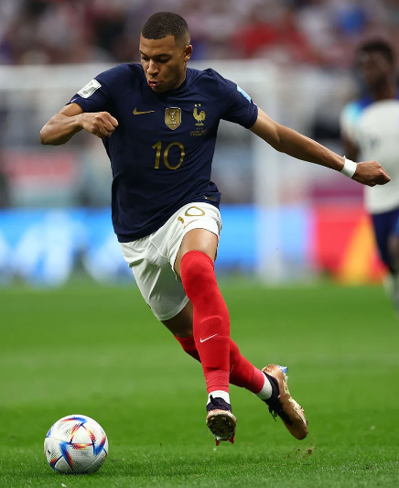
WHAT HAS EUROPE GOT TO DO WITH
PE
Physical Education in Europe can trace its roots all the way back to Ancient Greece, where people were instructed in PE as far back as 386 BC!
The European Union identified that the lack of physical education contributes to 500,000 deaths per year and comes at a huge financial cost.
They acknowledged that physical education not only benefits fitness and health, but also benefits children in later life with skills and values such as teamwork, fair play and respect.
Policies and frameworks have been put in place to ensure a high-quality, consistent approach to physical education across all schools in Europe.
Discussion question: which (non-British) European sporting teams or personalities have been influential in the development of a particular sport? (E.g. the Spanish football team’s tiki-taka technique of rapid short passing.)

