Slide 1
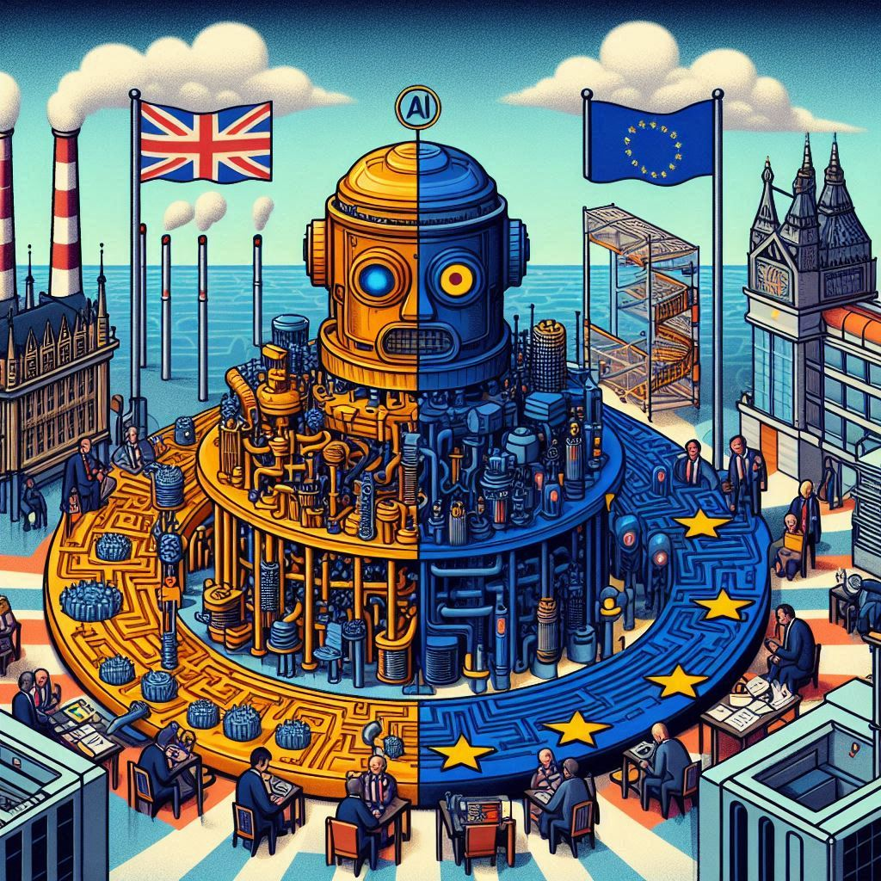
AI: MISINFORMATION, TRANSPARENCY, AND LEGISLATION
European Parliament Liaison Office
in the UK

Slide 2
PRESENTERS
ANNA HUTH
Project Leader on Youth and Culture
European Parliament Liaison Office in the UK
Contact: ana-maria.huth@europarl.europa.eu
ASHER JACOBSBERG
Director, Involver
Contractor, European Parliament Liaison Office in the UK
Contact: asher@involver.org.uk
More information about the youth offer of the European Parliament Liaison Office in the UK: europarl.org.uk

Slide 3
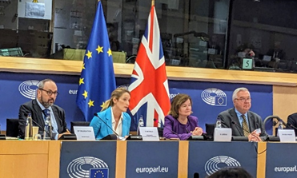
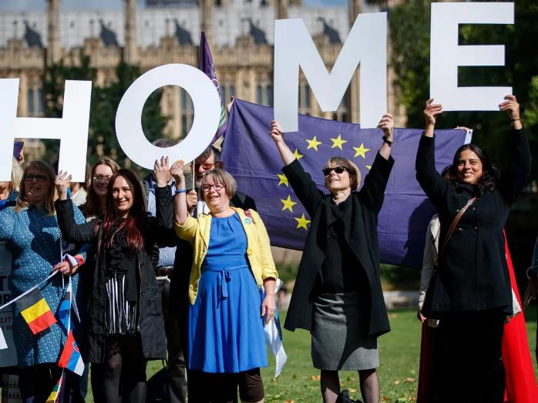

WHAT IS THE WORK OF THE EUROPEAN PARLIAMENT IN THE UK?
Reach out to EU citizens living in the UK (see: European Elections 2024)
Support EU - UK political liaison and dialogue between the European Parliament and Westminster (see: Parliamentary Partnership Assembly, Delegation visits etc.)
Manage EP youth programmes in the UK: Ambassador Schools, Euroscola, Educational Sessions, visits/talks
Cultural diplomacy programmes: 12 Star Gallery exhibitions, events
Values projects: LUX Audience Awards, human right events (e.g. Sakharov-prize, LGBTQ rights)

Slide 4

WHY ARE WE TALKING ABOUT AI?
Hot topic: key challenge for our societies
Both the EU and UK respond to the challenge and strive for global influence
Demonstrates different ways of making decisions
EU-UK relations: different and similar approaches - divergence vs convergence
Touches on our work with young people and the issues they care about

Slide 5
ISSUES FOR (YOUNG) CITIZENS
Innovation
Education
Privacy
Jobs
Legislation
Truth
Human Rights

Slide 6
UK/EU AI REGULATION HISTORY
United Kingdom
European Union
March 2023: AI Regulation White Paper
Consultations
February 2024: A pro-innovation approach to AI regulation: government response
March 2024: EP adopts AI Act, the world’s first comprehensive legal framework on AI and will apply in the same way across the EU’s 27 European Member States, creating a harmonized approach to the regulation of AI.
Spring 2025: AU AI Act fully applicable
'Unlike the EU's AI Act, which will create new compliance obligations for a range of AI actors ... the UK government is developing a principles-based framework for existing regulators to interpret and apply within their sector-specific domains‘ - White & Case global law firm

Slide 7
DIFFERING APPROACHES
United Kingdom
European Union
Light regulatory approach, Guidance, ‘Hold and wait’
‘Vertical’ regulation sector-by-sector: existing regulators assess the impact of AI in their field
Focus on promoting UK as home of innovation
Seeks to be home to international AI regulator, for example the it refers the US risk management framework of January 2023.
Does not rule out new laws or a cross-sectoral general regulation in the future.
Legislation with penalties
‘Horizontal’ regulation: rules apply across sectors (see EU competences)
Focus to improve the functioning of the European market and to promote human-centric and trustworthy AI, while ensuring a high level of protection of fundamental rights against the harmful effects of AI systems and supporting innovation.
Focus on the use of AI systems instead of the technology itself.
Risk based approach: the higher the risk the stricter the rules, unacceptable risk is prohibited.

Slide 8
A CLOSER LOOK
United Kingdom
European Union
Five principles:
safety, security and robustness;
appropriate transparency and explainability;
fairness;
accountability and governance; and
contestability and redress.
The AI Act introduces:
a ban on the use of certain AI systems, allowing the exceptional use of remote biometric identification (RBI) systems used for law enforcement purposes, subject to specific restrictions and safeguards;
specific requirements for AI systems considered as high-risk, subject to a conformity assessment before being placed on the EU market;
transparency requirements for AI systems involving a limited risk to the health, safety and human rights of EU citizens; and
a tailored and tiered governance mechanism for GPAI models, with more stringent obligations for those presenting systemic risks (a separate report will analyse the relevant provisions for GPAI models and systems).

Slide 9


DIVERGENCE: IT’S A TWO-WAY THING
Brexit’s impact on the UK's global AI leadership
‘Brussels’ effect: EU is exporter of regulation (laws apply to any firm whose technology is being used in the EU)
The EU AI Act may also apply directly in Northern Ireland under the Windsor Framework
EU-UK Trade and Cooperation Agreement (TCA) (November 2023): the European Parliament welcomed 'regulatory cooperation on ... emerging technologies, including artificial intelligence'.
Re-joining Horizon Europe (February 2024), UK AI minister Jonathan Berry offered to work with the EU on regulation, stating that London's approach to copyright in AI was likely to be 'reasonably close' to that of Brussels.
The UK and France are already cooperating on AI in safety and technology development.
UK general election on 4 July 2024: "A Labour government would urgently introduce binding regulation and establish a new regulatory innovation office for AI".

Slide 10
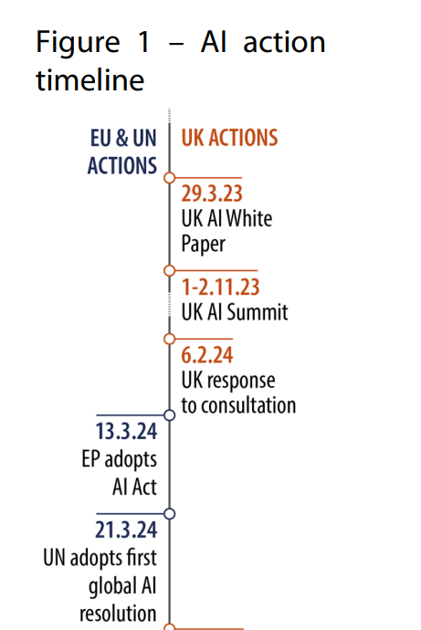
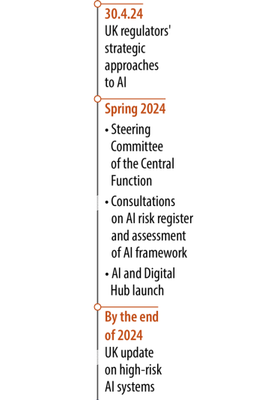
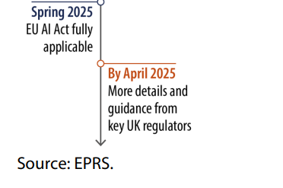
AI ACTION TIMELINE

Slide 11
USEFUL SOURCES
A pro-innovation approach to AI regulation: government response: https://www.gov.uk/government/consultations/ai-regulation-a-pro-innovation-approach-policy-proposals/outcome/a-pro-innovation-approach-to-ai-regulation-government-response
Artificial intelligence act: Council and Parliament strike a deal on the first rules for AI in the world: https://www.consilium.europa.eu/en/press/press-releases/2023/12/09/artificial-intelligence-act-council-and-parliament-strike-a-deal-on-the-first-worldwide-rules-for-ai/
The United Kingdom and artificial intelligence: https://www.europarl.europa.eu/RegData/etudes/ATAG/2024/762285/EPRS_ATA(2024)762285_EN.pdf
Global AI Law Policy Tracker, IAPP (February 2024): https://iapp.org/media/pdf/resource_center/global_ai_law_policy_tracker.pdf
The United Kingdom and artificial intelligence, EPRS At a Glance 19-04-2024
Artificial Intelligence (Regulation) Bill [HL] / House of Lords, Library Briefing, 18 March 2024
Press articles:
UK working on rules for training of AI models with creative work / Financial Times, 19 May 2024
UK rethinks AI legislation as alarm grows over potential risks / Financial Times, 15 April 2024
UK Versus EU: Who Has A Better Policy Approach To AI? / NOAH GREENE. In TechPolicy Press FEB 28, 2024

Slide 12
VERTICAL VS HORIZONTAL
 | SECTOR | MEDIA | HEALTHCARE | POLICING
RISK LEVEL |  | Copyright Libel | CQCC Privacy | Home Secretary Human Rights
UNACCEPTABLE | Banned
HIGH | Heavily regulated Human oversight
LIMITED | Less regulation Transparency requirements
MINIMAL/NO | Minimal regulation Encourage innovation
Notes:
Vertical tends to deal with the creator of the technology, whereas Horizontal deals with the sector it is used in.
Vertical tends to assume that you know what your technology will be used for, and so the requirements come from that, vertical waits to see how a technology is used in a sector and then regulates based on usage.
This is tricky where sectors don’t have strong regulation, like in elections.

Slide 13


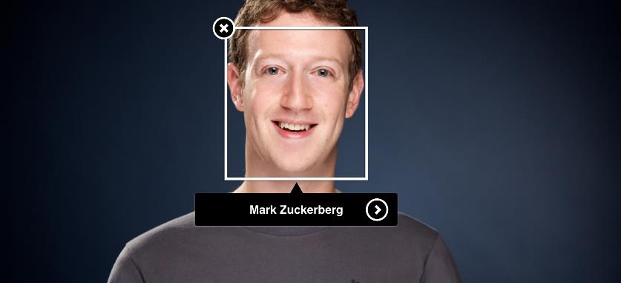
GET THE
RISK RIGHT
Let’s play:
This Photo by Unknown Author is licensed under CC BY-SA
This Photo by Unknown Author is licensed under CC BY

Slide 14

GET THE RISK RIGHT
Social scoring
UNACCEPTABLE
HIGH
LIMITED
MINIMAL/NO
This Photo by Unknown Author is licensed under CC BY

Slide 15
GET THE RISK RIGHT
Social scoring
UNACCEPTABLE
This Photo by Unknown Author is licensed under CC BY

Slide 16

GET THE RISK RIGHT
Giving legal assistance
UNACCEPTABLE
HIGH
LIMITED
MINIMAL/NO
This Photo by Unknown Author is licensed under CC BY-SA-NC

Slide 17
GET THE RISK RIGHT
Giving legal assistance
HIGH
This Photo by Unknown Author is licensed under CC BY-SA-NC

Slide 18
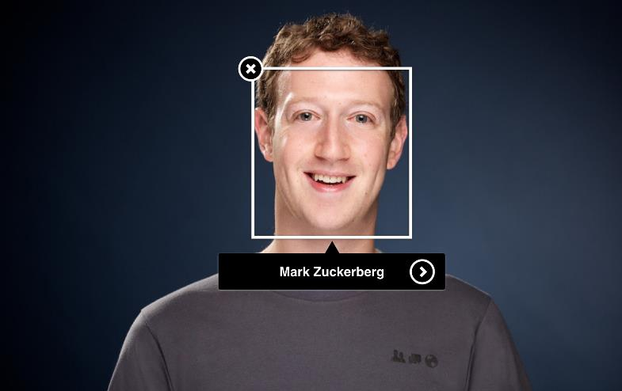
GET THE RISK RIGHT
Biometric recognition
UNACCEPTABLE
HIGH
LIMITED
MINIMAL/NO

Slide 19
GET THE RISK RIGHT
Biometric recognition
UNACCEPTABLE
HIGH
LIMITED

Slide 20

GET THE RISK RIGHT
Toys and games
UNACCEPTABLE
HIGH
LIMITED
MINIMAL/NO

Slide 21
GET THE RISK RIGHT
Toys and games
UNACCEPTABLE

Slide 22

GET THE RISK RIGHT
Toys and games
MINIMAL/NO

Slide 23

GET THE RISK RIGHT
Toys and games
HIGH

Slide 24

GET THE RISK RIGHT
Creating deep fakes
UNACCEPTABLE
HIGH
LIMITED
MINIMAL/NO

Slide 25
GET THE RISK RIGHT
Creating deep fakes
LIMITED

Slide 26
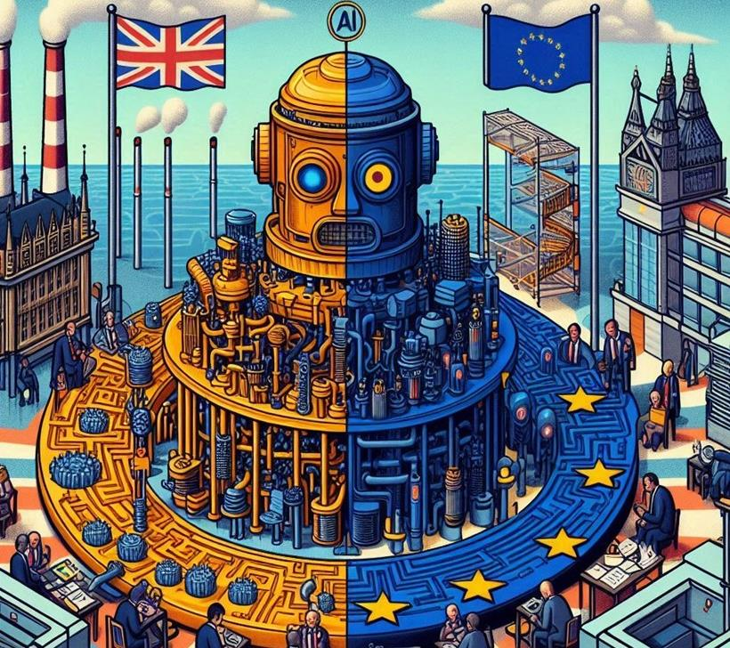


WHAT IS TRANSPARENCY?
AI
generated

Slide 27


HOW WOULD YOU STOP THIS?
Maia Sandu
Rosehip tea

Slide 28

HOW WOULD YOU DEAL WITH THIS?
Clogger

Slide 29
HOW WOULD YOU DEAL WITH THIS?
Clogger
Dogger

