Slide 1
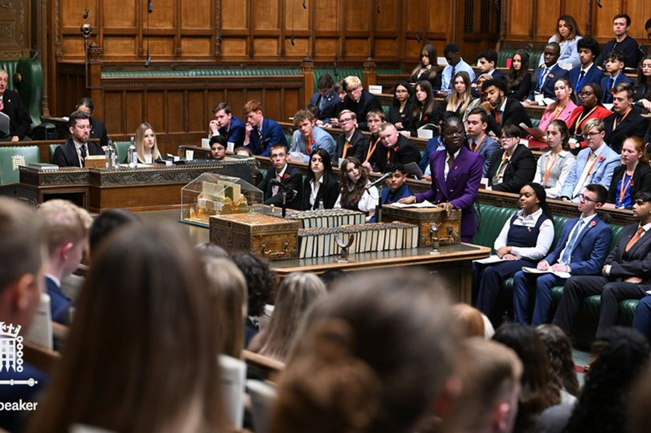
UK Youth Parliament

Slide 2
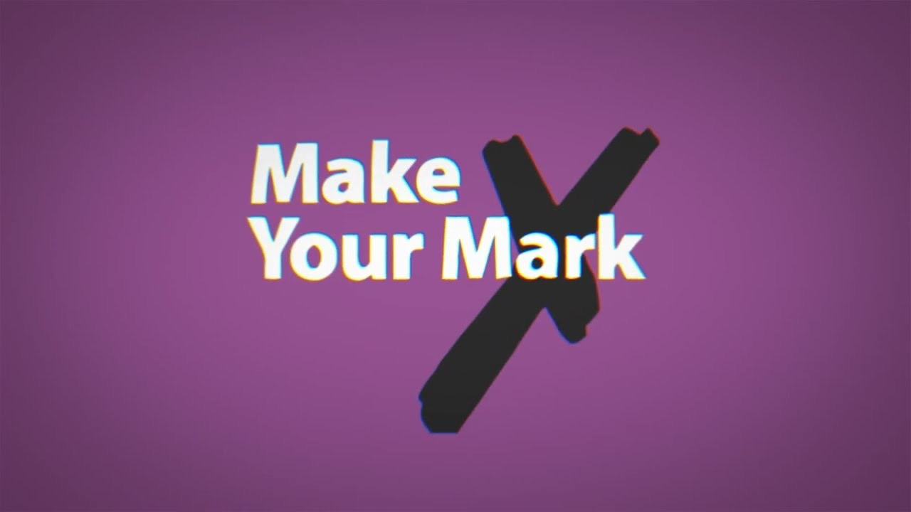
What is the UK Youth Parliament?
The UK Youth Parliament is a group of 369 elected young people from the ages of 11-18 who represent their constituencies as a whole.
Aims to move social change, and create new opportunities for young people.
Gives us access to head decision makers, and puts young people at the forefront of policy making.

Slide 3
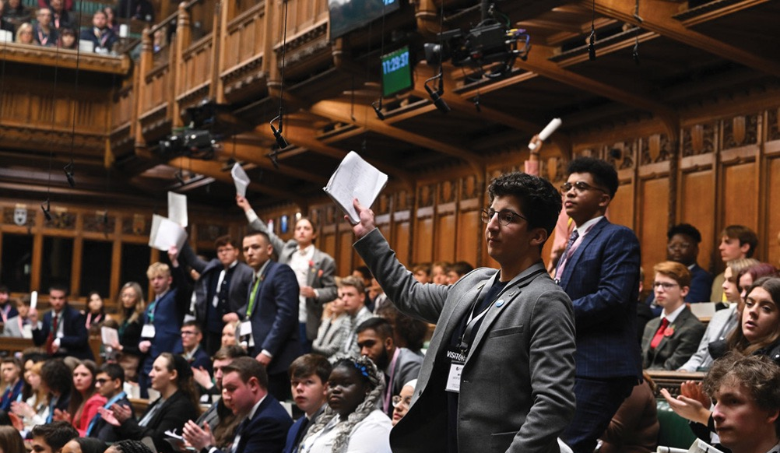
What is my role?
Member of the Youth Parliament for Stroud and The Cotswolds.
Working on forming a Youth Council in Gloucestershire.
Aiming to improve the understanding of politics amongst young people.
Connecting with the young people in my area.
Representing all of you on a national level, at events such as the House of Commons.

Slide 4
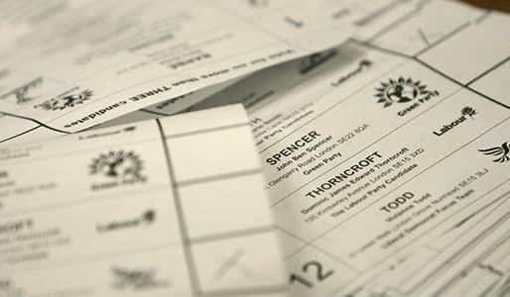
Why is it important to be involved in politics?
It is helpful to see the issues that you care about represented at a higher level.
It is helpful to understand the world around you.

Slide 5
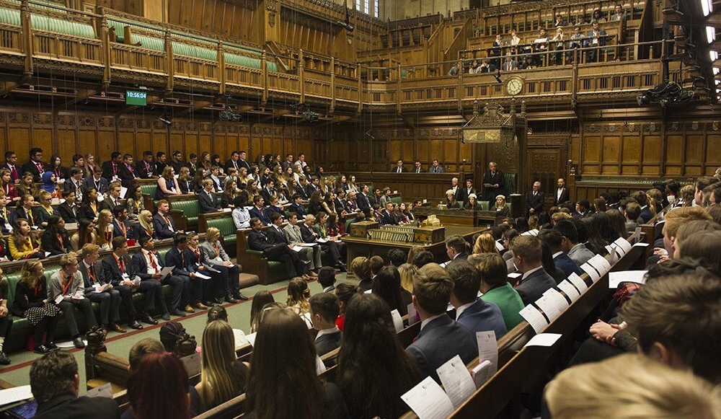
How can you get involved in politics?
Join a youth council, youth board, etc.
Vote in the Make Your Mark process.
Watch the news, keep updated on world events.
Talk to your local MYP.

Slide 6
Thank you for listening!
Any questions?
Contact me: 19LaneB@stroudhigh.gloucs.sch.uk

Slide 7
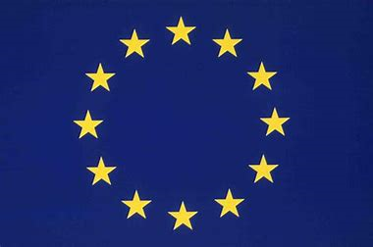
European Parliament

Slide 8
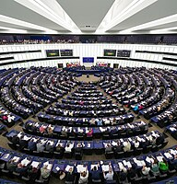
What is the European Parliament?
The European Parliament’s official seat is located in Strasbourg, France – it also meets in Brussels, Belgium.
It is the only directly elected EU body and represents citizens of the EU.
Elections for MEPs have been held every five years since 1979.
The European Parliament's powers have steadily increased with each change of the EU treaties that determine their powers.
Many laws in member states now stem from the need to implement European legislation made in the European Parliament.

Slide 9
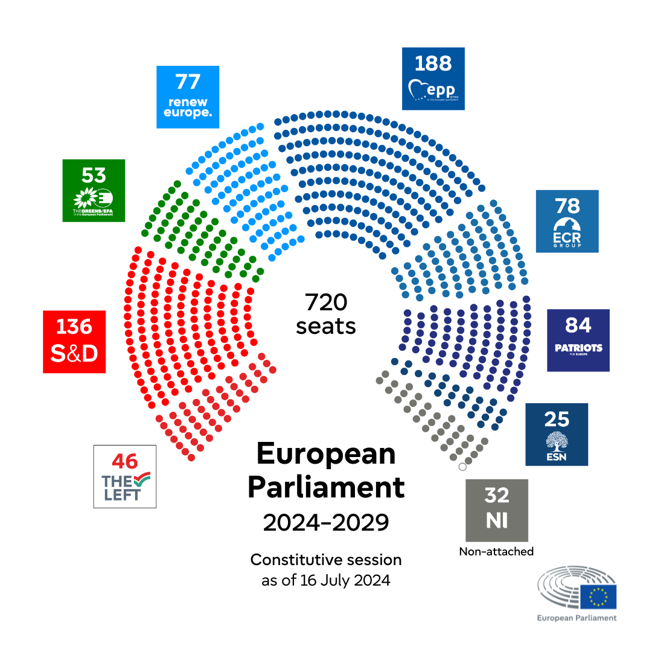
The creation of the European Parliament
On March 19th of 1958 the European Parliamentary Assembly met for the first time.
The Assembly was formed by expanding several other communities: the European Assembly of Coal and Steel Community, European Economic Community and European Atomic Energy Community.
The Assembly was renamed the European Parliament on March 30 1962.
Its main role is to ensure the democratic legitimacy of the European Law.
This shows how it is organised – with different parties/political groups.

Slide 10
Political Groups
There are eight political groups in the current parliament
    The group of the European people's parliament
    Group of the Progressive Alliance of Socialists and Democrats
    Renew Europe
    Group of the Greens/European Free Aliance
    European Conservatives and Reformists Group
    Patriots for Europe
    Europe of Sovereign Nations
    The Left Group in the European Parliament
    Some MEP's sit as non-attached MEP's- known as non-inscrits.
Over the nine terms that the EP has sat, the number of MEPs, Member states, political groups and the number of national political parties have increased and sometimes shrunk.
For example:
    Session of 1979-84: 410 MEPs. Session of 2014-19: 751 MEPs.
    Session of 2024-29: 720 MEPs
    Session of 1979-84: 9 member states. Session of 2014-19: 28 member states. Session of 2024-29: 27 member states

Slide 11

Electoral system
The EP has up to 720 seats.
MEPs are elected for these seats under national electoral systems, but these have to observe common principles established in EU law.
Almost all Member States allow the possibility to vote from abroad in EP elections.
The Amendments to the 1976 Electoral Act state that Member States may provide the possibilities of advance voting, postal voting and electronic and internet voting in elections to the EP.
The minimum age to be eligible to vote and to stand as a candidate in the European election is established by national law. In most Member States, it is 18. In Greece it is 17, in Belgium, Germany, Austria and Malta it is 16.

Slide 12
Thank you for listening!
Any questions please email 19dellowb@stroudhigh.gloucs.sch.uk

