Slide 1
DEMOCRACY QUIZ
EUROPE DAY

Slide 2
EUROPE DAY DEMOCRACY QUIZ
A) Greek
B) English
C) Arabic
D) Hindi
1. Which language does the word ‘democracy’ originally come from?

Slide 3


EUROPE DAY DEMOCRACY QUIZ
A) Greek
B) English
C) Arabic
D) Latin
1. Which language does the word ‘democracy’ originally come from?

Slide 4
EUROPE DAY DEMOCRACY QUIZ
European democracy is traced back to Ancient Greece.
“Athens is often regarded by western scholars as the birthplace of democracy and remains an important reference point for democracy, as evidenced by the etymological origins of democracy in English and many other languages being traced back to the Greek words dêmos and krátos.
Literature about the Athenian democracy spans centuries with the earliest works being The Republic of Plato and Politics of Aristotle.”

Slide 5
EUROPE DAY DEMOCRACY QUIZ
Voting
Power
Together
Stupid
2. ‘Demo’ means ‘(common) people’ what does ‘cracy’ (krátos) mean?

Slide 6
EUROPE DAY DEMOCRACY QUIZ
Voting
Power
Together
Stupid
2. ‘Demo’ means ‘(common) people’; what does ‘cracy’ (krátos) mean?

Slide 7
EUROPE DAY DEMOCRACY QUIZ
The root of the word democracy is ‘people power’.
Democracy means that no one is in power because of who their parents were, how much money they have, or how strong they are.
Power is shared between all the people.
In big democracies, we often use voting as a way to express this power and involve everyone in making decisions, but it’s not the only thing required to make a system democratic.

Slide 8
EUROPE DAY DEMOCRACY QUIZ
1883
1916
1945
1971
3. In what year were women given the same voting rights as men in Switzerland?

Slide 9
EUROPE DAY DEMOCRACY QUIZ
1883
1916
1945
1971
3. In what year were women given the same voting rights as men in Switzerland?

Slide 10
EUROPE DAY DEMOCRACY QUIZ
Who can vote has changed over time. Often it has just been restricted to older men who own property.
As people have seen the advantages that being involved in decision-making brings, more and more people have demanded their right to participate.
Those who have power have often resisted sharing it with a wider group of people. People all over the world have campaigned, protested, argued, and even died for their right to vote. Many are still denied that right.

Slide 11
EUROPE DAY DEMOCRACY QUIZ
Greece
Spain
Poland
Romania
4. In 1971, which of these countries were ruled by a dictator (one person who ruled by force and fear)?

Slide 12
EUROPE DAY DEMOCRACY QUIZ
Greece
Spain
Poland
Romania
4. In 1971, which of these countries were ruled by a dictator (one person who ruled by force and fear)?

Slide 13
EUROPE DAY DEMOCRACY QUIZ
All were. Greece and Spain got rid of their dictators in the 1970s, Poland and Romania in the 1990s.
There were dictatorships in many countries in Europe long after the Second World War.
Greece, Spain, and Portugal had right-wing dictatorships into the 1970s.
Most of eastern Europe, including Poland, Romania, Bulgaria, Czechoslovakia, Albania, Yugoslavia, and East Germany were communist dictatorships until the 1990s.

Slide 14
EUROPE DAY DEMOCRACY QUIZ
Greece
Spain
Poland
Romania
5. Which of these countries are now members of the European Union (EU)?

Slide 15
EUROPE DAY DEMOCRACY QUIZ
Greece
Spain
Poland
Romania
5. Which of these countries are now members of the European Union (EU)?

Slide 16
EUROPE DAY DEMOCRACY QUIZ
All are. Greece joined in 1981, Spain in 1986,
Poland in 2004 and Romania in 2007.
Many European countries have joined the European Union (EU) as part of their journey to democracy.
To join the EU, countries must show they have a commitment to democracy, the rule of law, human rights, and protection of minorities.
The next slide shows which countries joined in each year.

Slide 17
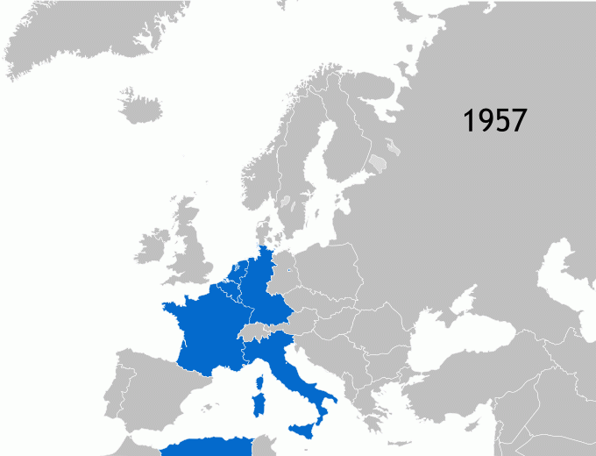
EUROPE DAY DEMOCRACY QUIZ
1957: Belgium, France, (West) Germany, Italy, Luxembourg, the Netherlands
1973: Denmark, Ireland, the United Kingdom
1981: Greece
1986: Spain, Portugal
1995: Austria, Finland, Sweden
2004: Cyprus, Czech Republic, Estonia, Hungary, Latvia, Lithuania, Malta, Poland, Slovakia, Slovenia
2007: Bulgaria, Romania
2013: Croatia
2020: United Kingdom leaves

Slide 18
EUROPE DAY DEMOCRACY QUIZ
European Union
India
United Kingdom
United States of America
6. Which of these had elections last year?

Slide 19
EUROPE DAY DEMOCRACY QUIZ
European Union
India
United Kingdom
United States of America
6. Which of these had elections last year?

Slide 20
EUROPE DAY DEMOCRACY QUIZ
All of them! 2024 was THE year of elections. Almost half the world’s population could vote.
India is the world’s biggest democracy; almost 1 BILLION people were registered to vote.
The European Union held the world’s second biggest election from the 6th to the 9th of June.
The USA voted in Donald Trump for a second term.
The UK had a general election which also saw a change of Government, from Conservative to Labour.

Slide 21
EUROPE DAY DEMOCRACY QUIZ
Irish citizens
Swiss citizens
UK citizens
German citizens
7. Who can vote in European Union elections?

Slide 22
EUROPE DAY DEMOCRACY QUIZ
Irish citizens
Swiss citizens
UK citizens
German citizens
7. Who can vote in European Union elections?

Slide 23
EUROPE DAY DEMOCRACY QUIZ
To vote in EU elections, you need to be a citizen of an EU member state.
Irish and German citizens can vote in the European Parliament elections, along with the citizens of the other 25 EU member states.
The United Kingdom chose to leave the EU in 2016, so since 2020 UK citizens cannot vote in EU elections, and we do not send anyone to sit in the European Parliament.
Switzerland has never been part of the EU, so Switzerland does not elect any Members of the European Parliament either.

Slide 24
EUROPE DAY DEMOCRACY QUIZ
England
Northern Ireland
Scotland
Wales
8. Where in the UK can you vote at 16?

Slide 25
EUROPE DAY DEMOCRACY QUIZ
England
Northern Ireland
Scotland
Wales
8. Where in the UK can you vote at 16?

Slide 26
EUROPE DAY DEMOCRACY QUIZ
16- and 17-year-olds can vote for Members of the Scottish Parliament and Welsh Senedd
In England and Northern Ireland you need to be at least 18 to vote.
To vote in a general election (for Members of the UK Parliament) you must be 18 or over, wherever you are from.
You can register to vote at 16 throughout the UK.
In Scotland and Wales you may register from your 14th birthday.

Slide 27
EUROPE DAY DEMOCRACY QUIZ
1st January
9th March
9th May
6-9th June
9. On what day does the EU celebrate its ‘birthday’?

Slide 28
EUROPE DAY DEMOCRACY QUIZ
1st January
9th March
9th May
6-9th June
9. On what day does the EU celebrate its ‘birthday’?

Slide 29
EUROPE DAY DEMOCRACY QUIZ
9th May is Europe Day,
which is celebrated across Europe.
Europe Day, held on 9 May every year, celebrates peace and unity in Europe.
The date marks the anniversary of the historic 'Schuman declaration' that set out his idea for a new form of political cooperation in Europe, which would make war between Europe's nations unthinkable.
Schuman's proposal is considered to be the beginning of what is now the European Union.

Slide 30
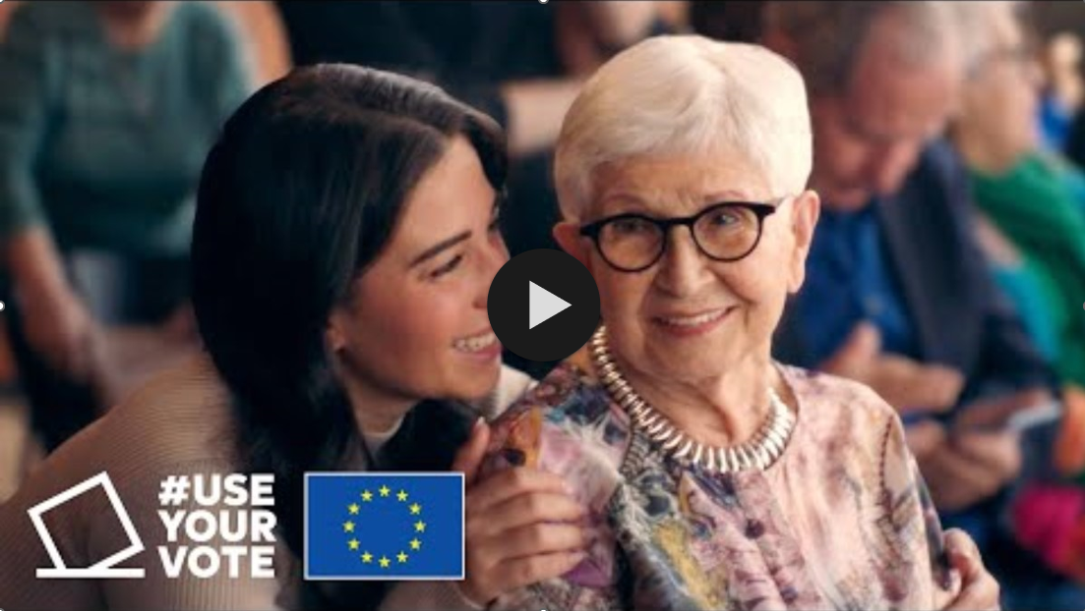
EUROPE DAY DEMOCRACY QUIZ
Wherever you are.
Register to vote.
Use your vote.
Or others will decide for you.
https://www.youtube.com/watch?v=LoiAADEcIxg

Slide 31


