Slide 1
EUROPE DAY 2025
9TH MAY

Slide 2
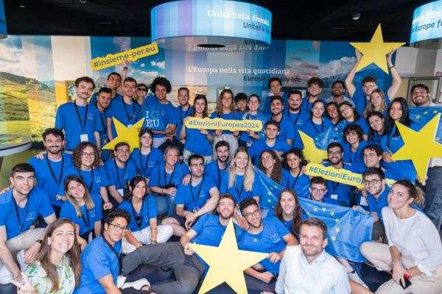
EUROPE DAY
9th May is
Europe Day,
which is celebrated across Europe.
But why?
Notes:
It’s considered the ‘birthday’ of the European Union.

Slide 3
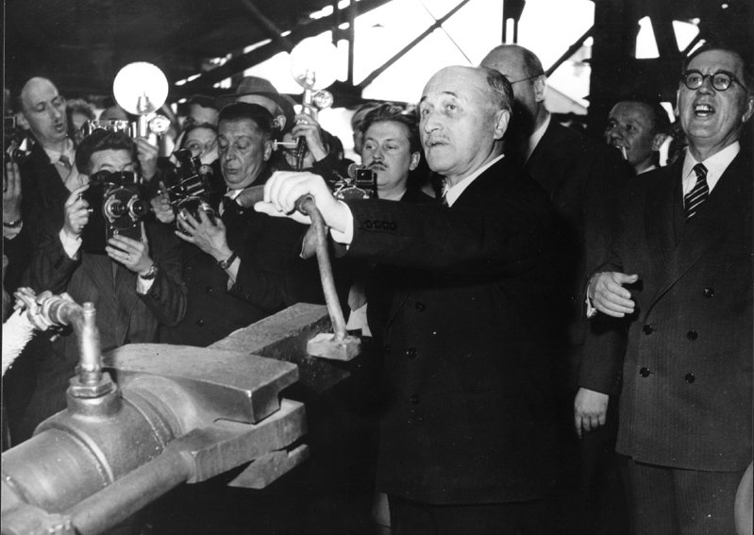
EUROPE DAY
A new beginning for Europe.
Working together for peace and prosperity.
Notes:
After the Second World War there was a fear that another war could develop, just as the Second World War had followed the First World War, despite all the promises that it would be the ‘War to End All Wars’.
The Schuman plan proposed joint control of coal and steel production, the most important materials for the armaments industry. The basic idea was that those without control over coal and steel production would not be able to fight a war. It was also hoped that collaborating on these key resources would enable Europe to rebuild both physically and economically.
This image shows Jean Monnet (who co-created the Schuman plan) making Europe’s first steel ingot.

Slide 4
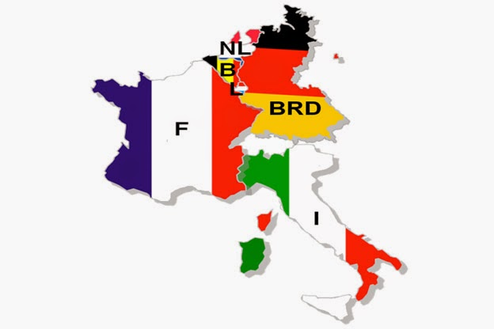
EUROPE DAY
From dictatorship to democracy.
This Photo by Unknown Author is licensed under CC BY-SA
Notes:
The end of the Second World War is often spoken of as the ‘defeat of Fascism’ and in much of Europe those dictatorships had fallen. The six countries that started what would go on to become the European Union were keen to cement their democracies and show that they could work with their democratic neighbours.
However, it was not the case that all of Europe enjoyed democratic freedoms such as freedom of speech, freedom of association, freedom of religion, and a free press.

Slide 5
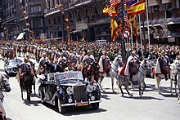
EUROPE DAY
Right-wing dictatorships in Southern Europe: Spain, Portugal and Greece.
This Photo by Unknown Author is licensed under CC BY-SA
Notes:
Until the 1970s, within your grandparents’ or parents’ lifetimes, Spain, Portugal, and Greece were all dictatorships under right-wing dictators.
So in those countries, they could not choose their own government. They could not vote out politicians they did not like. In fact, you could be put in prison for criticising the government.

Slide 6
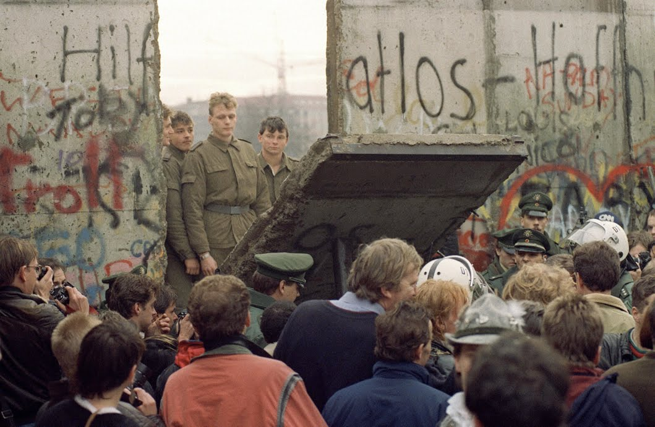
EUROPE DAY
Dictatorships in Eastern Europe: the Communist Bloc.
This Photo by Unknown Author is licensed under CC BY-NC-ND
Notes:
And until the 1990s, definitely within your parents’ lifetimes, Eastern Europe was under communist dictatorships.
Both communist and right-wing dictatorships claimed that they were ruling for the benefit of the people, but the people were not allowed to say whether they thought they were doing a bad (or good) job. The consequences for anyone speaking up, or asking for more rights could be dire.
This image shows soldiers from communist East Germany meeting democratic West Germans as the Berlin Wall, that split the city, came down in 1989.
So whilst the first talk about democracies in Europe is from over 2,500 years ago, for most of Europe it’s actually something pretty new.
You have probably lived your whole life in a democracy, you may take it for granted that the UK, and the rest of Europe will always be democracies, but there’s no reason to be so sure. Unless we work to preserve our democracy, it’s an easy thing to lose.
In this video you’ll hear from some people who have experienced what it’s like to not have democracy, and what they feel you should do about that.

Slide 7
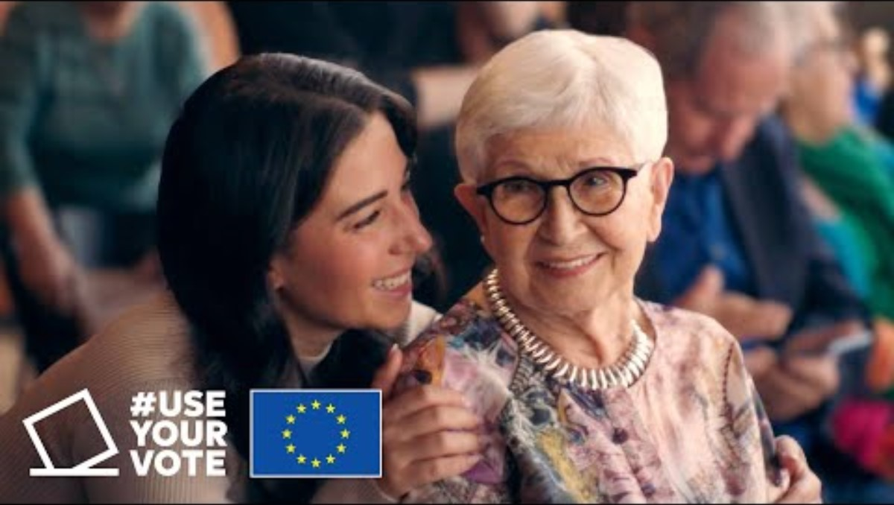
https://www.youtube.com/watch?v=LoiAADEcIxg
Notes:
https://www.youtube.com/watch?v=LoiAADEcIxg

Slide 8
EUROPE DAY
Celebrate your freedom.
Celebrate Europe’s freedom.
Register to vote.
elections.europa.eu
www.gov.uk/
register-to-vote
Notes:
Voting is a key way to get heard by those in positions of power. It’s your way to show them that really the power is with you, the people.
The more young people are registered to vote (and vote) the more politicians will make policy that works for young people.
If you’re a UK citizen, you can register to vote as soon as you turn 16. In Scotland and Wales you can register at 14.

Slide 9
