Slide 1

Secondary Assembly
8th May 2024

Slide 2

Our Schools

Slide 3
Meet and greet
Sharing Pupil’s work

Slide 4
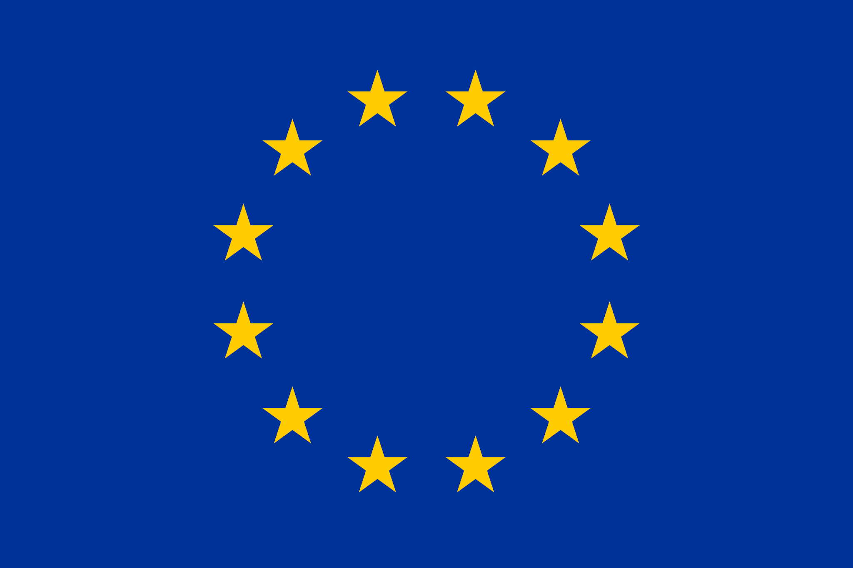
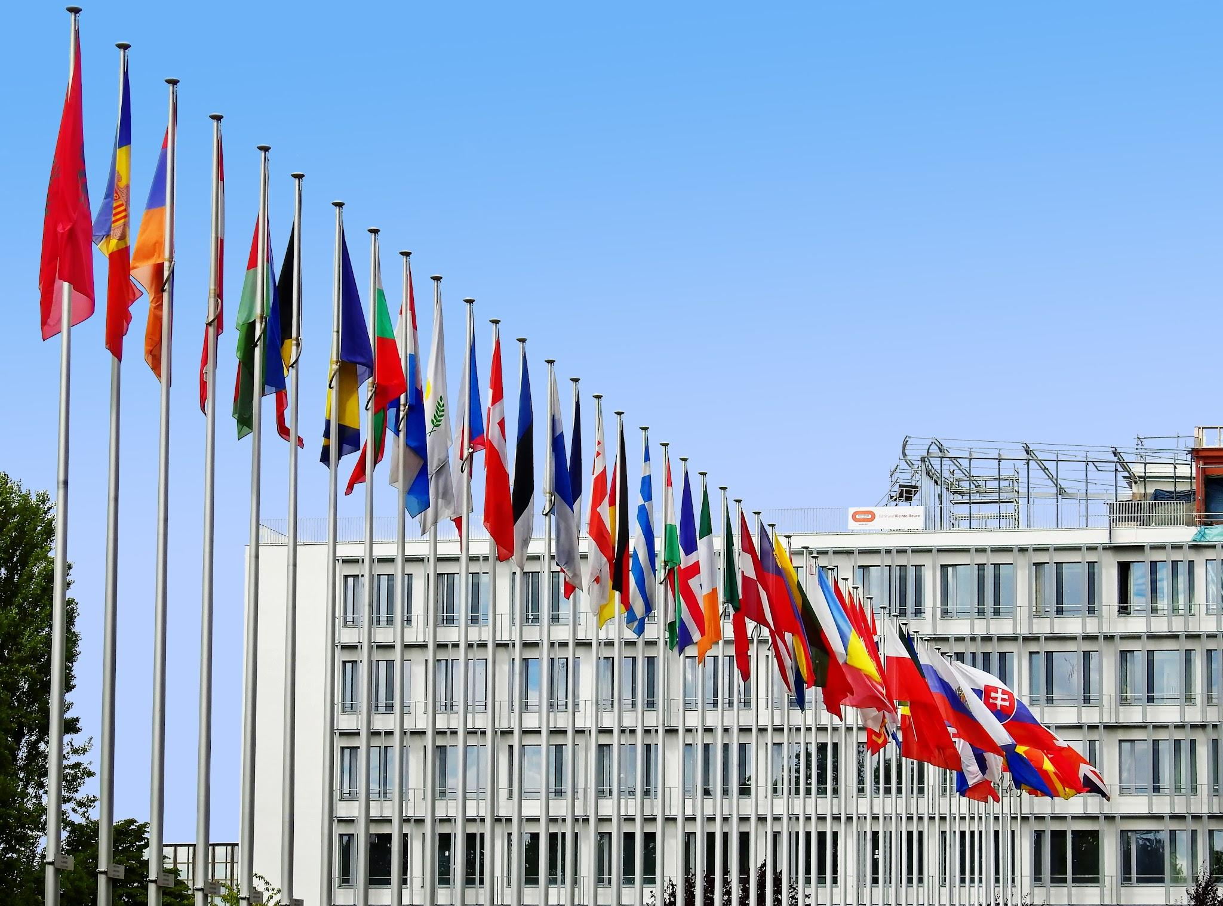
European Union (EU) countries Cultural Events

Slide 5
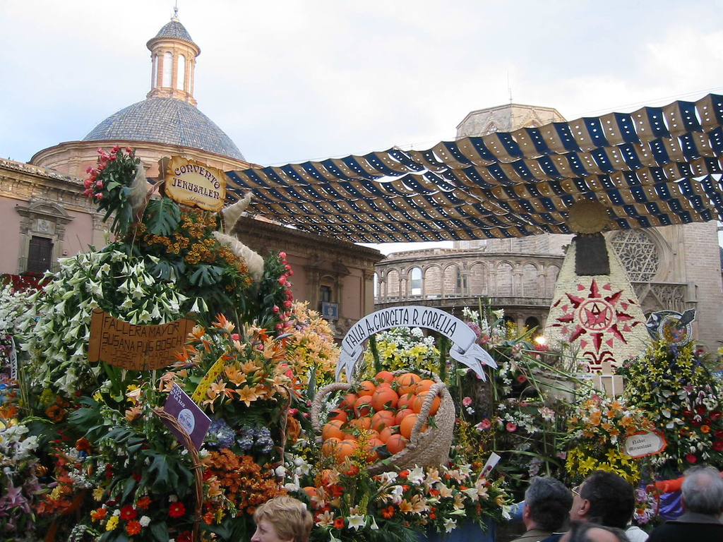
European Union (EU) countries culture
Las Fallas - España

Slide 6
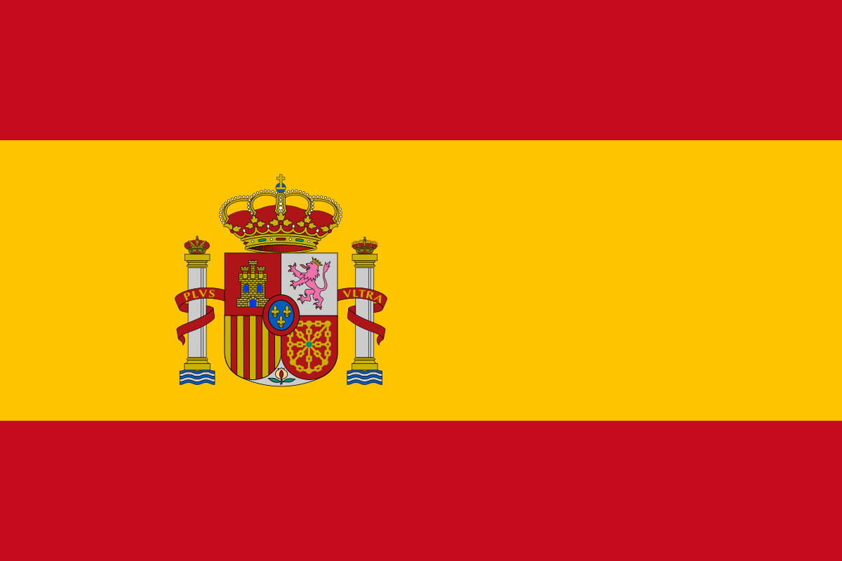
European Union (EU) countries culture
LAS FALLAS - Spain
Las Fallas is a festival celebrated in March in the city of Valencia. The origin of the festival goes back to the tradition of imposing bonfires with old furniture to celebrate the arrival of spring and it also coincides with the celebration of St Joseph’s day the patron Saint of Carpenters

Slide 7
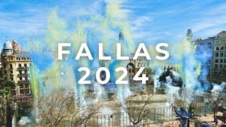
European Union (EU) countries culture
Notes:
The festival is a 5 day celebration including food, drink, street performances, fireworks and music and is attended by an estimated 200.000 people.

Slide 8
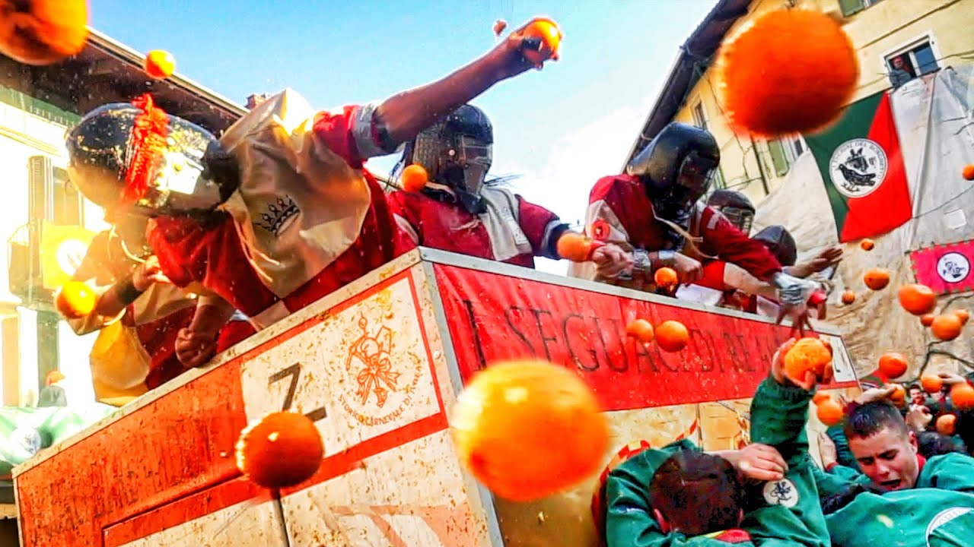
European Union (EU) countries culture
Carnevale di Ivrea-Italia

Slide 9
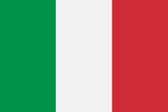
European Union (EU) countries culture
Carnevale di Ivrea-Italia
The Carnival of Ivrea, a city in Northern Italy takes place in February and is centred around ‘The Battle of the Oranges’. This is where 1000 people from the city are divided into 9 teams and throw oranges at each other. It is the biggest food fight in Italy.

Slide 10
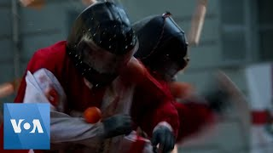
European Union (EU) countries culture
Notes:
At the 1994 battle an estimates quarter of a million kilograms of oranges where used in the fight!”

Slide 11
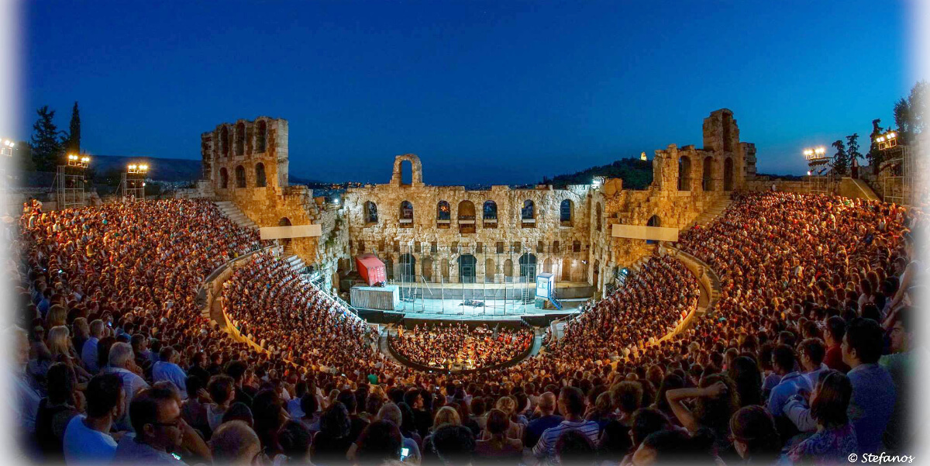
European Union (EU) countries culture
Epidaurus Festival -Greece

Slide 12

European Union (EU) countries culture
Epidaurus Festival - Greece
The festival in Epidaurus takes place in the ancient theatre in the city which dates back to 4th Century BC. This is a festival of the theatre and ancient plays are performed, both tragedies and comedies from Greek playwrights dating back over 2500 years.

Slide 13

European Union (EU) countries culture
Notes:
At the 1994 battle an estimates quarter of a million kilograms of oranges where used in the fight!”

Slide 14
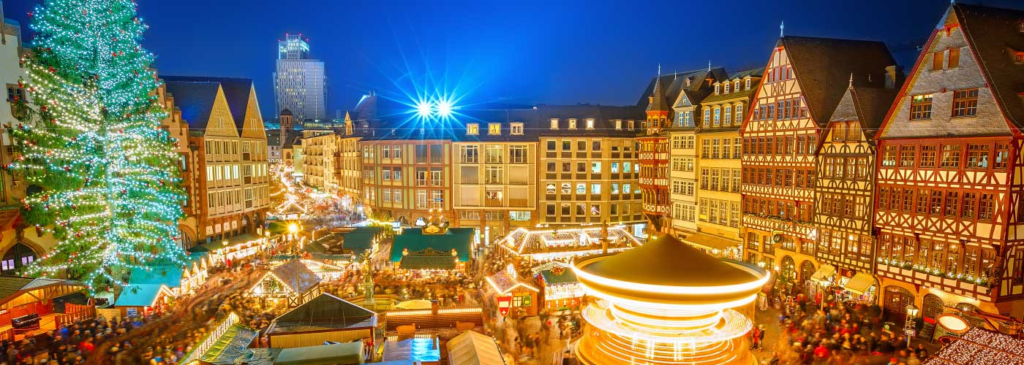
European Union (EU) countries culture
Weihnachtsmarkt in Berlin-Deutschland

Slide 15
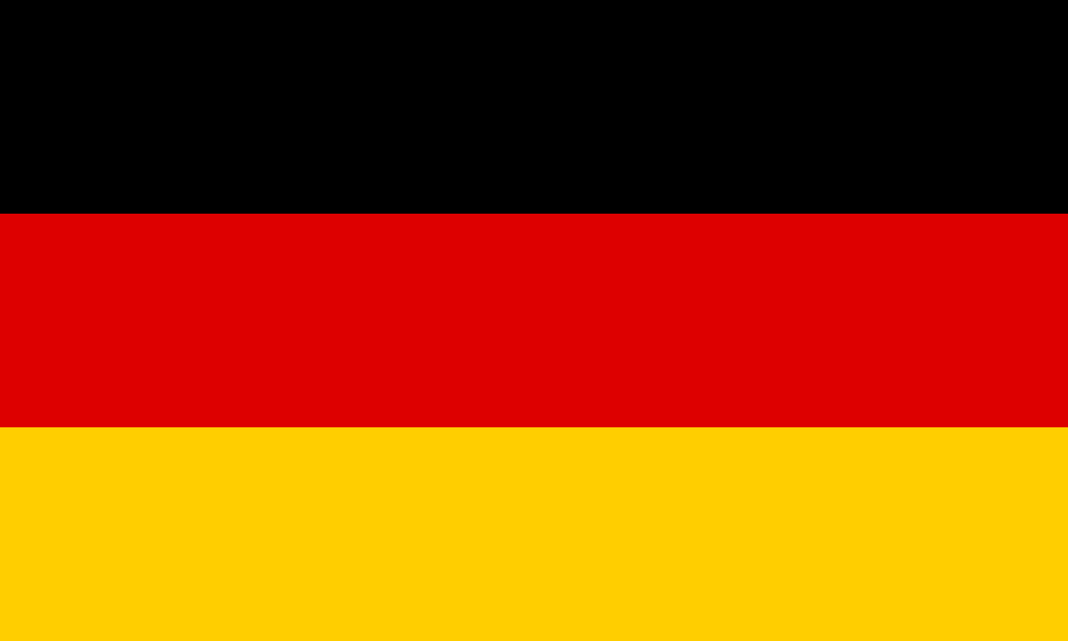
European Union (EU) countries culture
Weihnachtsmarkt in Berlin-Deutschland
The Weihnachtsmarkt or Christmas markets are found all over Germany. In Berlin there are more than 20 set up in historical buildings and city squares. About a month before Christmas, crowds of locals and tourists brave the cold to enjoy a variety of activities and seasonal specialities at these vibrant markets. You can find plenty of quaint wooden stalls selling winter clothing, trees, decorations, handicrafts, toys, and nativity figures and food and drinks.

Slide 16
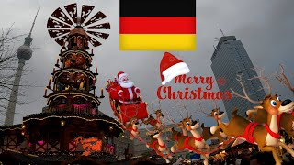
European Union (EU) countries culture
Notes:
At the 1994 battle an estimates quarter of a million kilograms of oranges where used in the fight!”

Slide 17
European Union (EU) countries culture
Quiz

Slide 18
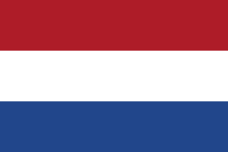

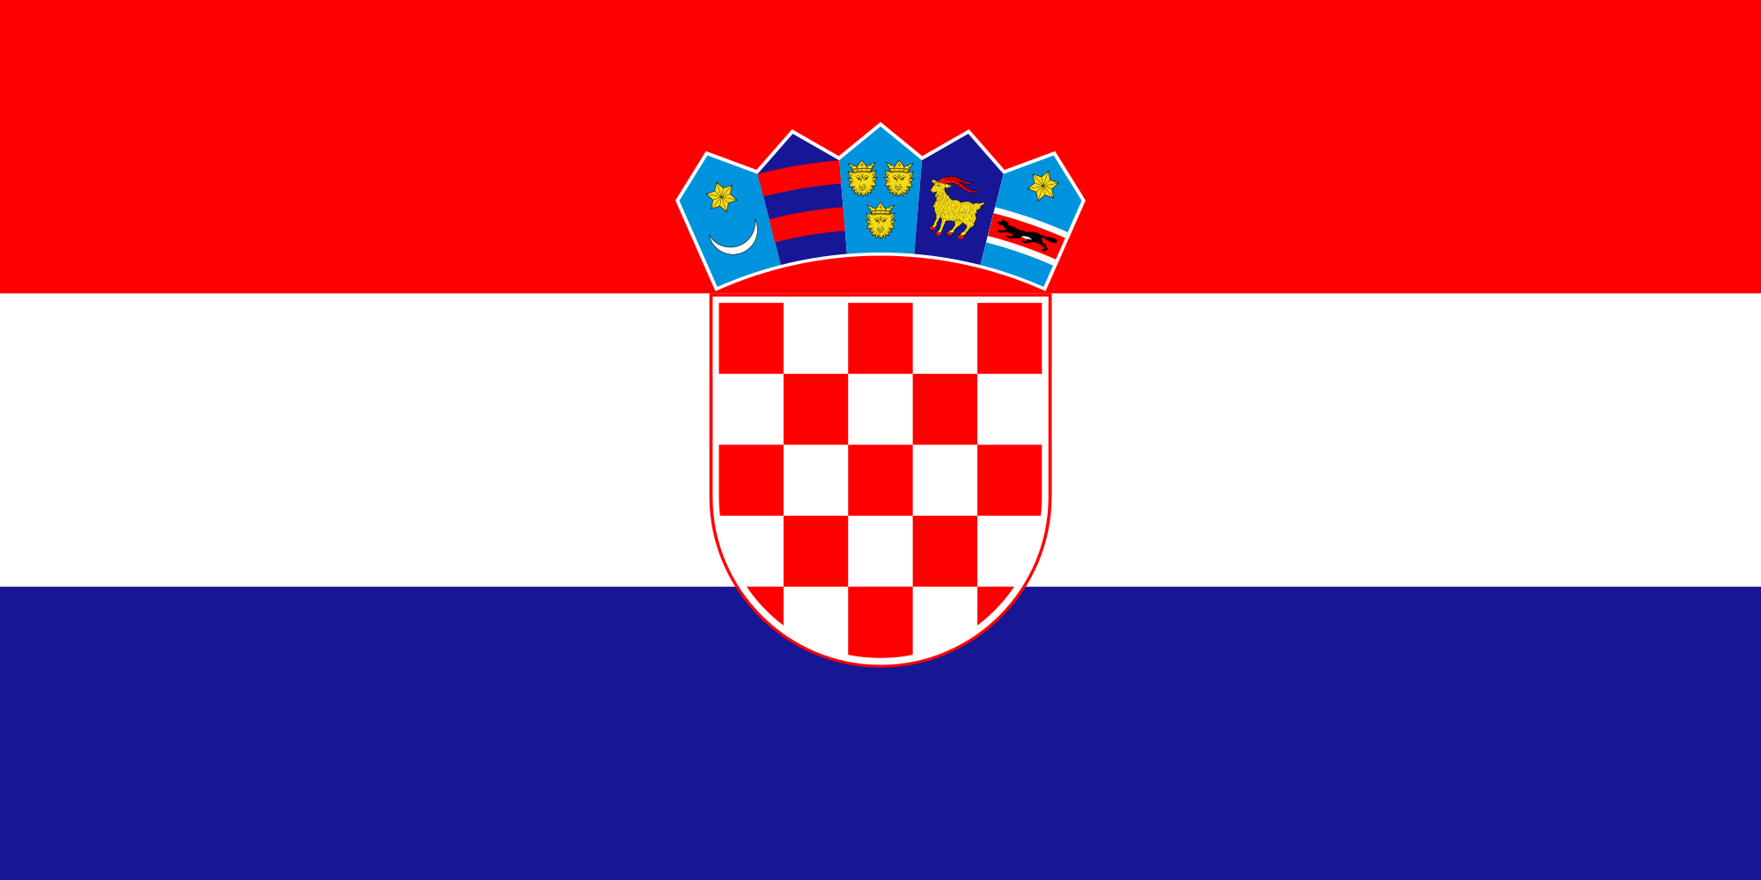
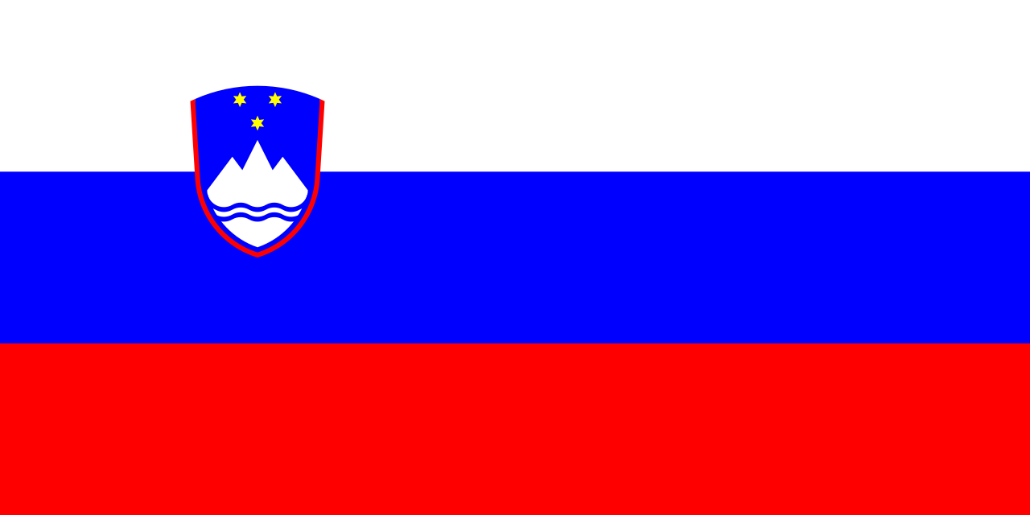
European Union (EU) countries culture
These are flags from other EU countries. Match the flag with the EU country
1
2
Slovenia
Netherlands
Luxembourg
Croatia
3
4

Slide 19
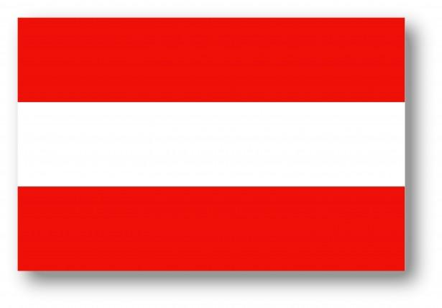
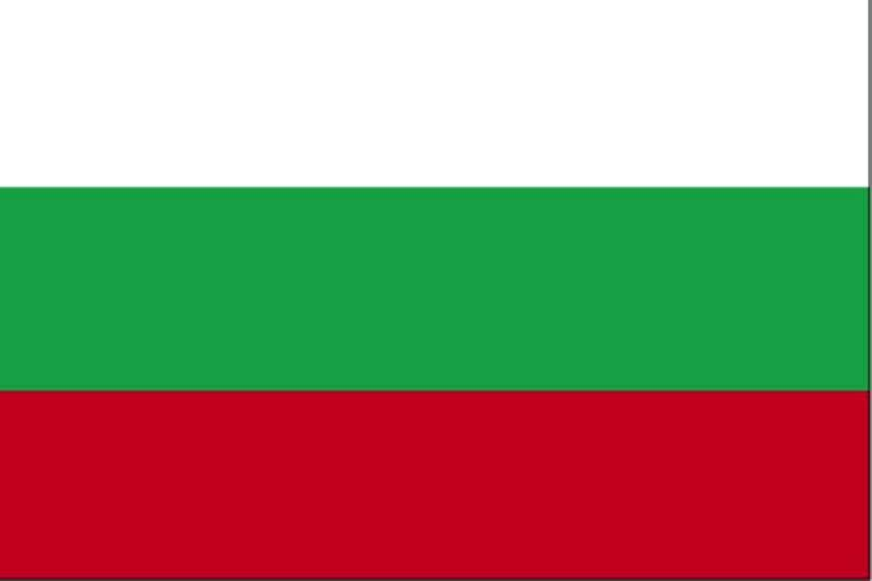

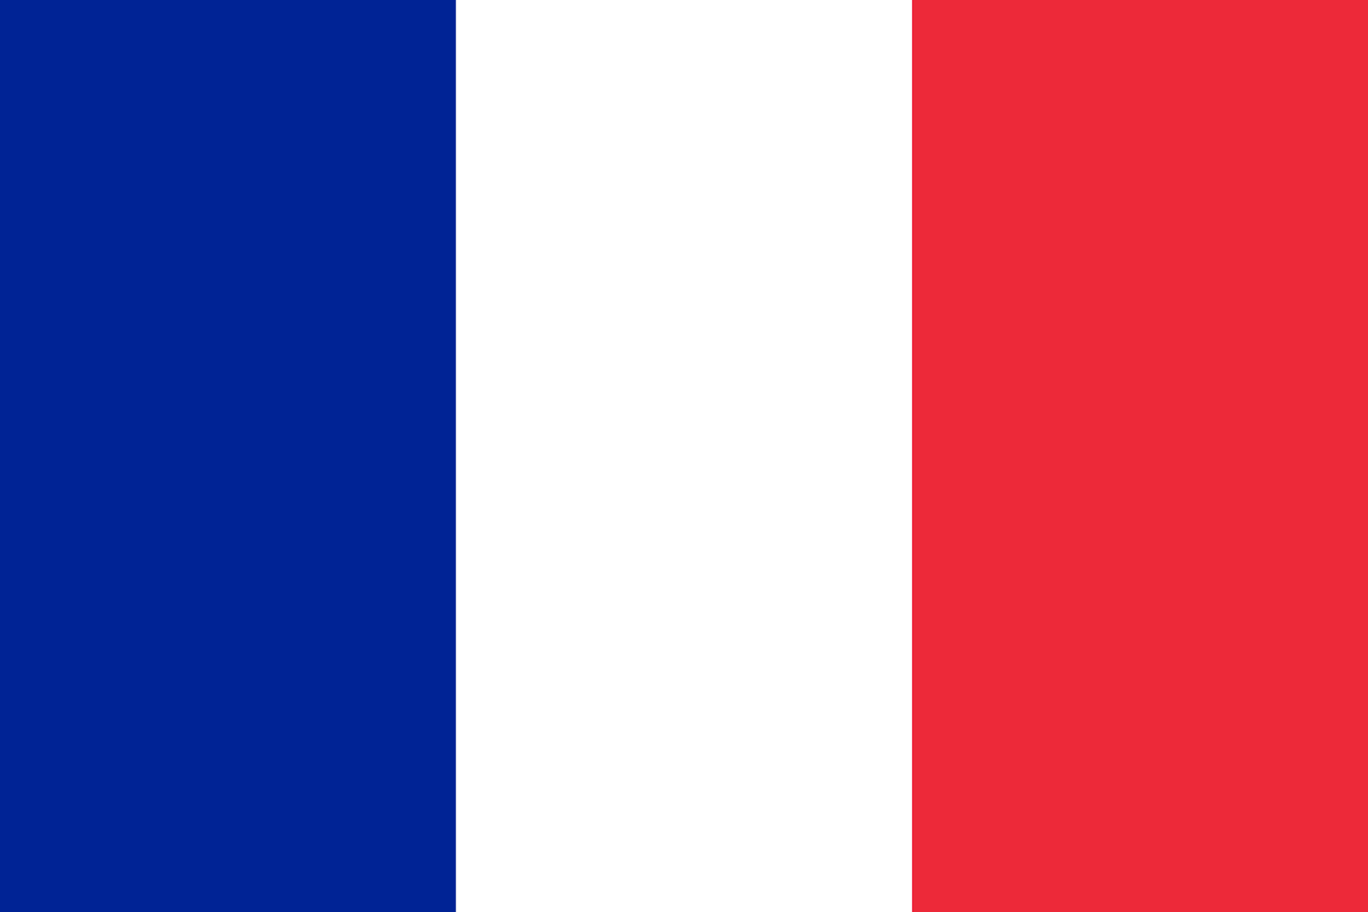
European Union (EU) countries culture
2. Which flag represents the country where you can find Notre Dame?
1
2
3
4

Slide 20
European Union (EU) countries culture
3. Which country is famous for Vampires?
Bulgaria
Latvia
Romania
Cyprus

Slide 21
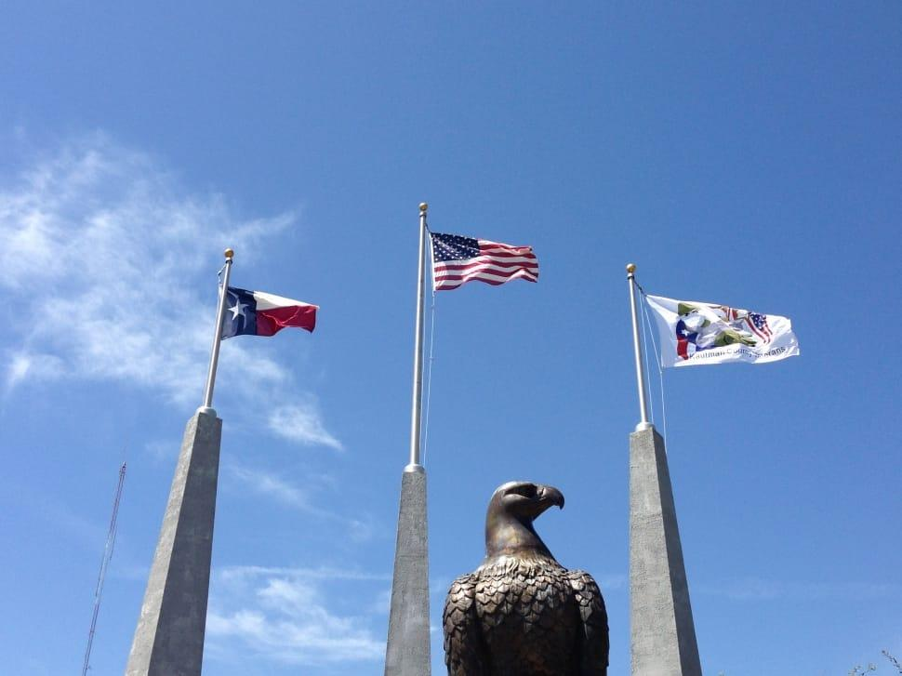
European Union (EU) countries culture
4. How many EU countries have flags with only 3 colours?
8
12
16
20

Slide 22
European Union (EU) countries culture
5. Match the EU country to the food it is famous for.
Waffles
Dumplings
Pickles
Moussaka
A Germany
B Spain
C France D Cyprus
E Latvia F France
G Belgium H Spain
I Poland J Bulgaria

Slide 23
European Union (EU) countries culture
Answers
(one point for every correct answer)

Slide 24
European Union (EU) countries culture
These are flags from other EU countries. Match the flag with the EU country
1
2
B) Netherlands
C) Luxembourg
3
4
D) Croatia
Slovenia

Slide 25
European Union (EU) countries culture
2. Which flag represents the country where you can find Notre Dame?
1
2
3
4
4) Notre Dame is in Paris, France

Slide 26
European Union (EU) countries culture
3. Which country is famous for Vampires?
Bulgaria
Latvia
C) Romania
D) Cyprus

Slide 27
European Union (EU) countries culture
4. How many EU countries have flags with only 3 colours?
8
12
C) 16
20

Slide 28
European Union (EU) countries culture
5. Match the EU country to the food it is famous for.
Waffles G Belgium
Dumplings I Poland
Pickles E Latvia
Moussaka J Bulgaria

Slide 29
European Union (EU) countries culture
What is your score out of 10?

