Slide 1












Junior Ambassador
Programme

Slide 2
What do we do?
The European Parliament Ambassador School Programme aims at increasing students’ awareness of European parliamentary democracy, the role of the European Parliament and European values. We encourage others to actively participate in EU democratic processes through our presentations in LIFE sessions.
Our aim is to engage and educate students on important issues and topics within society or that has happened in the past.

Slide 3
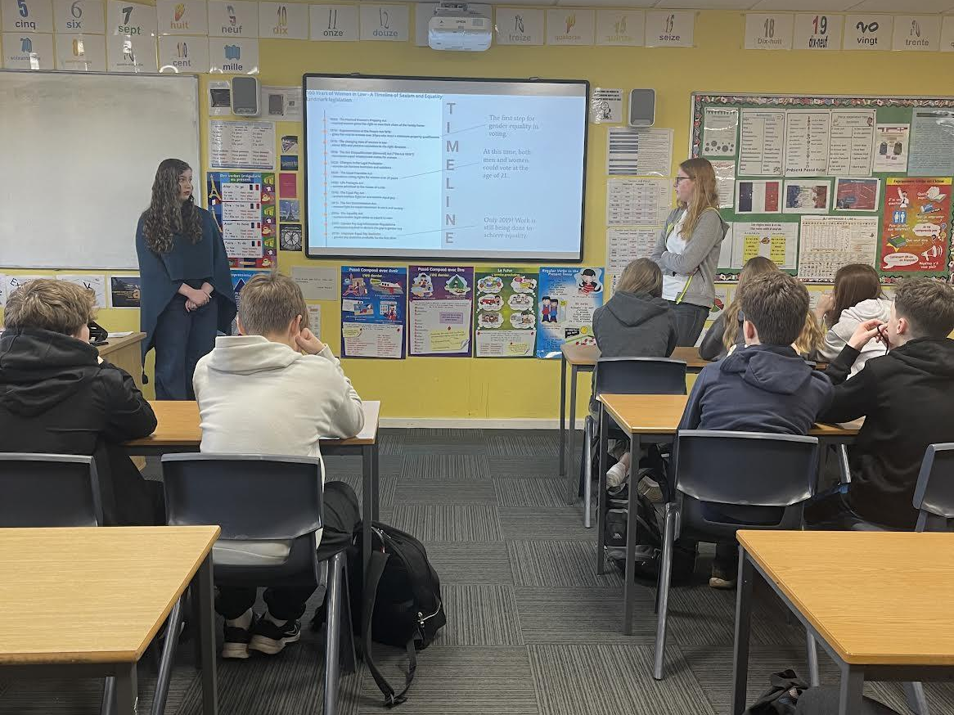
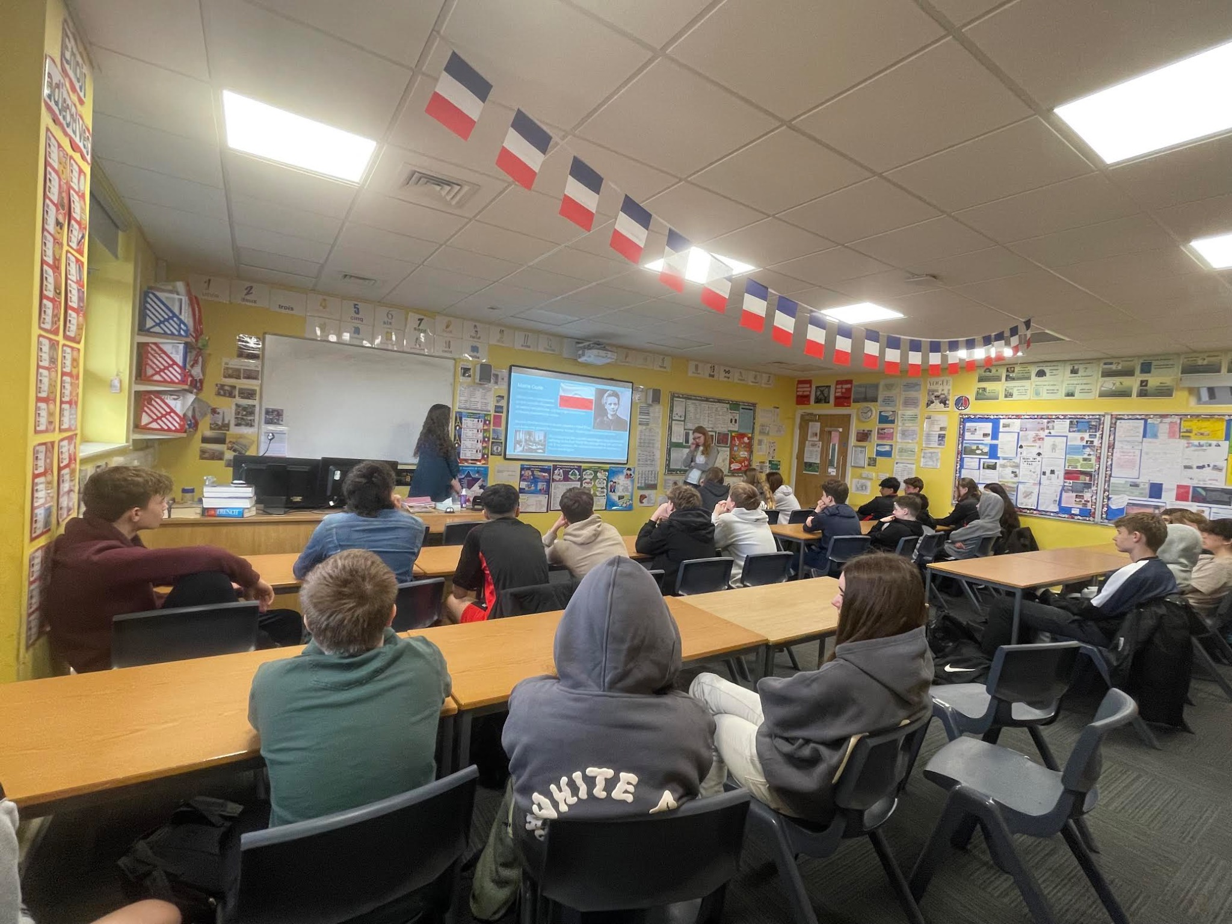
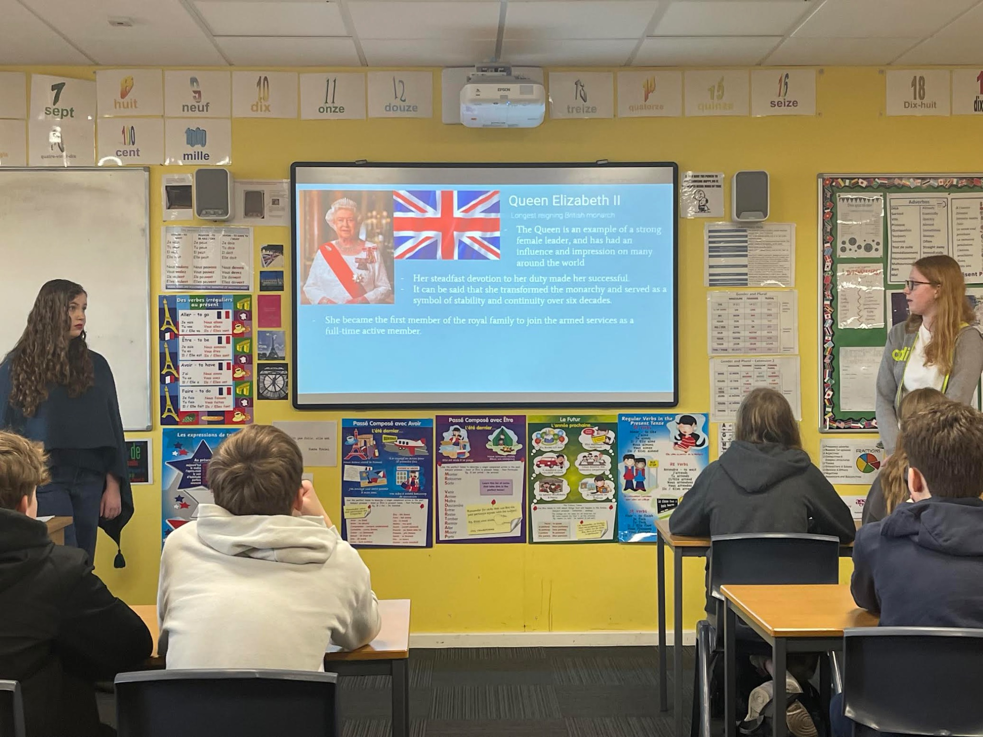
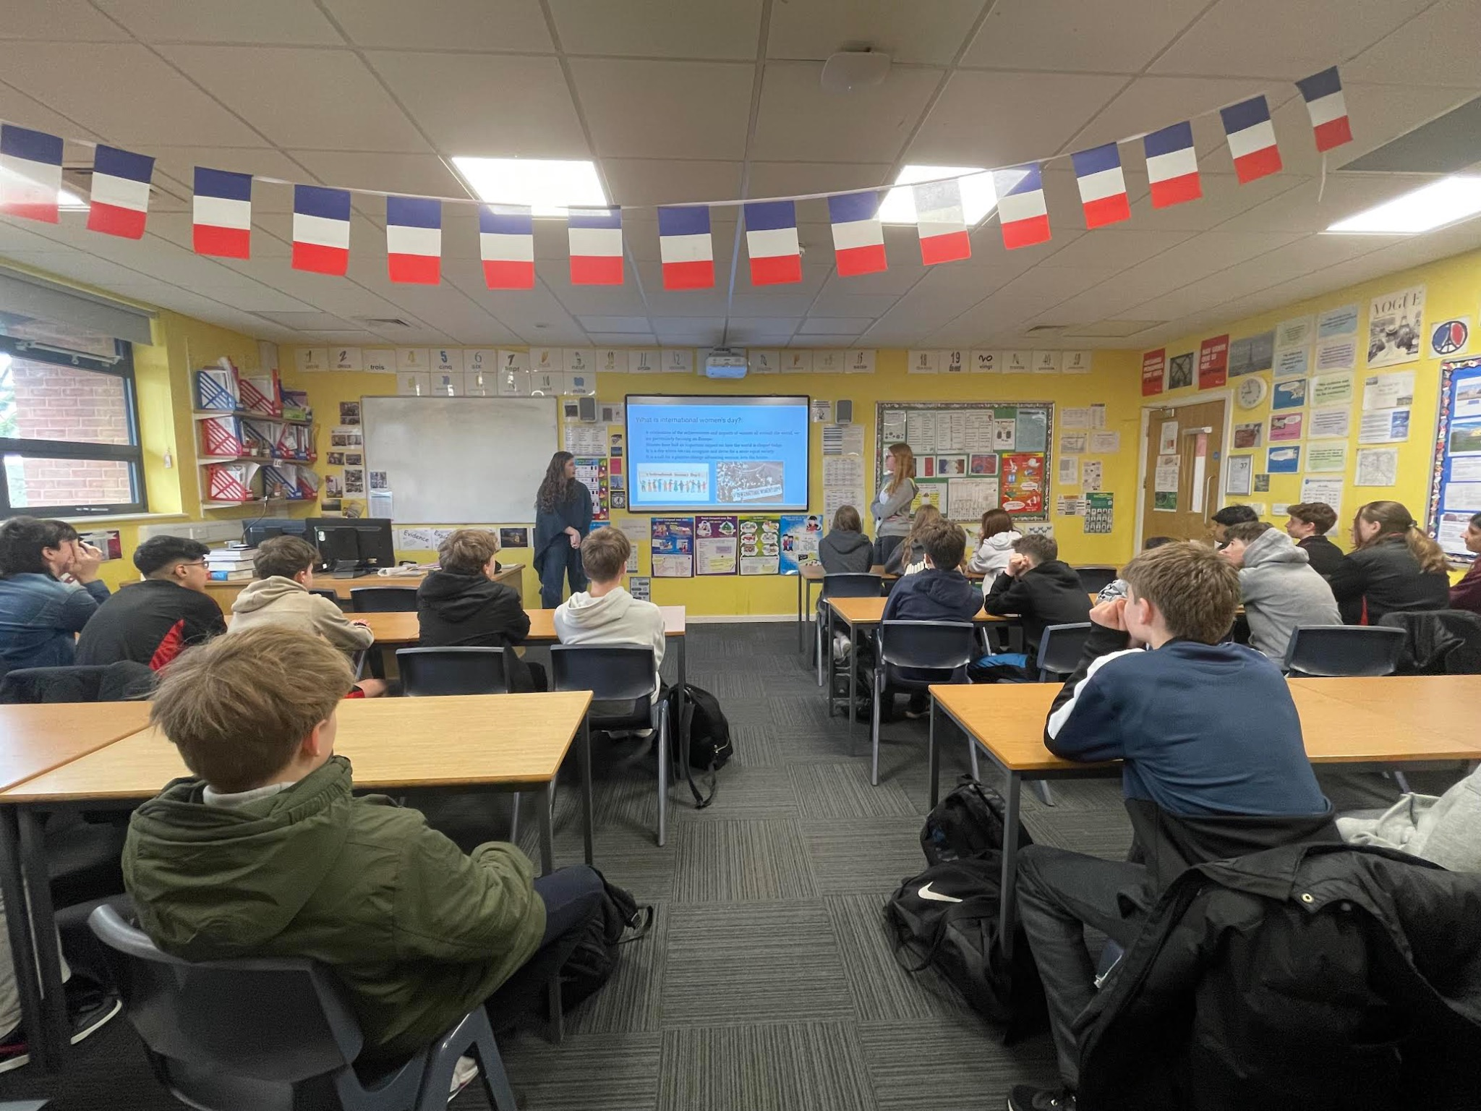
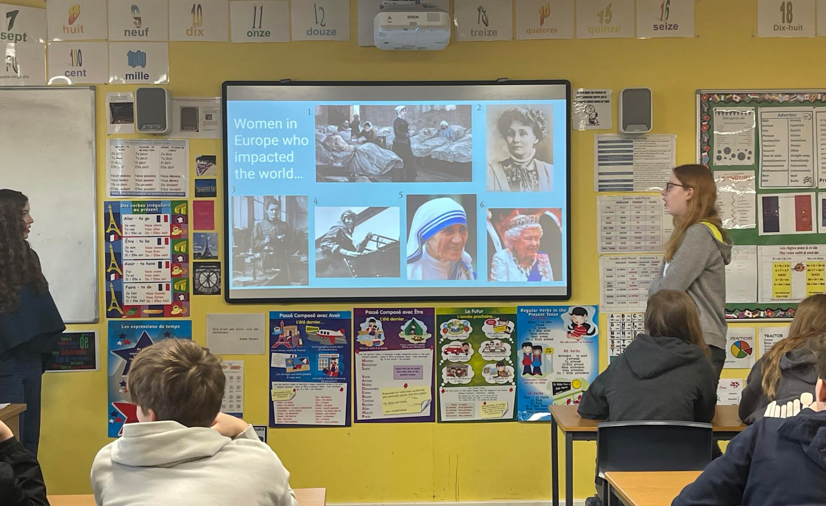
International Women’s Day
International Women’s Day was all about understanding key, influential Women throughout different generations and how they have impacted society today.

