Slide 1
EPAS Debate
European Parliament Ambassador

Slide 2
What is the European Parliament Ambassador Scheme?
We are working to promote the work of the European Parliament in the UK.
We have been running events to help you understand other European countries and how the European Parliament can impact them
You might have seen our information point in the top corridor?
You might have followed us on Instagram @stroudhighepas?
You might have participated in our stall at the Christmas fair?
You will soon have the opportunity to participate in an EUI quiz!

Slide 3
How are the debates going to work?
We are going to be debating some topics revolving the EU
First, we will give you some background info!
Then we will suggest some arguments for and against
You will get to choose whether you agree or disagree
We debate!
And then finally we'll hold a vote by a show of hands to find out where the majority lies

Slide 4
Should the climate change be the EU's top priority?
Yes, or No?

Slide 5

The current top priorities for the EU parliament
Promote peace
Offer freedom without internal borders
Establish internal market

Slide 6
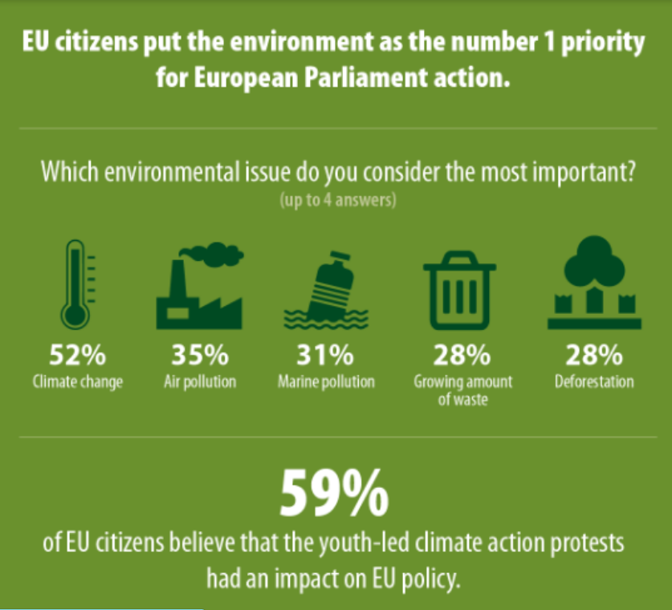
Climate change should be Parliament’s priority, according to citizens
https://www.europarl.europa.eu/news/en/press-room/20191129IPR67710/climate-change-should-be-parliament-s-first-priority-according-to-citizens

Slide 7
The Climate Crisis should be the EU's top priority
Agree:
Disagree:
The environment is a key factor in maintaining the future of the coming generations.
Although we're not directly affected, many people have been and still are (wildfires, flooding etc.) and in the future we may be too.
The climate crisis threatens world peace. There is high risk of conflicts emanating from rising sea levels, droughts, floods and other climate-related events. We should fix the climate crisis in order to work towards world peace.
The maintenance of the planet should be out top focus, figuring out what to do with said planet can come later.
The EU parliament have more important things to focus on.
The environment crisis doesn’t greatly affect our generation, so why should we care.
It's very expensive. Estimates of how much money it would take to end global climate change range between $300 billion and $50 trillion over the next two decades. We should be spending our funds on more important things, such as wars and defence.
.

Slide 8
Vote!

Slide 9
Should the EU focus on Ukraine over other countries at war?
Yes or No?

Slide 10
What is happening in Ukraine...
24 Feb 2022 – Putin orders tens of thousands of Russian troops to march into Ukraine, North, South and East.
9000 Ukrainian civilians including 500 children are estimated to have been killed by the war.
The international community has poured aid into Ukraine, with the USA, EU and UK sending over 100 billion euros collectively as well as countless arms donations.
There is still no end in sight.
Should Donald Trump become the next US President, there are strong signs that he will dramatically decrease aid to Ukraine.

Slide 11
The EU should focus on Ukraine over other countries at war.
Agree
Disagree
Ukraine is trying to become a member of the EU
EU already in a free trade agreement with Ukraine
Thus they have greater obligation to them
It borders so many EU countries so if a major war does happen it will most probably spill over
The EU is the biggest economic block in the world (bar China) so has economic obligations
Many countries in the world are former European colonies so we have obligations
All EU countries are members of the UN which is to maintain international peace and security

Slide 12
Vote!

Slide 13
Should the UK have left the EU?
Yes or No?

Slide 14
A little context
23 June 2016
The Referendum: UK citizens voted to leave the European Union (a close tie of 52 to 48%)
Jan.–Mar. 2019
Parliament rejected (x3) Theresa May's withdrawal agreement
Dec. 2019
Boris Johnson wins the majority to 'Get Brexit Done'
Jan. 2020
he passes the withdrawal agreement through parliaments
Dec. 2020
After a years' transition period, we leave the EU at 11pm in December 2020.

Slide 15
What has happened since then?
In short, leaving the EU has created many complications for the UK
Travelling is much more difficult – more border checks - but this has also helped the UK to make immigration rules more stringent
Co-operation on international projects has been complicated
Trading between the UK and other countries has been disrupted but we have been able to form numerous new trade deals such as the one with Australia

Slide 16
Should the UK have left the EU?
Agree
Disagree
We left the EU for a multitude of reasons, and we should stick to that. We should honor the 51% majority
Could create our own recovery plan that is similar on our own terms that could be just as successful
Other countries can function and successfully without the EU.
We will be able to focus on spending money purely on British recovery and won't be weighed down by supporting other economies.
Many people were uneducated on what Brexit truly meant when they voted to leave, so the vote was unfair
The UK may get left behind economically and culturally compared to the EU countries.
Creating our own plan does not work as we don’t have the large-scale funding nor the backing of neighboring countries
We didn’t get the Brexit deal most had hoped for and without this EU countries may be less willing to trade with us.

Slide 17
Vote!

