Slide 1
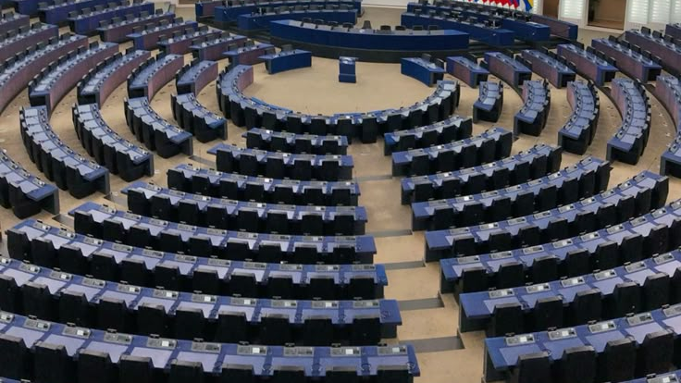
EPAS Debate
European Parliament Ambassadors

Slide 2
What is EPAS?
Educational initiative run by the European Parliament
Aims at improving students' political knowledge and participation
Increase awareness of European democracy, role of European parliament and European values.
Recent events:
Stalls
French film

Slide 3

Structure of the debate session:
Step 1. Introduce the topic and debate
Step 2. Background information
Step 3. Students will choose whether they agree or disagree, each group will sit together
Step 4. Each group will receive a sheet of potential argument points
Step 5. Debate
Step 6. Hold a final vote
Step 7. Repeat for the other two debates

Slide 4
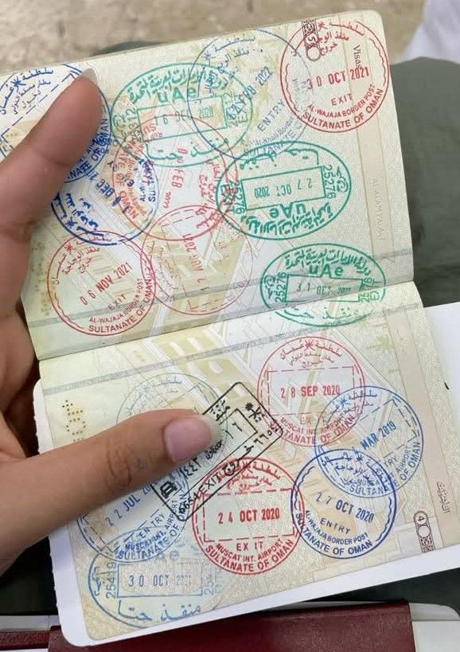
Debate 1 :
Should people born outside of a country be able to get a passport from there because of their ancestry, even if they do not live there?

Slide 5
Background:
Citizenship by ancestry – so for someone who was not born or raised in that country but has ansestry there
Parents from the country
Grandparents from the country
Proven ancestry from the 1800s
Proven ancestry and living in a neighbouring country
Does anyone know that they have a passport from ancestry?

Slide 6
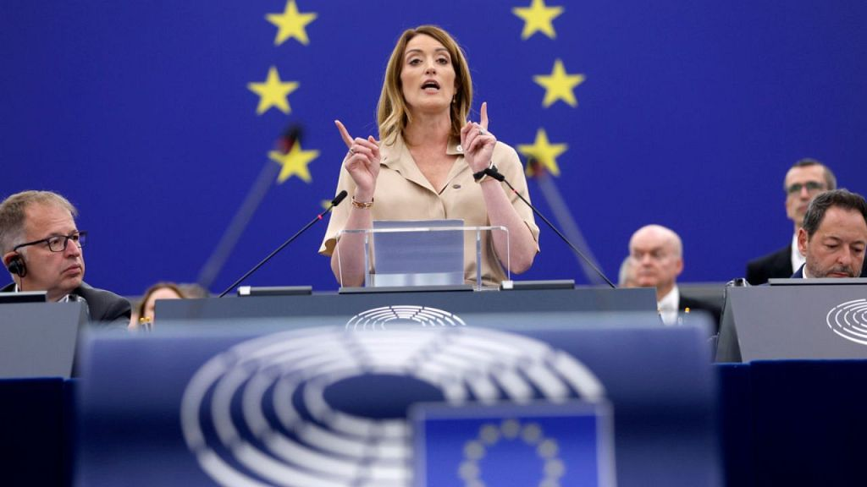
So, what do you think?
Should people not born or raised in a country be able to get a passport for it? What limits should there be?

Slide 7

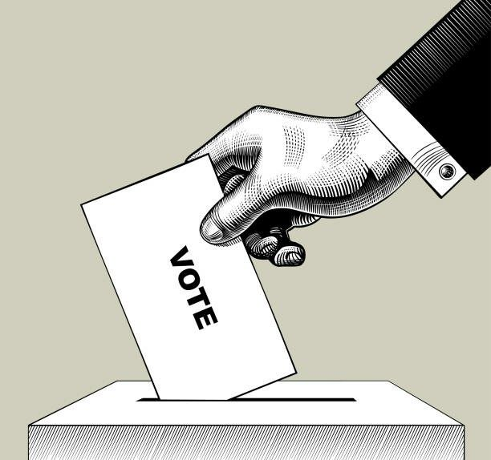
Time to Vote
Stand on the RIGHT side of the room if you FOR with the motion
(yes, people who are not born or raised in a country should be able to get a passport for it)
Stand on the LEFT side of the room if you are AGAINST the motion
(no, people who are not born or raised in a country should be able to get a passport for it)

Slide 8
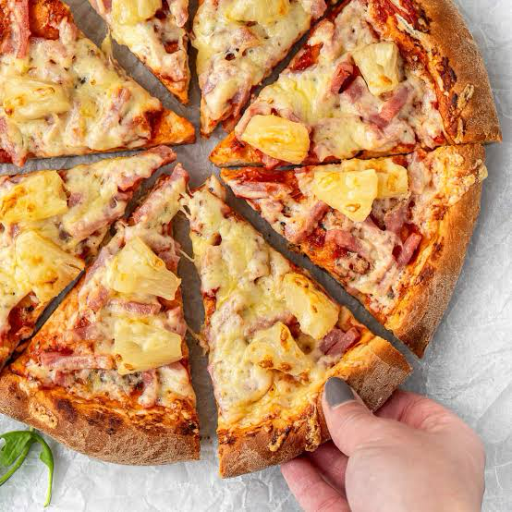
Debate 2
Does pineapple belong on pizza?

Slide 9
Background:
Traditional pizza ingredients
Affecting the taste of pizza
Affecting the texture of pizza
Pineapple is a fruit
Culutral integrity

Slide 10
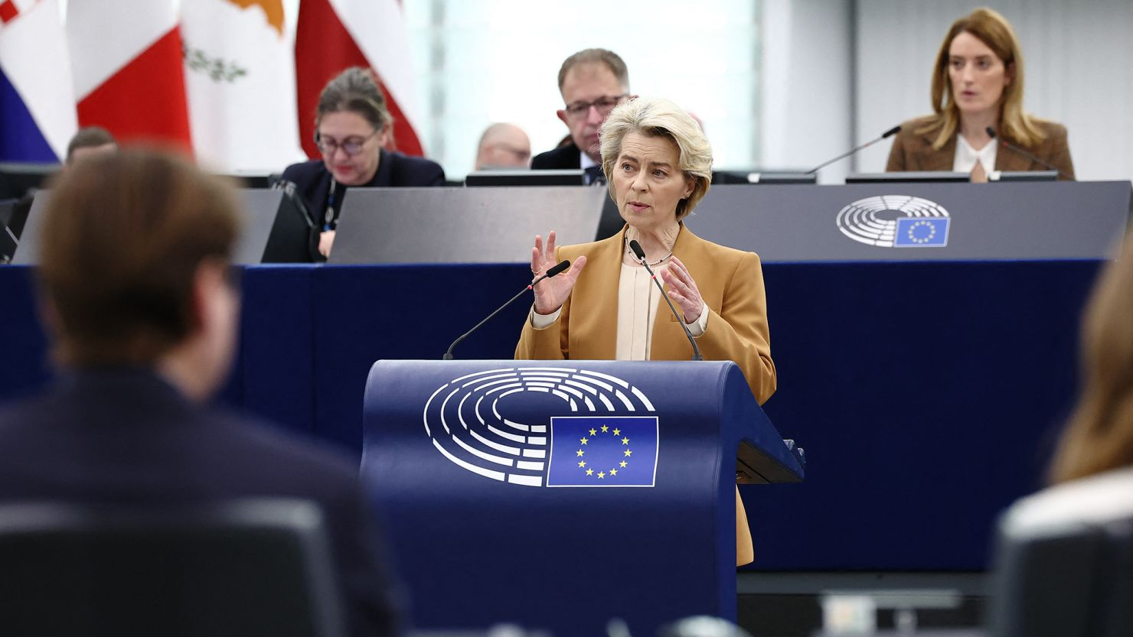
So, what do you think?
Does pineapple belong on pizza?

Slide 11
Time to Vote
Stand on the RIGHT side of the room if you FOR with the motion
(yes, pineapple belongs on pizza)
Stand on the LEFT side of the room if you are AGAINST the motion
(no, pineapple does not belong on pizza)

Slide 12

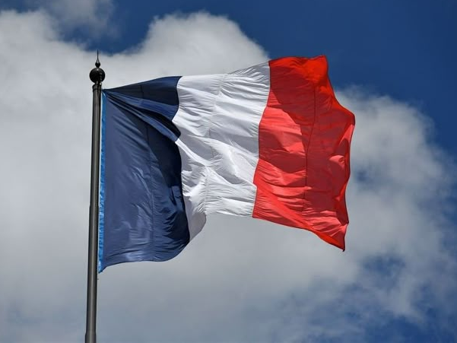
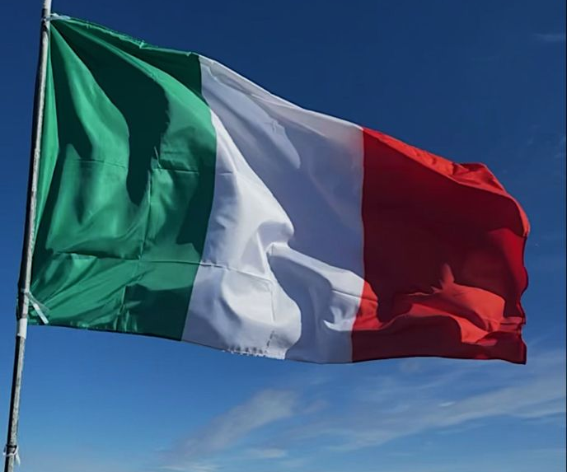
Debate 1 :
Is France, Italy or Germany more dominant than the other two?

Slide 13
Background:
Germany has 96 seats in the European Parliament
International influence
Senior positions held
Economic influence
France has 81 seatsseats in the European Parliament
Italy has 76 seats seats in the European Parliament

Slide 14
More information :
What does dominance mean?
Numerical strength : how many seats a country's MEPS have in comparison to others
Leadership roles: how many committee chairs or bureau positions members from that country hold
Economic influence: how much power a country has because it has a strong economy and other countries depend on its money, trade or products.
Economic Background: The word economy describes how a country or place is doing in making goods, and how much money it has.
GDP: gross domestic product, total value of goods and services produced in an economy
Country | GDP
Germany | $5.01 trillion
France | $3.36 trillion
Italy | $2.54 trillion

Slide 15
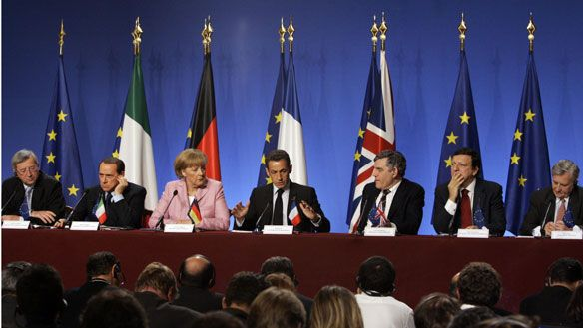
So, what do you think?
Is France, Italy or Germany more dominant than the other two ?

Slide 16
Time to Vote
Stand on the RIGHT side of the room if you FOR with the motion
(yes, one country is more dominant than the other two)
Stand on the LEFT side of the room if you are AGAINST the motion
(no, all three countries are equal in dominance)

