Slide 1
EU- Funded Research & Innovation in Cancer & Chronic Pain
By Izzy Margetts

Slide 2
Horizon
EUR 93.5 billion
Horizon Europe is the worlds largest research and innovation programme running from 2021 to 2027
EUR 8.2
billion
Total funding
Health research funding
Supports ground breaking ideas across various fields, from curing diseases to safeguarding cultural heritage
Cross border collaboration
Make partnerships with industries
Support innovations with break through potential which may be too risky for investors
Five main missions: fighting cancer, adapting to climate change, protecting our oceans, living in greener cities, ensuring soil health and food

Slide 3
EU MISSION: CANCER
€4 BILLION
€1.25 BILLION
Spend on previous cancer research projects
Funding for Europe’s beating cancer plan
Over 2.5 million people in the EU-27 are diagnosed with cancer annually, with 1.3 million people dying from the disease annually
The economic cost of cancer was €199 billion in 2018 across the EU27 plus Iceland, Norway, Switzerland and the UK₁
Aim to improve the lives of more than 3 million people by 2030 through prevention, cure and for those affected by cancer including their families to live longer and with a higher quality of life
Notes:
They want a better understanding of cancer, Allowing for earlier diagnosis and optimisation of treatment and improve cancer patients’ quality of life during and beyond their cancer treatment

Slide 4
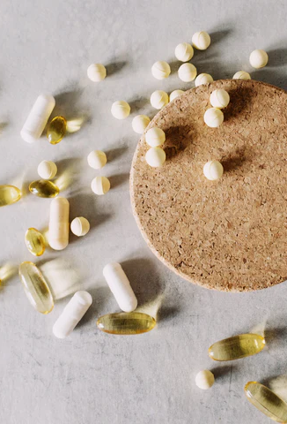
01
RAPAMYCIN- can we beat ageing?
Curiosity and a simple compound in soil bacteria help unlock a potential way to slow down ageing | Horizon Magazine

Slide 5
RAPAMYCIN- slowing down cancer growth
Rapamycin was discovered in soil samples from Easter Island by Professor Micheal Hall
It was isolated from a bacterium called Streptomyces hygroscopicus
In 2024 Professor Micheal Hall received the Balzan Prize for ‘ground breaking contribution’ to our understanding of the molecular mechanism that regulate cell growth and ageing
Rapamycin is able to supress the body’s immune response.
It is now used to treat certain forms of cancer and for preventing organ rejection

Slide 6

RAPAMYCIN- How it works
Rapamycin interferes with the enzyme TOR (target of rapamycin)
Initially TOR was thought to control cell division
Now, research reveals that TOR orchestrates CELL GROWTH, which was previously thought to be unregulated
TOR acts like a ‘nutrient sensor’ – when TOR is active, the cell focuses on cell growth RATHER THAN maintenance, in response to food
When calorie intake is reduced TOR shifts to maintenance mode.
The cell focuses on repair processes, cleaning up damaged components, conserving resources.

Slide 7
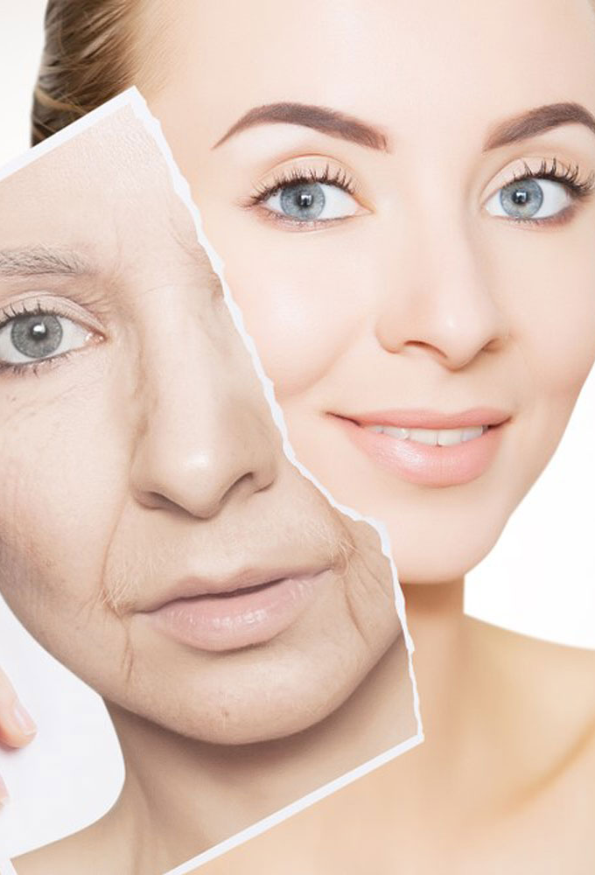
Slowing ageing
Ageing is often associated with the build up of cellular damage overtime.
Reducing TOR activity due to dietary restrictions can slow down the ageing process.
Rapamycin can mimic the effects of dietary restrictions by restricting TOR activity.
Rapamycin can slow the ageing process and delay the onset of age-related disease such as cancer and neurodegenerative disorders

Slide 8
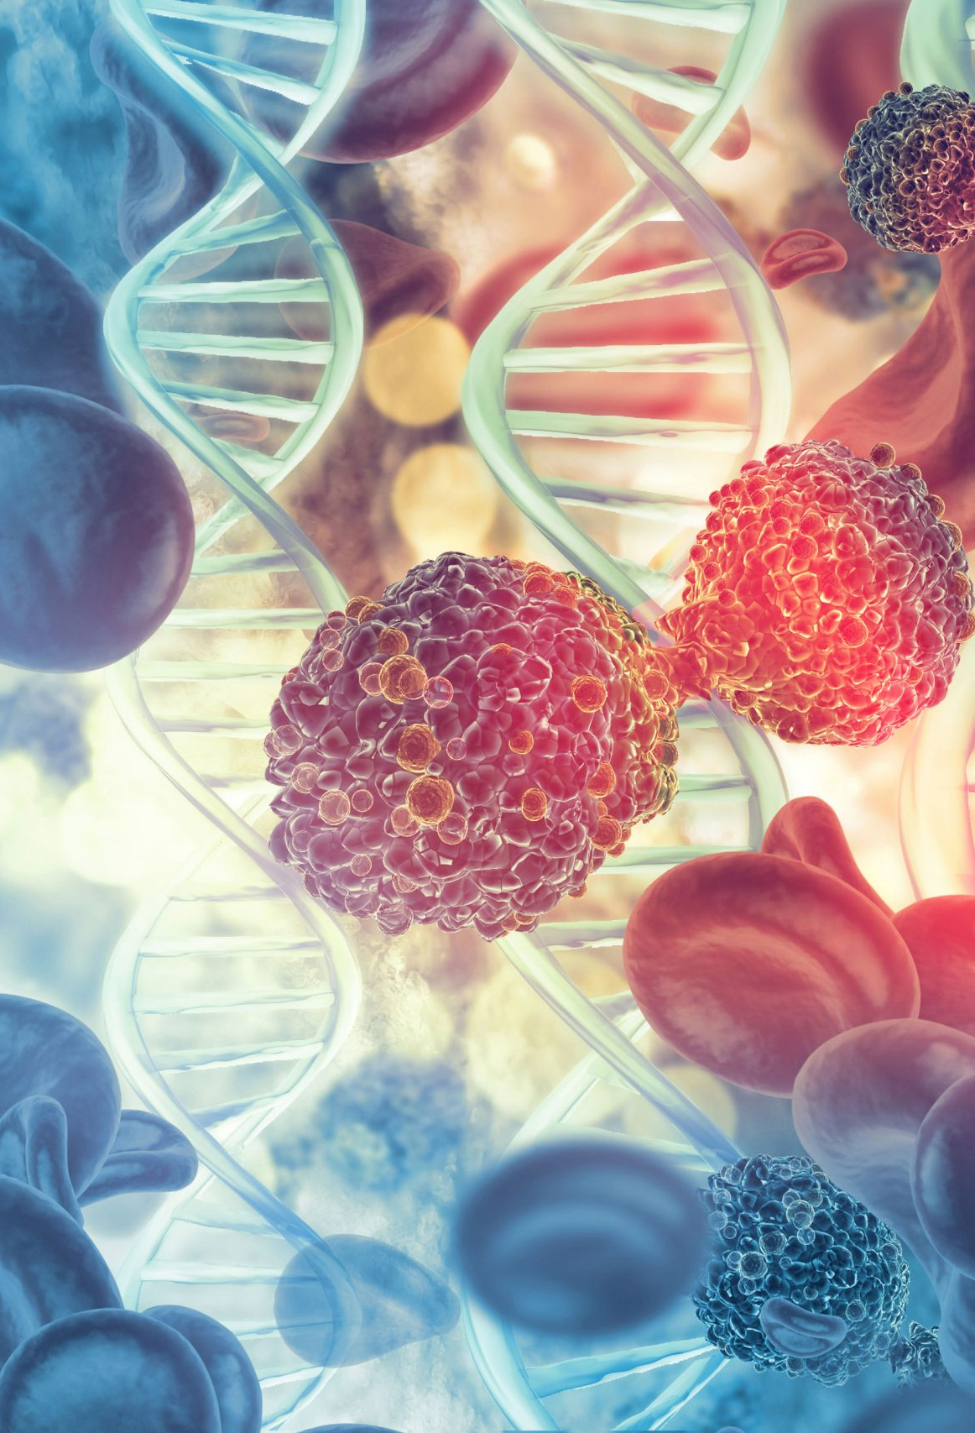
Slowing down cancer
“It has been calculated that the TOR complexes are upregulated and contribute to tumorigenicity in ~70% of all cancers” – Micheal Hall
Restricting TOR activity with rapamycin can slow the growth of cancer cells, making them more susceptible to chemotherapy and radiation
CONS:
- rapamycin can affect normal cell function
- Can lead to side effects

Slide 9
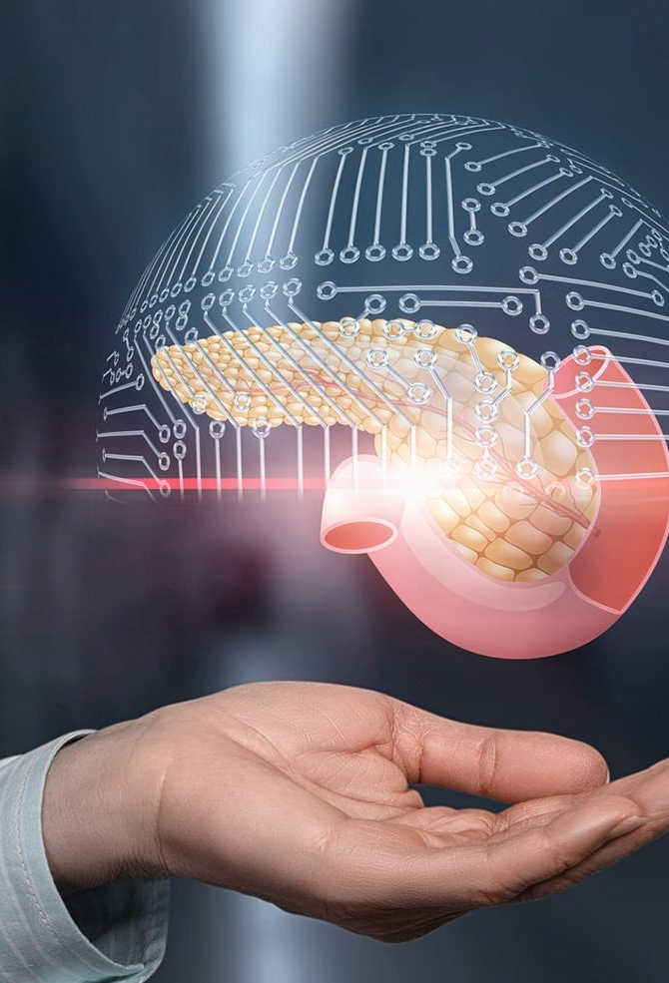
02
PANCAIN- fighting pancreatic cancer with AI
Fighting pancreatic cancer with computers and lasers | Horizon Magazine

Slide 10
How fatal is pancreatic cancer?
132,000 deaths
Pancreatic cancer patients face some of the lowest chances of survival of all cancers in europe
4.6 months
From pancreatic cancer in Europe in 2020
Median survival time
25%
12%
Of pancreatic cancer patients survive for a year
Of pancreatic cancer patients are still alive after 5 years

Slide 11
PANCAIM
At PANCAIM they believe that the biggest challenge in treating pancreatic cancer is selecting the right drug for the individual patient.
Novel immunotherapy drugs specifically target tumors with a particular genome
However pancreatic patients with a tumor with a similar genotype still tend to present with a whole range of disease patterns i.e. differ in phenotype.
PANCAIM integrates genomics and imaging phenomics using AI
The project relies on machine learning to scrutinise patient scans and tissue samples as well
as DNA from the cancer
The aim is to help clinical decision- makers to give the right treatment to the right patient at the right time.
Reducing trial-and-error use of expensive drugs with strong side effects

Slide 12
the issue with pancreatic cancer is late diagnosis, poor outcome and no currative chemo
Quotes taken from Henkjan Huisman, a professor of medical imaging and AI at Radboud UMC
and Dr John Hermans, a clinician and a part of PANCAIM
Because the disease has already spread too far when it is detected in about 80% of patients, lifesaving surgery for them is impossible.
‘ Tumors can be visible on early CT scans but they are missed in about 40% of the cases’ - HERMANS
PANCAIM have collected thousands of patient scans to train AI to recognise early signs of pancreatic cancer.
‘ AI can do things humans can’t such as spot a couple of cells among a billion or hone in on tiny structures’ - HUISMAN
Digital images of patient’s tissue show millions of cells which pathologists must carefully examine for signs of cancer.
This is painstaking work and abnormalities are easily overlooked.
.

Slide 13
03
LASER OPTIMAL- fighting pancreatic cancer with lasers
Fighting pancreatic cancer with computers and lasers | Horizon Magazine

Slide 14
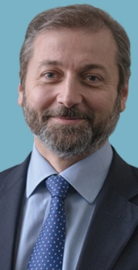
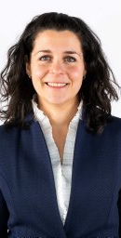
Dr Francesco Di Matteo broke medical ground by guiding a laser light through thin fibre optic cable towards patient’s tumours in the pancreas to destroy them with a tiny laser.
Now the technique is being refined by Dr Paola Saccomandi as part of another EU funded project called LASER OPTIMAL

Slide 15
LASER OPTIMAL
8 pancreatic cancer patients so far have had their tumors scanned using MRI. Calculations were run for individual patients.
This told the surgeon where and how much energy to direct at the patient’s tumor
Scientists guide laser light through a tiny fibre optic cable.
The light absorbed by the tissue is converted into heat. Prolonged exposure of tumor cells from 45-55°C causes irreversible cell damage.
PROS
CONS
They can control the energy delivery in the tumors, aiming to minimise unwanted heat dispersion into surrounding healthy tissue
This could provide an alternative to surgical resection
The pancreas has a lot of important blood vessels therefore it is important that the light does not damage them and cause bleeding
Notes:
As part of a new monitoring approach, the tumour’s temperature was tracked to achieve optimal temperature for destroying cancer cells.

Slide 16
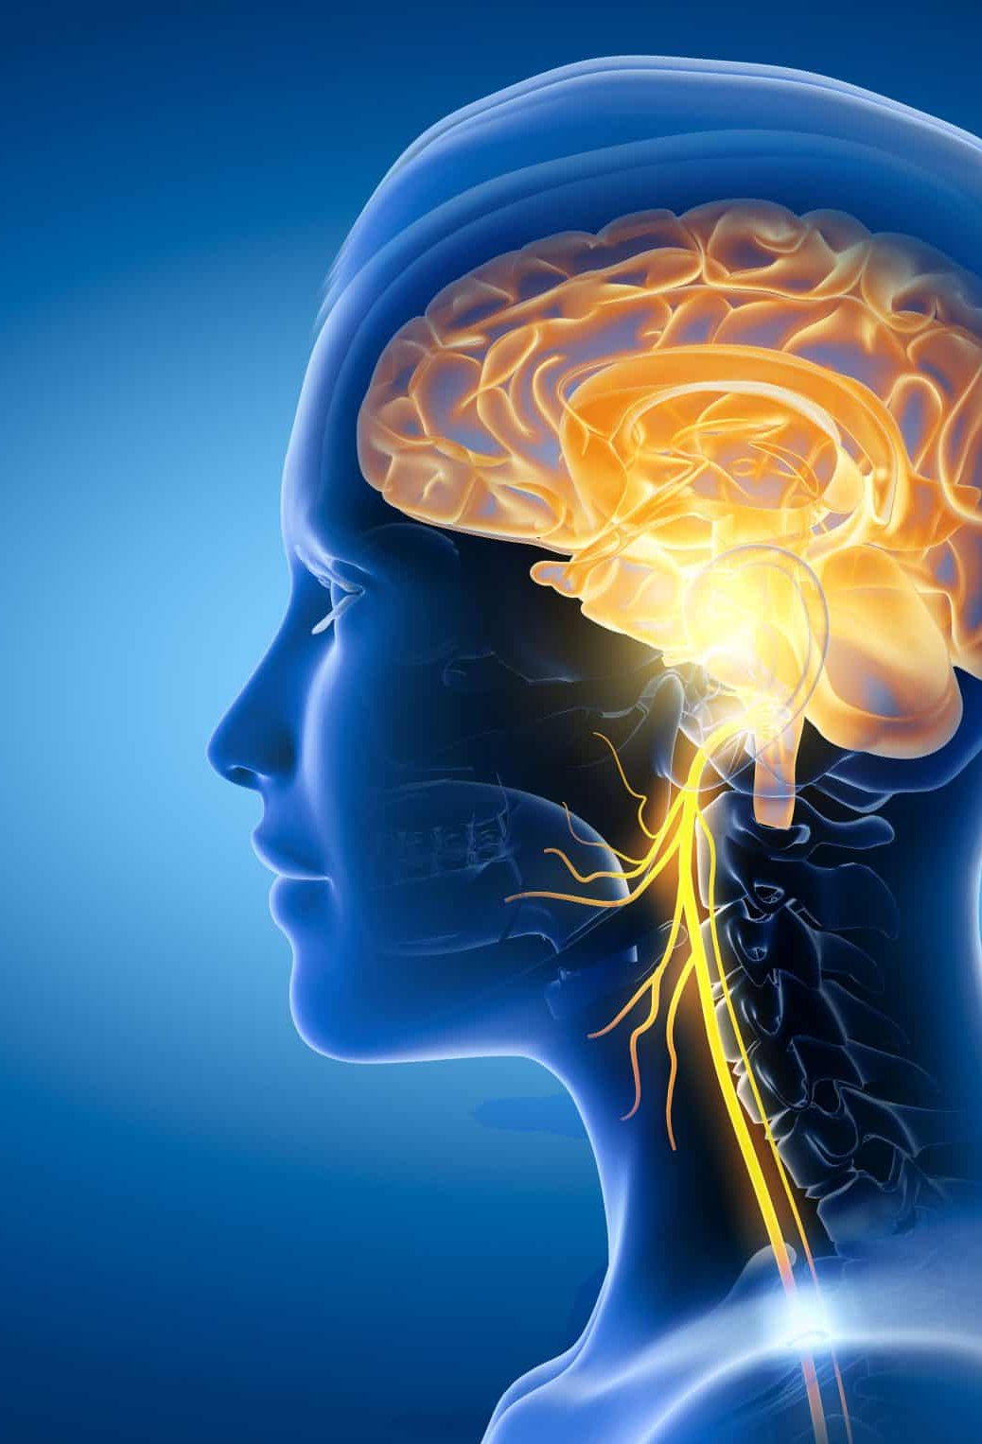
04
AURIMOD- VIVO unlocking the vagus nerve
Touching a nerve in the fight against chronic pain and diseases | Horizon Magazine

Slide 17
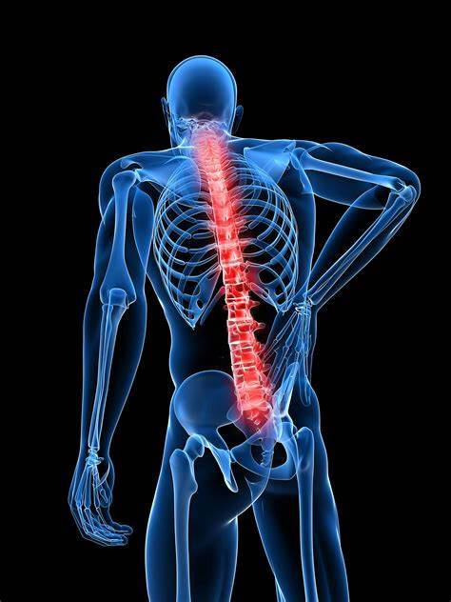
‘There are few, if any, effective pharmaceutical treatments for complex pain conditions’
-says an 83 year old Austrian woman living with chronic pain
An estimated 20% of Europeans experience chronic pain
150 million Europeans
Chronic pain causes an EU economic loss of
€441 billion annually
Stefan Kampusch led a research project that received EU funding to alleviate chronic pain by stimulating the longest cranial nerve in the body, the Vagus nerve.
Kampusch developed Aurimod, a company that designed VIVO.
VIVO is a prescription-only wearable device that stimulates the vagus nerve.

Slide 18
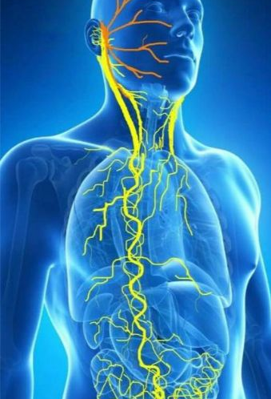
What is the Vagus nerve?
‘The vagus nerve plays a key role in processing pain.’
-Kampusch
The vagus nerve is the longest nerve of the autonomic nervous system.
It is part of the parasympathetic nervous system and helps to regulate heart rate, blood pressure, sweating, digestion, and even speaking.
By stimulating the vagus nerve we can target both the brain stem and brain circuits where pain is processed and controlled.
Other forms of stimulating the vagus nerve can help treat neurological disorders such as epilepsy and depression

Slide 19
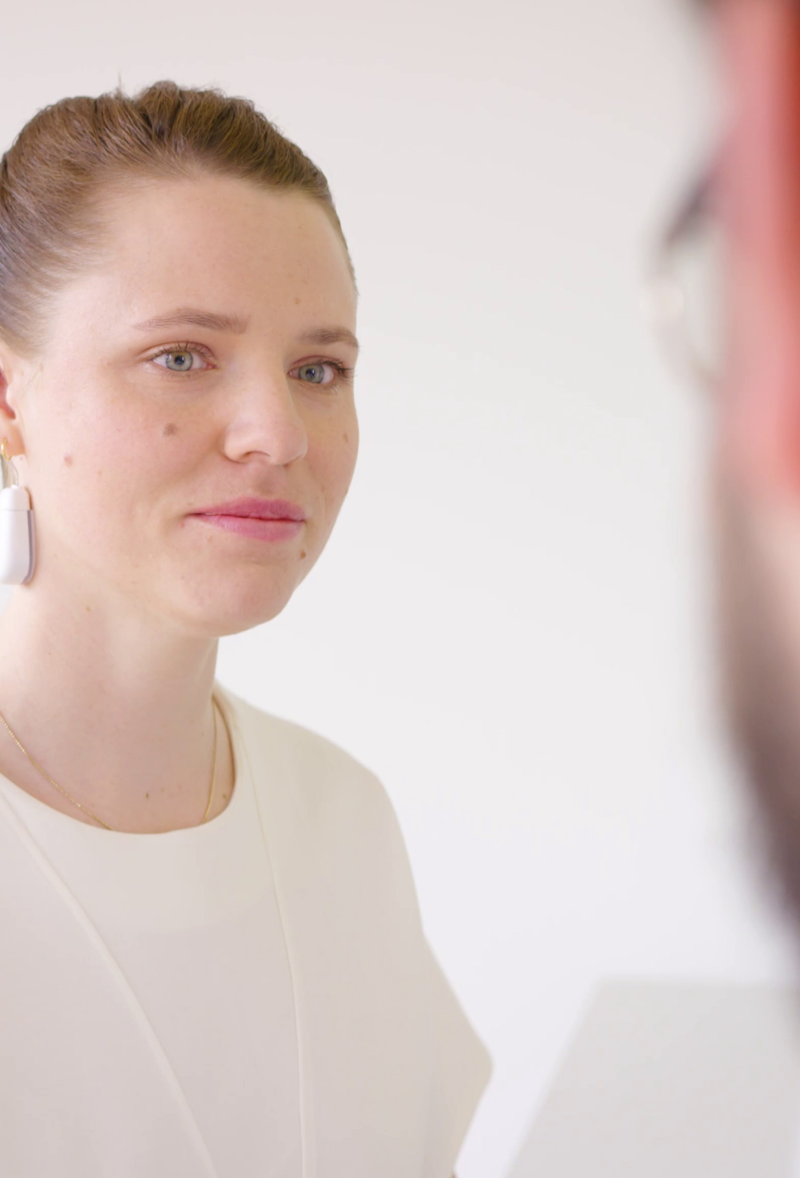
What’s VIVO?
VIVO resets the vagus nerve when signals reporting pain back to the brain get subdued and the nervous system gets stuck in pain mode.
It aims correct the signals that say there’s pain when there’s no actual injury.
VIVO attatches behind the ear where electrodes enter the skin close to the autonomic vagus nerve.
A small battery powered stimulator is then attached to the neck, just behind the ear.
The electrodes stimulate the vagus nerve in a special rhythm which triggers the body’s own sustainable pain relief.
Possible advantages of this treatment:
Personalised
Without the side effects of medication
Less invasive

Slide 20
RESULTS
83%
96%
Over six weeks of intake
Sustainable pain reduction
Less opiod intake
VIVO has the possibility to be integrated into more comprehensive pain management

Slide 21

05
MyPAL Project
- the power of palliative helathcare
https://projects.research-and-innovation.ec.europa.eu/en/horizon-magazine/mission-transform-palliative-healthcare

Slide 22
What is Palliative Healthcare?
Palliative healthcare is focused on providing relief from pain and other symptoms of a terminal illness.
Palliative care implements multiple approaches to improve quality of life.

Slide 23

MyPAL Project
MyPAL project aims to change the doctor-patient relationship through digital platforms.
They want to enable better communication between patients and doctors to enable them to provide better care and ultimately improve their quality of life.

Slide 24
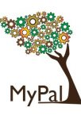
Research trial
A trial was conducted with over 200 adults and adolescent cancer patient in 5 different EU countries, they used MyPAL for over 2 years.
MyPAL allowed patients to communicate remotely to their doctors, educate themselves on illness, report real-time updates on their health and fill in questionaires
MyPAL can give doctors a fuller overview of a patient’s health status before they see them in person.
This could allow doctors to give more personalised, targeted healthcare to their patient.

Slide 25
MyPAL
‘It is a supplement to usual care it doesn’t replace it’
-explains Dr Chatzikonstantinou
MyPAL could make up for how little doctors see patients in person – usually 10 minutes every 3 months for each patient.
The app accumulates data on each patient and can identify vital patterns using built in statistical and analytical functions.
MyPAL has the potential to address geographical imbalances for those who can’t receive the same depth of healthcare due to their remote location
Notes:
As part of a new monitoring approach, the tumour’s temperature was tracked to achieve optimal temperature for destroying cancer cells.

Slide 26
Thanks
Do you have any questions?
All articles referenced from Horizon – The EU Research & Innovation Magazine
Horizon Magazine | Research and Innovation
Please keep this slide for attribution

Slide 27


