Slide 2
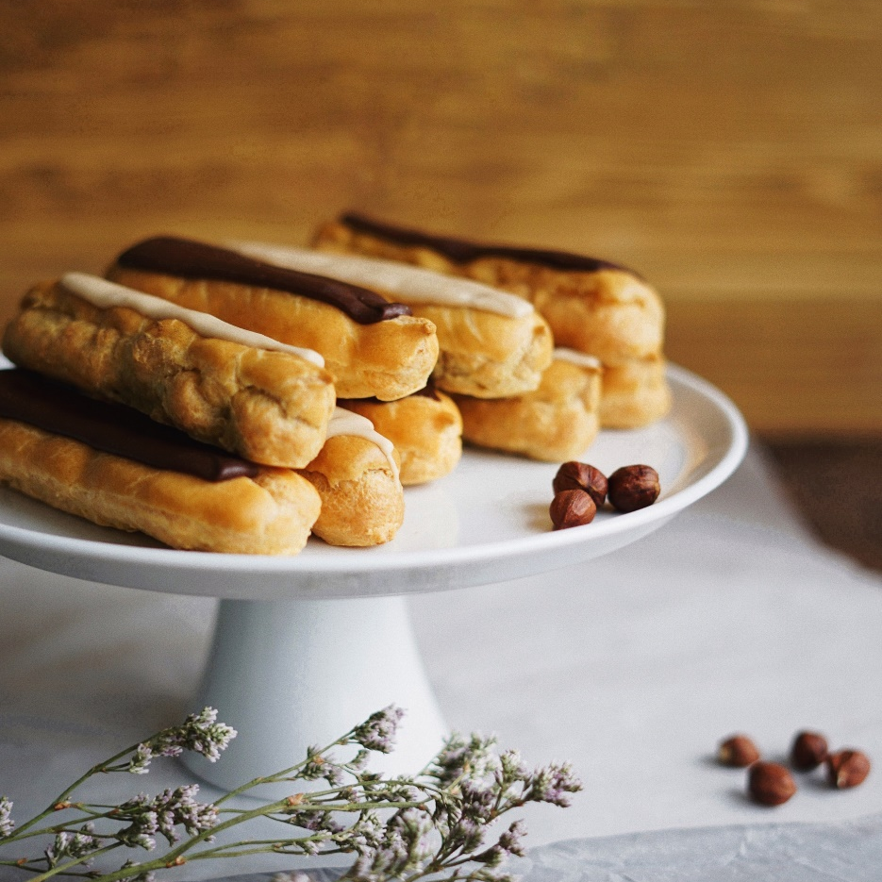
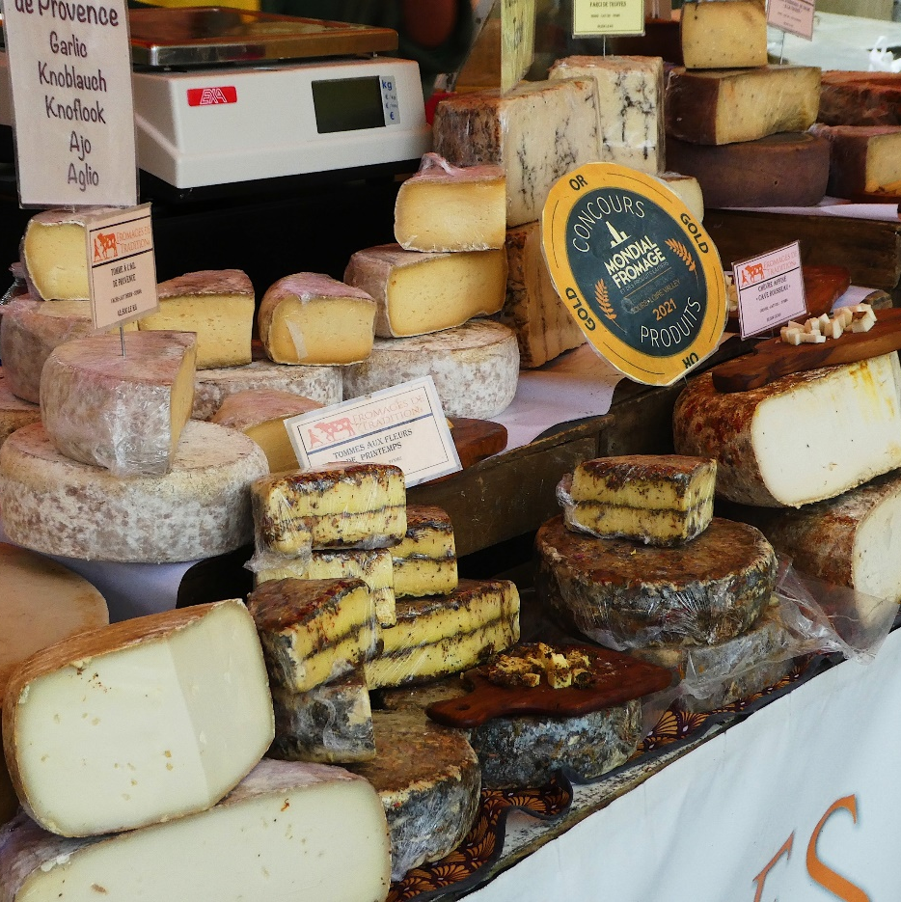
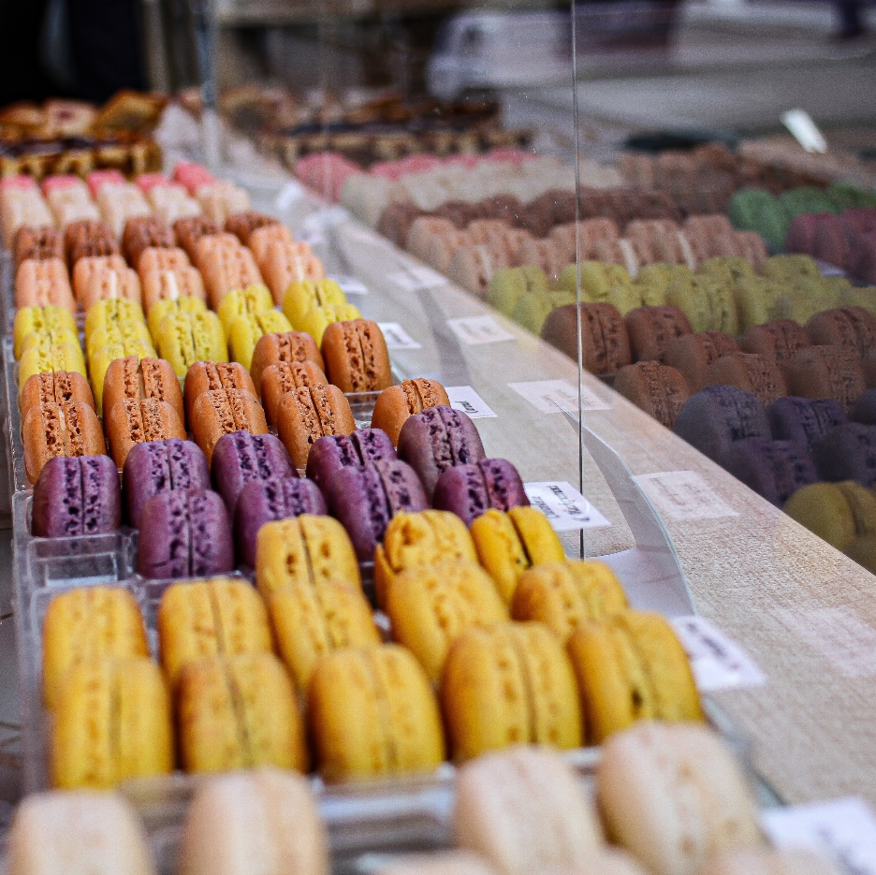
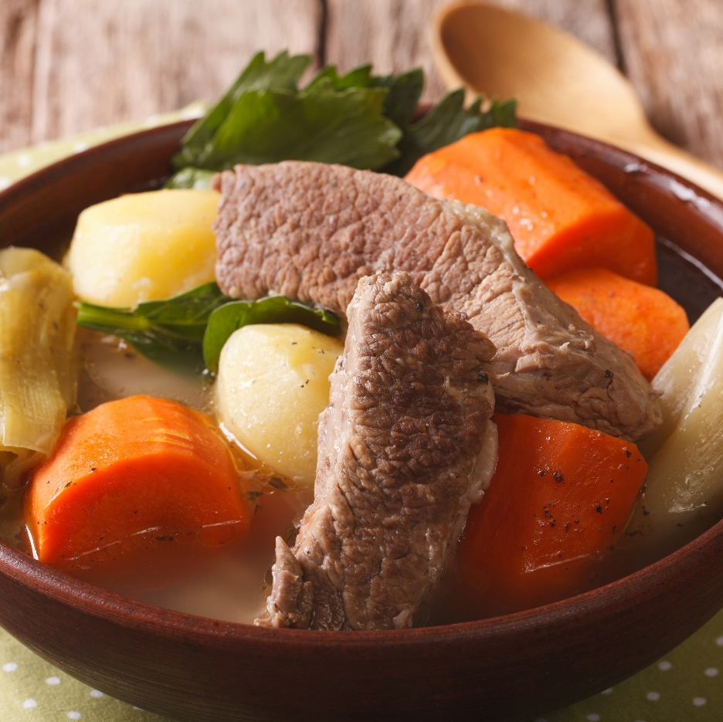
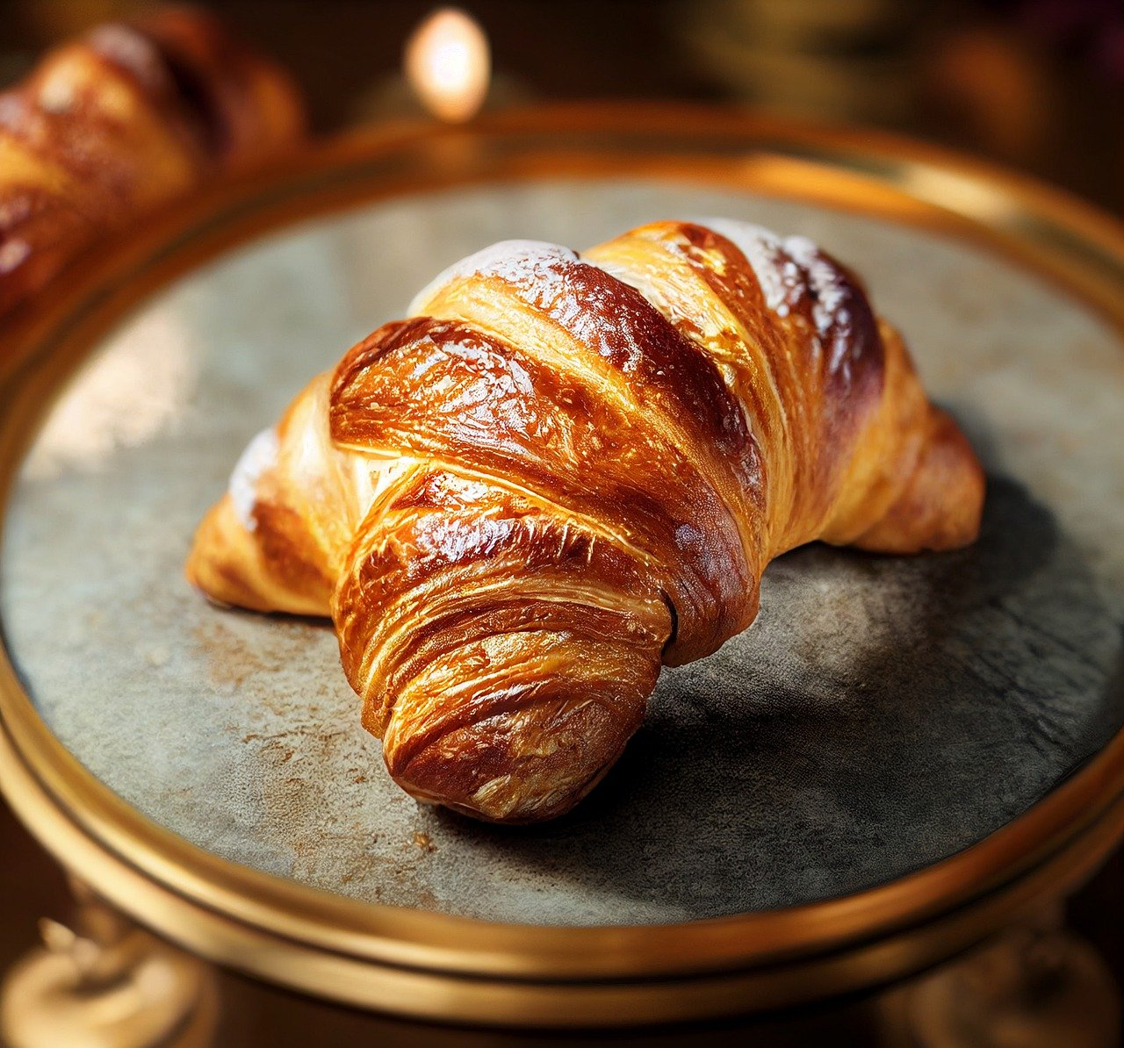
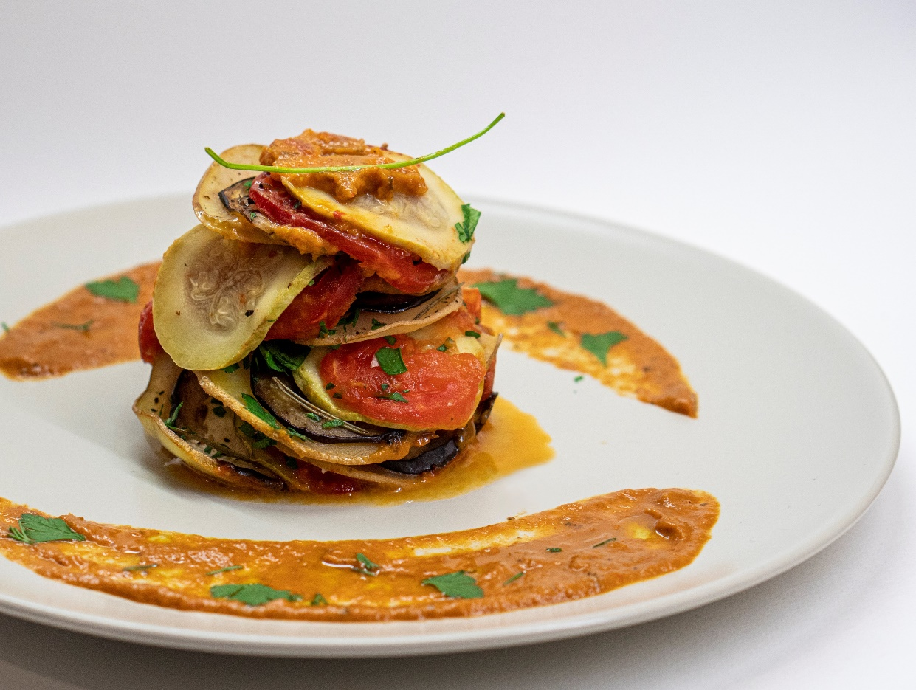
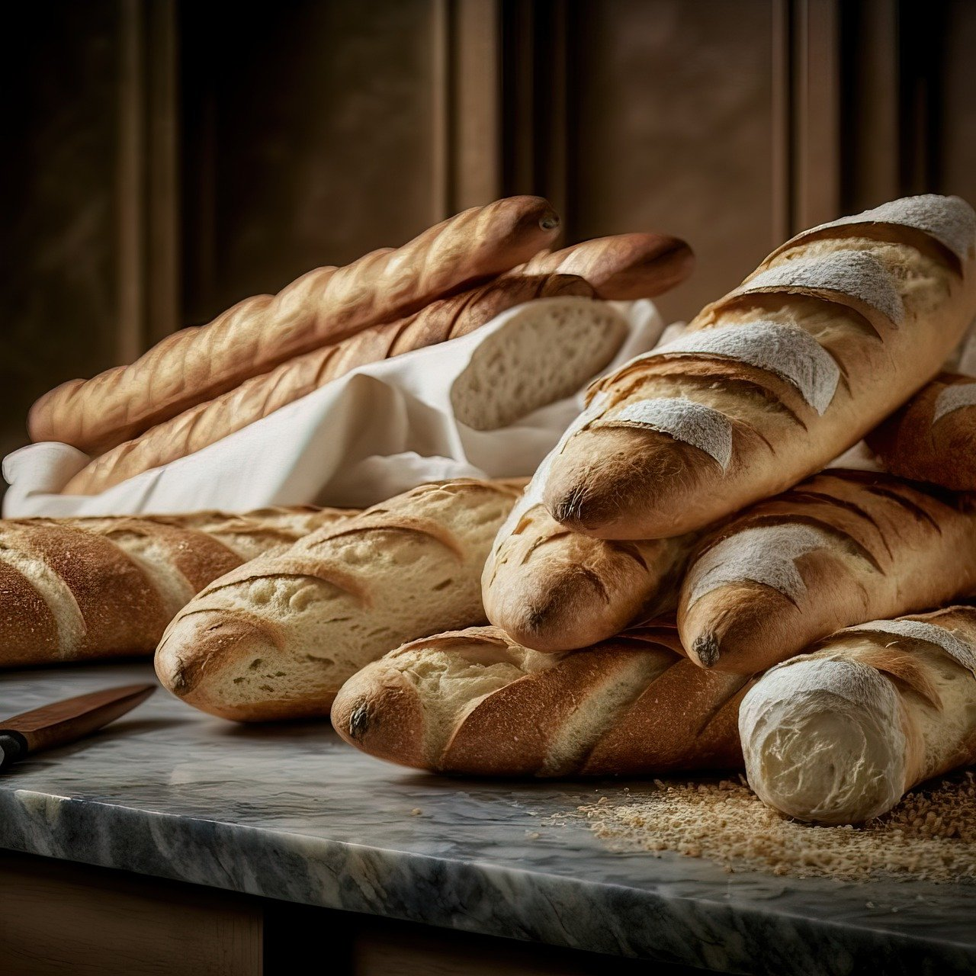
How many French foods can you name?

Slide 3
Baguettes
Classic French baguettes contain four ingredients: yeast, flour, water and salt.

Slide 4
Cheese- fromage
French cheeses can be made from the milk of goats, sheep or cows.
It is thought that more than 1000 types of cheese exist in France.
Some of the most popular French cheeses include Camembert, Brie and Roquefort.
Some cheeses are protected and regulated by French law!

Slide 5
Croissants
A croissant is a buttery, flaky pastry named for its crescent shape.
Some classic French croissant recipes only require eight ingredients.

Slide 6
Macarons
Macarons are made from egg white, icing sugar, granulated sugar and ground almonds.
A filling of ganache, buttercream or jam is sandwiched between two ‘cookies’ to complete the macaron.

Slide 7
Pot-au-feu
Pot-au-feu is a national dish of France.
It is a type of stew, with meat and vegetables slow-cooked for a long time.
Beef is the most commonly-used meat for this dish.

Slide 8
Ratatouille
Ratatouille is a stew made up of tomatoes, peppers, courgettes, aubergines, onions and garlic.
It can be served alone as a vegetable stew or as part of a main meal with lamb.

Slide 9
Eclairs
Eclairs are made from choux pastry.
Fillings can vary but whipped cream or custard is often used.
They are usually topped with chocolate.
Eclair means ‘lightning’ in French.

