Slide 1
Europe Day
9th May

Slide 2
EUROPE DAY
Every year on May 9th, we celebrate Europe Day. It is a special day to celebrate friendship and peace between countries in Europe.
A long time ago, a man named Robert Schuman had a brilliant idea: he wanted countries to work together as a team so they would never fight a war again. His idea started the European Union, which helps countries stay united and keep things peaceful today.
The UK is not in the European Union, but it is on the continent of Europe and we have lots of similarities with other European countries.
9th May is
Europe Day,
which is celebrated across Europe.

Slide 3
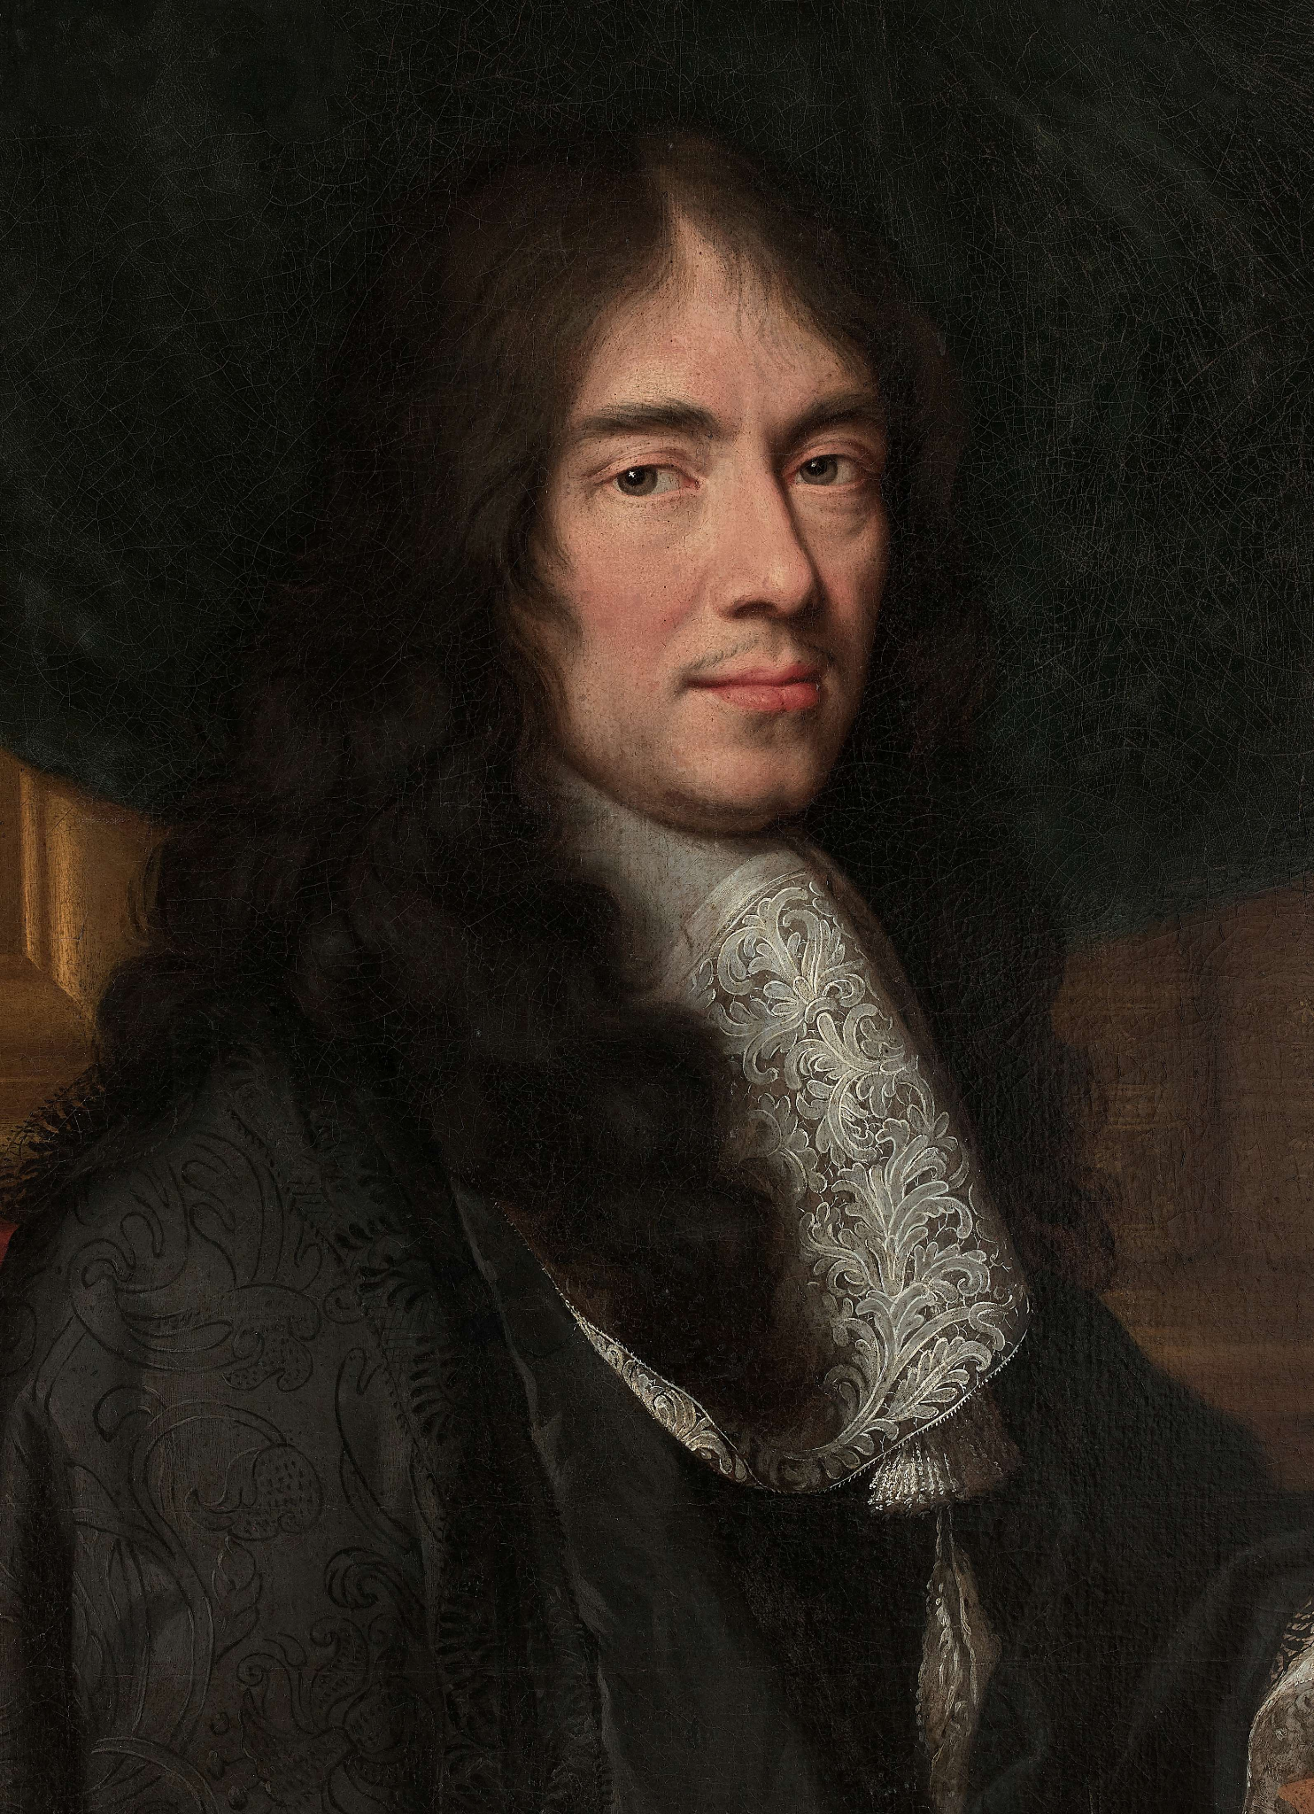
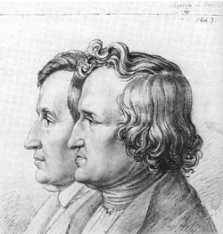
EUROPE DAY
Charles Perrault was a French author who wrote down many famous fairytales in the 1600s, helping to make stories like Cinderella and Sleeping Beauty popular all over the world.
The Brothers Grimm were two German brothers who traveled around their country collecting traditional folk tales from people to make sure the stories were preserved for future generations.
A lot of your favourite stories and films came from other parts of Europe originally!

Slide 4
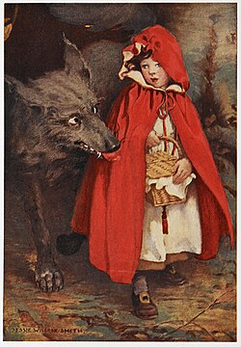
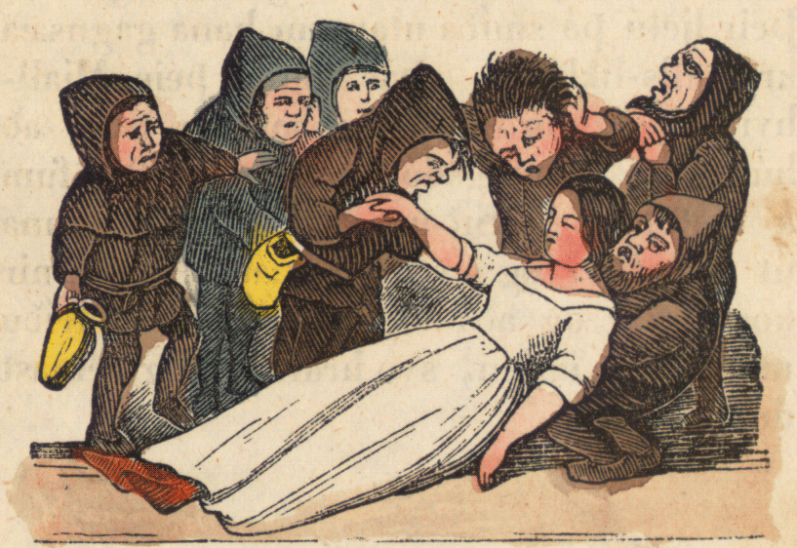
EUROPE DAY
We’re going to read two of their stories.
What similarities and differences do you notice?

Slide 5
Le petit chaperon rouge
Little Red Riding Hood
Charles Perrault’s version, 1600s

Slide 6
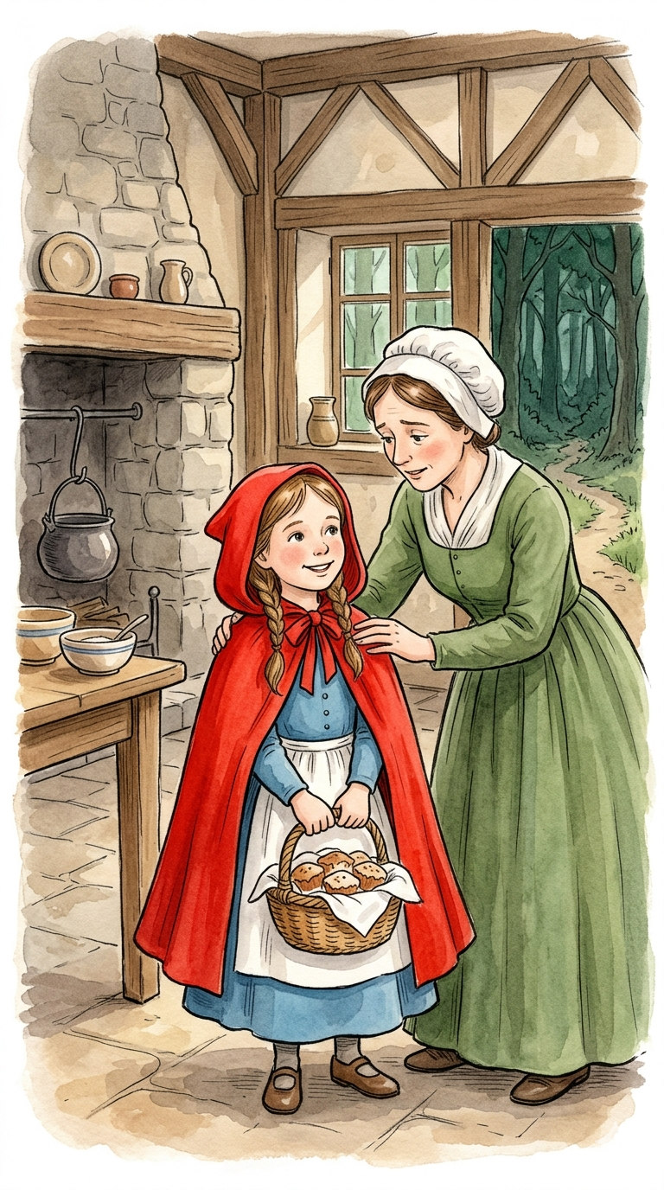
Once upon a time, there was a sweet girl who loved to wear a bright red cape. Her mother asked her to take a basket of cakes to her grandmother, who lived deep in the woods. "Be careful," her mother said, "and don't talk to any strangers along the way."

Slide 7
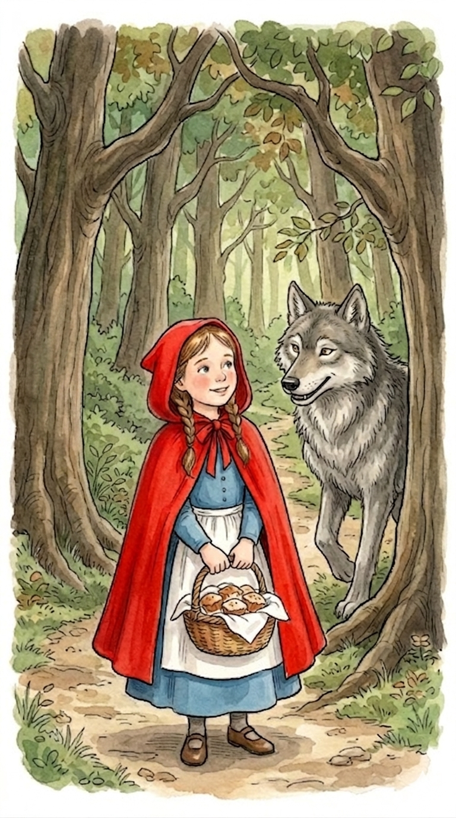
As the girl walked through the trees, a hungry wolf jumped out. He acted very friendly and asked where she was going. The girl didn't know he was a trickster, so she told him all about her grandmother’s house. The wolf ran ahead as fast as he could.

Slide 8
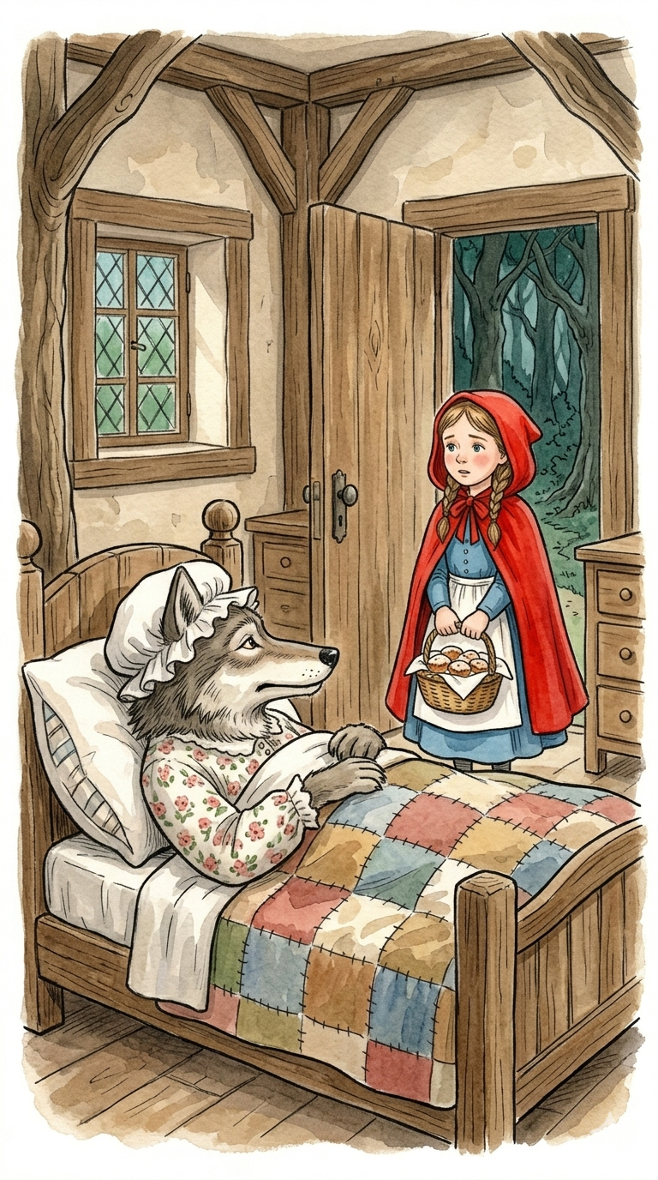
The wolf reached the house first and tricked the grandmother. He then climbed into her bed, pulled the covers up to his nose, and waited. When the little girl walked in, she went to the bed and said, “Oh, Grandmother, what big ears you have!"

Slide 9
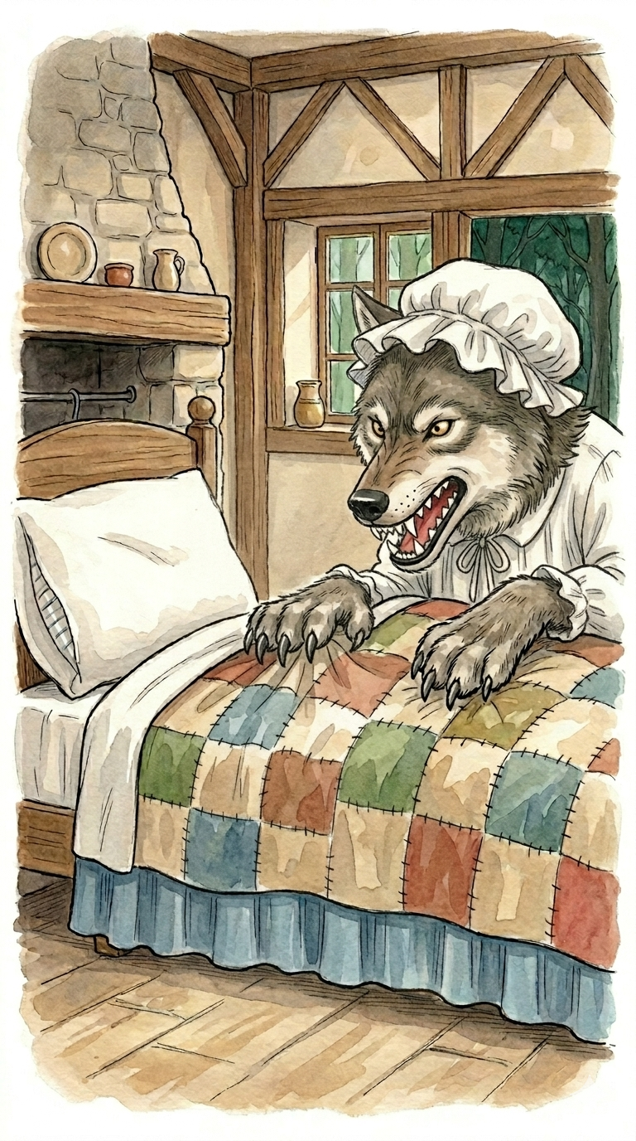
“All the better to hear you with!" said the wolf. “And Grandmother," the girl whispered, “what big teeth you have!" The wolf growled, “All the better to eat you with!" And with one big gulp, he swallowed the girl up.

Slide 10
In the version that Charles Perrault wrote a long, long time ago, that is exactly how the story ended. The wolf had fooled everyone, and the story served as a very serious warning to children to always listen to their parents and stay safe on their path.

Slide 11
Brothers Grimm version, 1800s
Schneewittchen Snow White

Slide 12
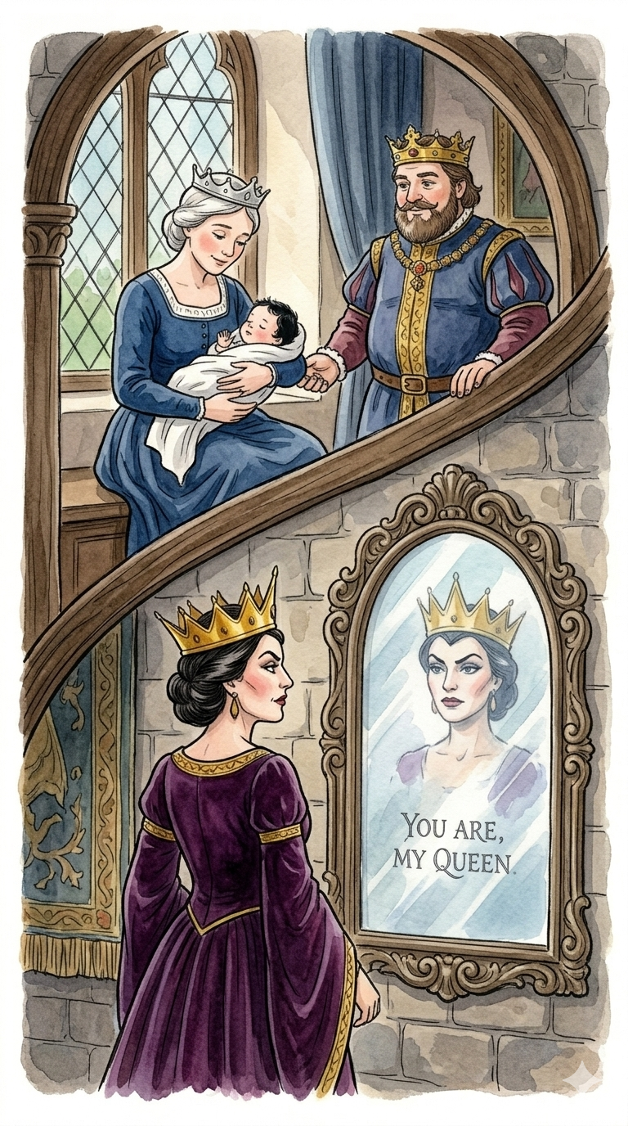
Once, a beautiful queen wished for a baby. Soon, she had a daughter, named Snow White. Sadly, the queen died, and the king married a new, proud wife. This queen had a magic mirror and asked it, "Mirror, mirror, on the wall, who is the fairest of them all?" The mirror always said, "You are," until Snow White grew up.

Slide 13
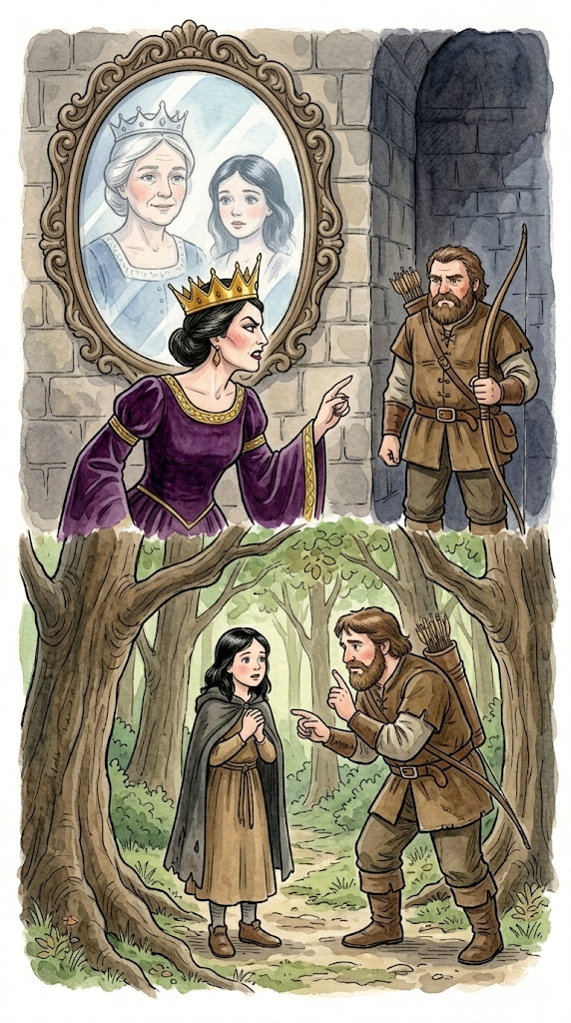
One day, the mirror told the queen that Snow White was the fairest! Furious, the queen ordered a huntsman to take Snow White into the deep woods and make sure she never came back. But the huntsman was kind. He let her go and told her to hide.

Slide 14
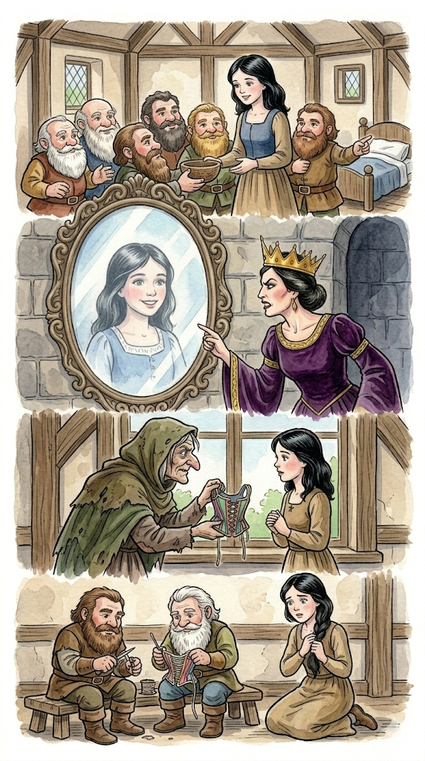
Snow White found a tiny cottage where seven kind dwarves lived, and they said she could stay. But the mirror told the queen that Snow White was still alive! The wicked queen disguised herself and tried to stop Snow White three times with tricky, dangerous gifts. The dwarves saved her twice.

Slide 15
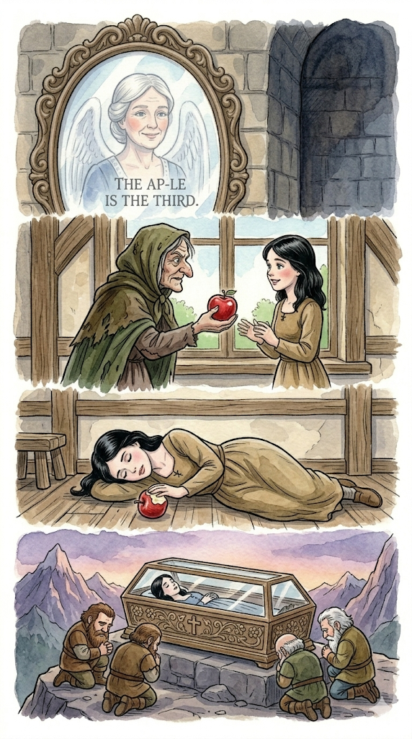
Finally, the queen came with a perfect, but poisoned, red apple. Snow White thought it was safe, but after one bite she fell very still. The sad dwarves put her in a beautiful glass coffin on a mountain.

Slide 16
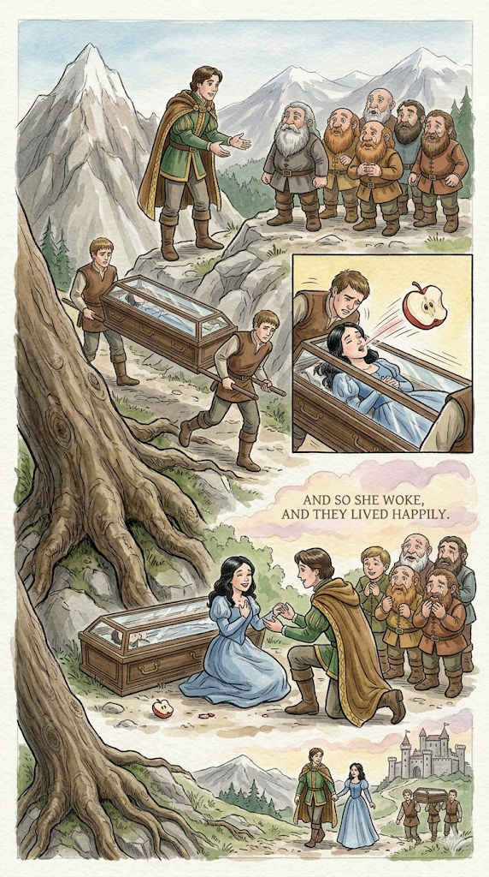
A prince saw Snow White and asked to take the coffin to his castle. As his servants carried it, they stumbled over a huge root! The jolt made the piece of poisoned apple pop right out of Snow White's mouth! She woke up, smiling, and they lived happily ever after.

Slide 17
EUROPE DAY
What similarities and differences did you notice?

Slide 18
EUROPE DAY
What is your favourite story? Why? Are there different versions of it?
I wonder if they came from somewhere else in Europe originally…?

