Slide 1





EUROPEAN
parliament

Slide 2



The main EU
institutions

Slide 3
Council of the European Union
The Council represents the interests of the member states. The Council of the European Union is made up of representatives of the governments of the member states. These representatives are usually ministers, such as foreign ministers, finance ministers, or environment ministers. The Council is the institution that represents the interests of the member states.

Slide 4
The European Commission
The Commission proposes legislation (law). The European Commission is made up of 27 members, one from each EU country. They are called Commissioners. The Commissioners are responsible for different areas of EU policy, such as trade, agriculture, and environment. They are appointed by the European Council.

Slide 5
The European parliament
The Parliament is the directly elected body representing the citizens of the EU. The European Parliament is made up of 705 members. These members are called Members of the European Parliament (MEPs). MEPs are organized into political groups, which represent different political views. The largest political group in the European Parliament is the European People's Party.

Slide 6




So what can the EU parliament do?
Legislating - The Parliament shares the power to make laws with the Council of the European Union
Budgeting - The Parliament has equal power with the Council to decide on the EU budget
Supervising - The Parliament supervises the work of the European Commission
Electing - The Parliament elects the President of the European Commission

Slide 7

MEP insight
Gender Split
Age range
23
50
76
youngest
average
oldest
61%
39%
50%
new to parliament
previous MEP
0.1% other
50%

Slide 8


UK-EU relations
Since the new labour government there has been a noticeable improvement in the relation ship between the two.
Areas of cooperation between the UK and EU include security and defence, climate change and energy

Slide 9


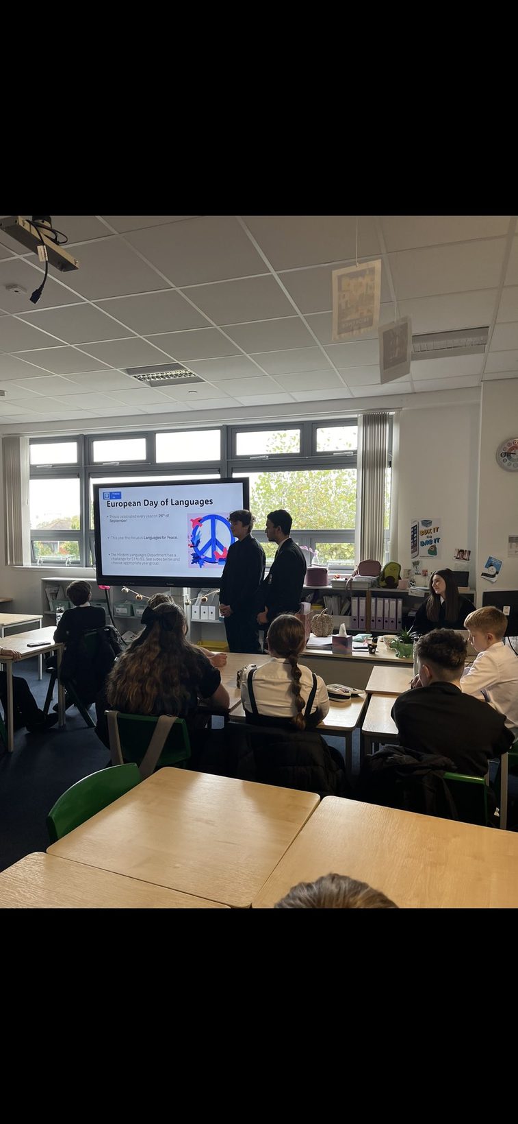
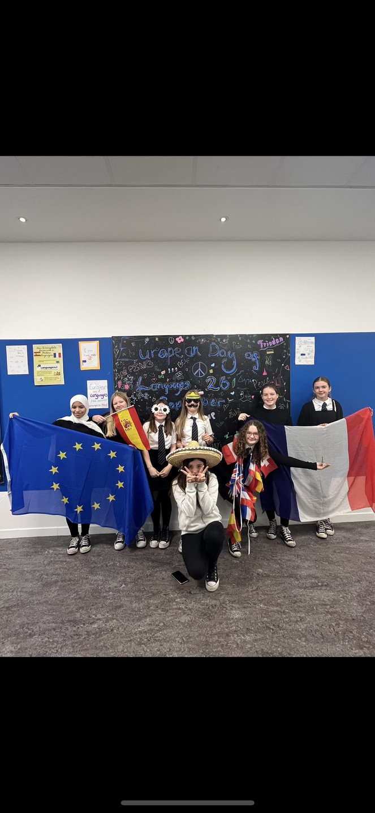
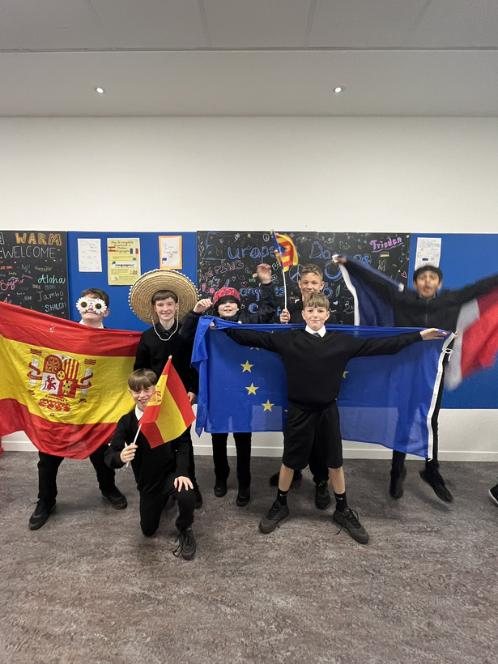
What we’ve done
We have been busy across the school from creating quizzes to leading classes in the department. One quiz was made for the kids to guess the language another pupil from prestwick was speaking. Another about general knowledge on Europe.

Slide 10
Thank you!

