Slide 1


80 years since liberation.
Aspiration Endeavour Integrity Respect

Slide 2
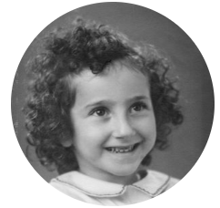
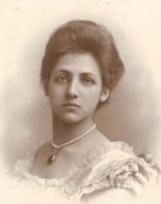
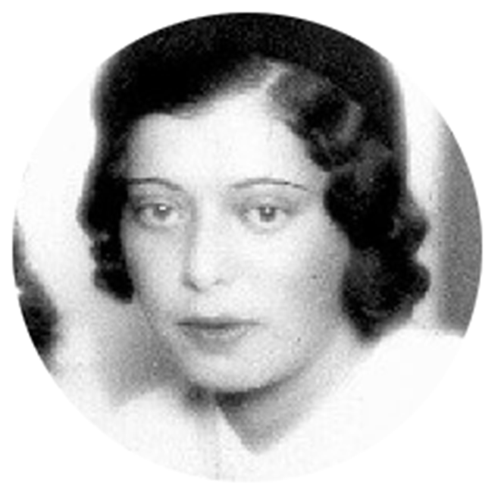
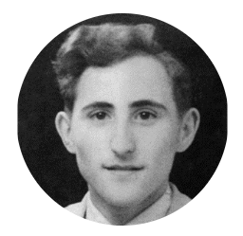
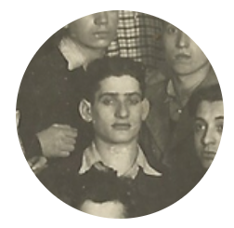
How do the stories of these five people contribute to the theme of Holocaust Memorial Day?
Aspiration Endeavour Integrity Respect

Slide 3



“The Sikh Princess”
During the 1930s, Catherine lived in Germany. During the rise of the Nazi Party, she helped German-Jewish families by providing a safe passage to England. With the increasing threat of war, she decided to move to England, and her house became a sanctuary for several Jewish families who escaped the Blitz. She is a great representation of how, if we help people, it can have a great impact in the future.
Aspiration Endeavour Integrity Respect

Slide 4

Gad Beck was a gay Jewish man in Nazi-occupied Berlin. He survived by joining a resistance group. His lover, Manfred, chose to stay with his family and was sent to Auschwitz. This tragedy highlights the importance of fighting prejudice and discrimination to create a better future.
Aspiration Endeavour Integrity Respect

Slide 5

Blanch Benedick, a Jewish girl from Copenhagen, escaped the Nazis in 1943 with her family. A family hid them, and they fled to safety in Sweden. The journey was scary, but they all survived and rebuilt their lives. To make a better future, we need to learn from the past, be kind, and stand against hate.
Aspiration Endeavour Integrity Respect

Slide 6



The Nazis killed Helene Melanie Lebel, a woman with schizophrenia, because they saw her as different. The Nazis targeted people with mental illnesses and disabilities, killing many of them. We can work against such atrocities by combatting prejudice and discrimination.
Aspiration Endeavour Integrity Respect

Slide 7

David Berger, a young Jewish man from Poland, fled to Vilnius after the German invasion. He joined a youth group and sent his girlfriend a photo. In 1941, he wrote a goodbye postcard before he was killed. We can honour his memory be fighting dehumanisation to create a better future and strive to create a world where the horrors of the Holocaust never happen again.
Aspiration Endeavour Integrity Respect

Slide 8
How do the stories of these five people contribute to the theme of Holocaust Memorial Day?
Aspiration Endeavour Integrity Respect

