Slide 1
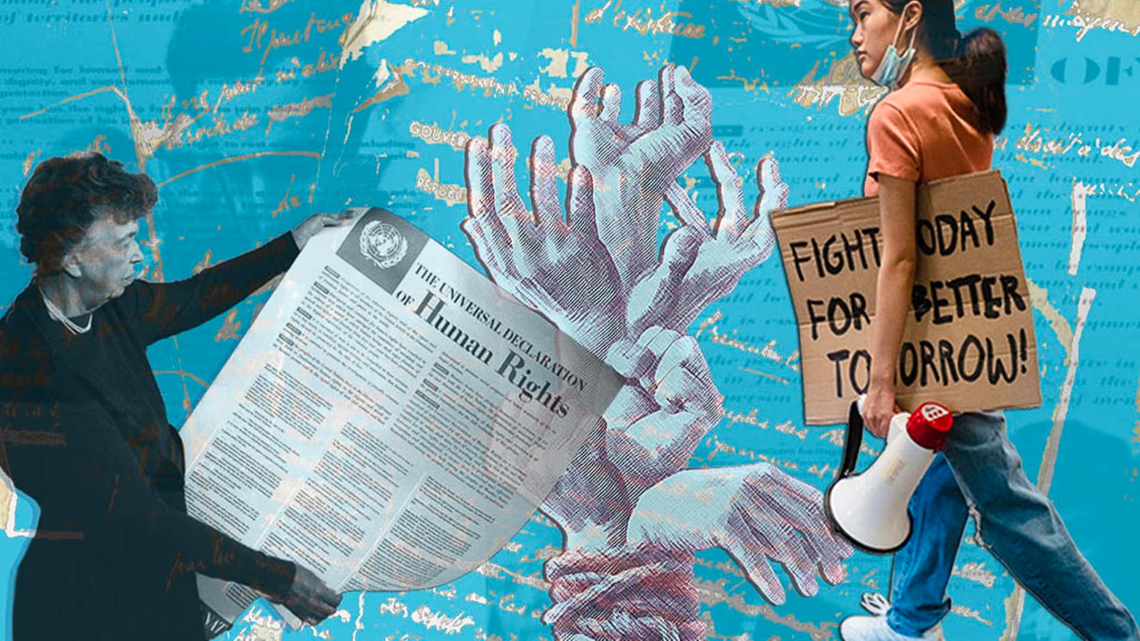


EUROPEAN PARLIAMENT AMBASSADOR SCHOOLS PROGRAMME
Human Rights Day 2023
CELEBRATING 75 YEARS OF THE UNIVERSAL DECLARATION OF HUMAN RIGHTS

Slide 2
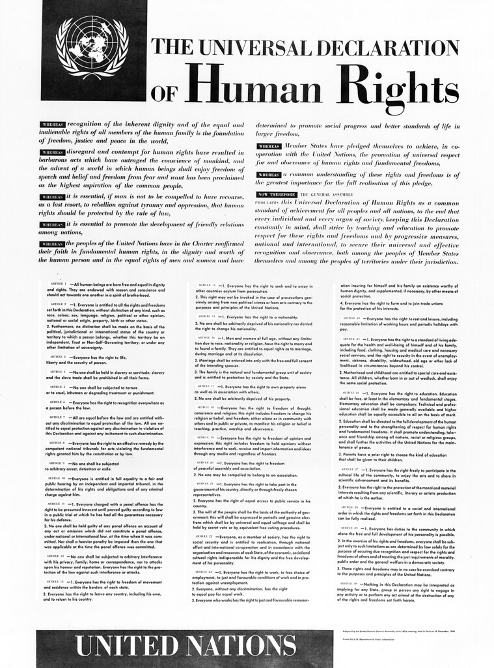
What is human rights day?
Human Rights Day is observed by the international community every year on 10 December. It commemorates the day in 1948 the United Nations General Assembly adopted the Universal Declaration of Human Rights.
2023 marks 75 years since the singing of the declaration.

Slide 3
What are human rights and why are they important?
The Universal Declaration of Human Rights
“enshrines the rights and freedoms of all human beings”
and sets out 30 of the basic rights and fundamental freedoms
these rights include:
Article One: All human beings are born free and equal in dignity and rights
Article Four: No one shall be held in slavery and the slave trade shall be prohibited
Article 18: Everyone has the right to freedom of religion
Article 26: Everyone has the right to education

Slide 4
Following the Second World War, the United Nations declared that the
“barbarous acts which outraged the conscience of mankind”
should never be allowed to happen again
No matter what our differences are, we all have equal human rights
This means human rights are the same for every man, woman and child across the world, no matter what their circumstances.
All 193 member states of the United Nations have signed the declaration, but some countries are better at enforcing them than others.
In the United Kingdom, our rights are guaranteed by law; but, in other countries, many people are not afforded the rights they deserve.

Slide 5
A committee to draft the Human Rights Convention was set up in February 1947.
Chaired by Eleanor Roosevelt of the United States, she was instrumental in formulating the Declaration.
Mrs. Roosevelt submitted the declaration to the United Nations General Assembly with the following words:
“We stand today at the threshold of a great event both in the life of the United Nations and in the life of mankind. This declaration may well become the international Magna Carta for all men everywhere.”

Slide 6
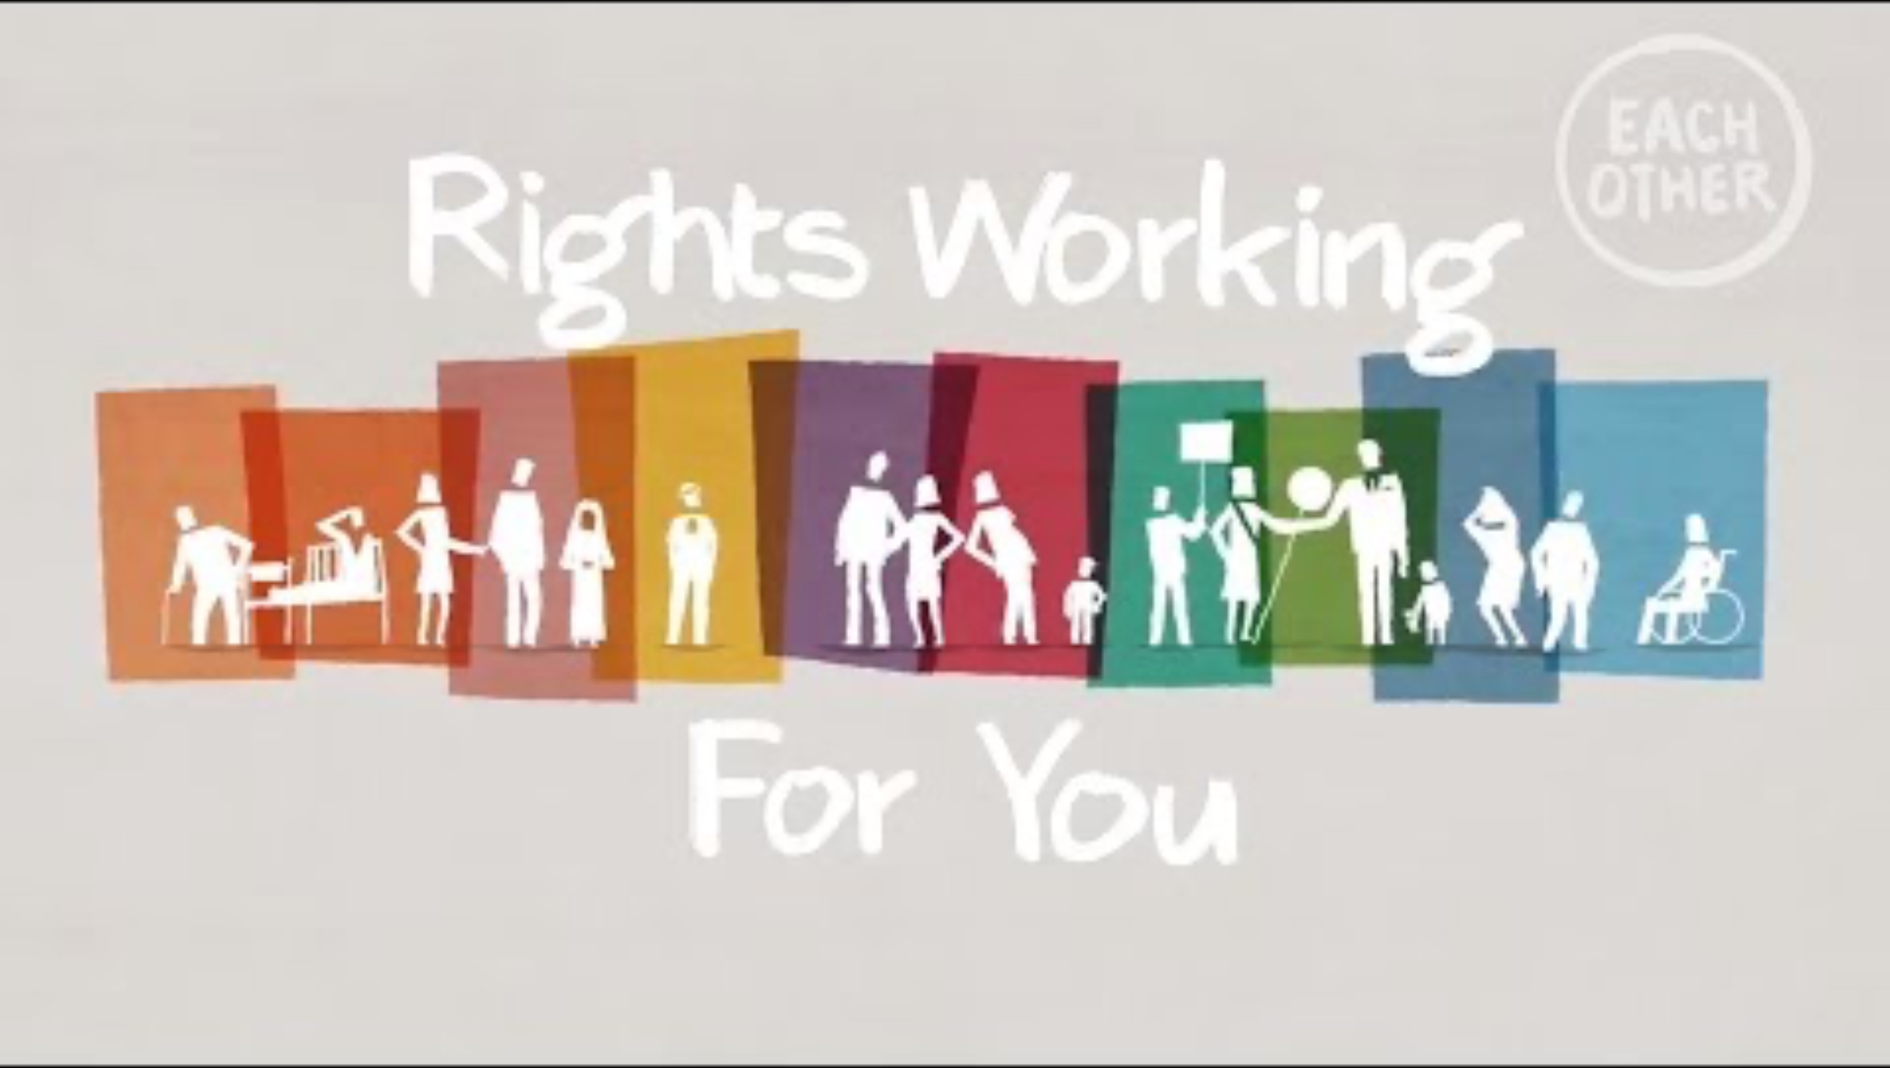

Slide 7
When have Human Rights been taken away?
Not everyone has had their rights respected.
The 1994 Genocide against the Tutsi’s in Rwanda
More than One Million people were murdered over 100 days
The Holocaust
Over Six Million Jewish People were murdered - this promoted the UDHR to be written
Apartheid in South Africa
The segregation of Black South Africans and removing their basic rights

Slide 8
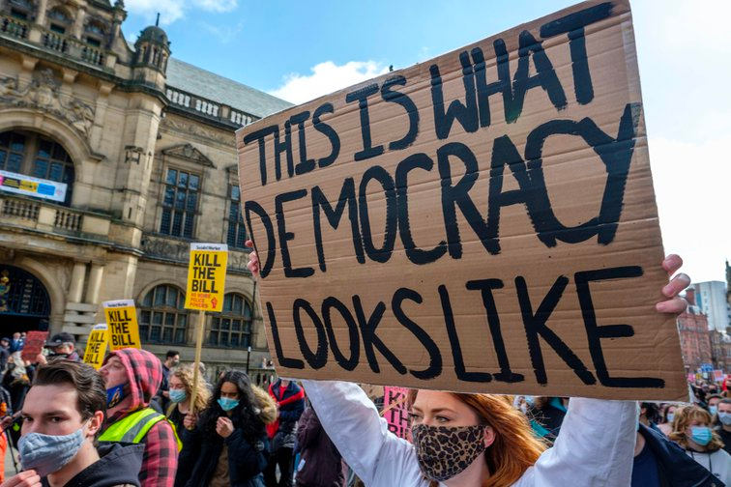
Why should we celebrate human rights?
Throughout history we have seen the horrors that can be allowed to happen when Human Rights are taken away.
Wars, Slavery, The Banning of Education, and Censorship of Speech
standing up for human rights means standing up for what is right

Slide 9

To deny people their Human Rights is to challenge their very humanity.
NELSON MANDELA

Slide 10
What are your Human Rights?
All human beings are born free and equal in dignity and rights.
Everyone is entitled to all the rights in the declaration without distinction.
Everyone has the right to life, liberty, and security of person.
No one shall be held in slavery or servitude.
No one shall be subjected to torture or inhumane treatment.
Everyone has the right to recognition everywhere as a person before the law.
All are equal before the law and are entitled to equal protection of the law.
Everyone has the right to an effective remedy by the national tribunal.
No one shall be subjected to arbitrary arrest, detention, or exile.
Everyone is entitled to a fair and public hearing by an impartial tribunal.
The right to be presumed innocent until proven guilty.
No one shall be subjected to interference with their privacy.
Everyone has the right to freedom of movement.
Everyone has the right to seek safety from persecution.
Everyone has the right to a nationality.

Slide 11
What are your Human Rights?
The right to marry and found a family.
Everyone has the right to own property and shall not be deprived of it.
Everyone has the right to freedom of thought, conscience, and religion.
Everyone has the right to freedom of opinion and expression.
Everyone has the right to freedom of peaceful assembly and association.
Everyone has the right to participate in the government of their country.
Everyone has the right to social security in accordance with the resources of the State.
Everyone has the right to work, to free choice of employment and favourable conditions.
Everyone has the right to rest and leisure.
Everyone has the right to a standard of living adequate for the health and wellbeing of themself.
Everyone has the right to education, and it shall be free in fundamental stages.
Everyone has the right to participate in the cultural life of the community.
Everyone is entitled to a social and international order in which their rights are respected.
These rights may not be exercised contrary to the principles of the United Nations.
Nothing in this declaration may be interpreted as aimed at the destruction of freedom.

Slide 12
To celebrate 75 years of human rights:
know your rights
and fight for them, always

