Slide 1
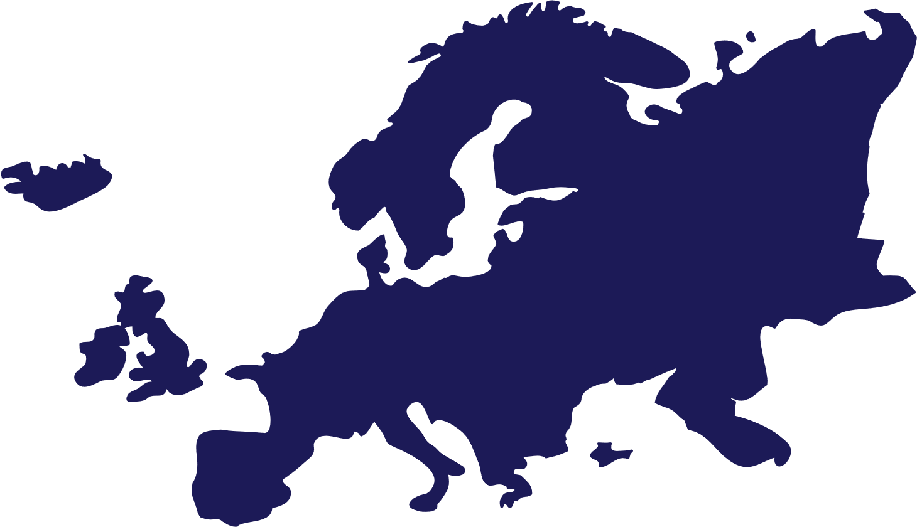
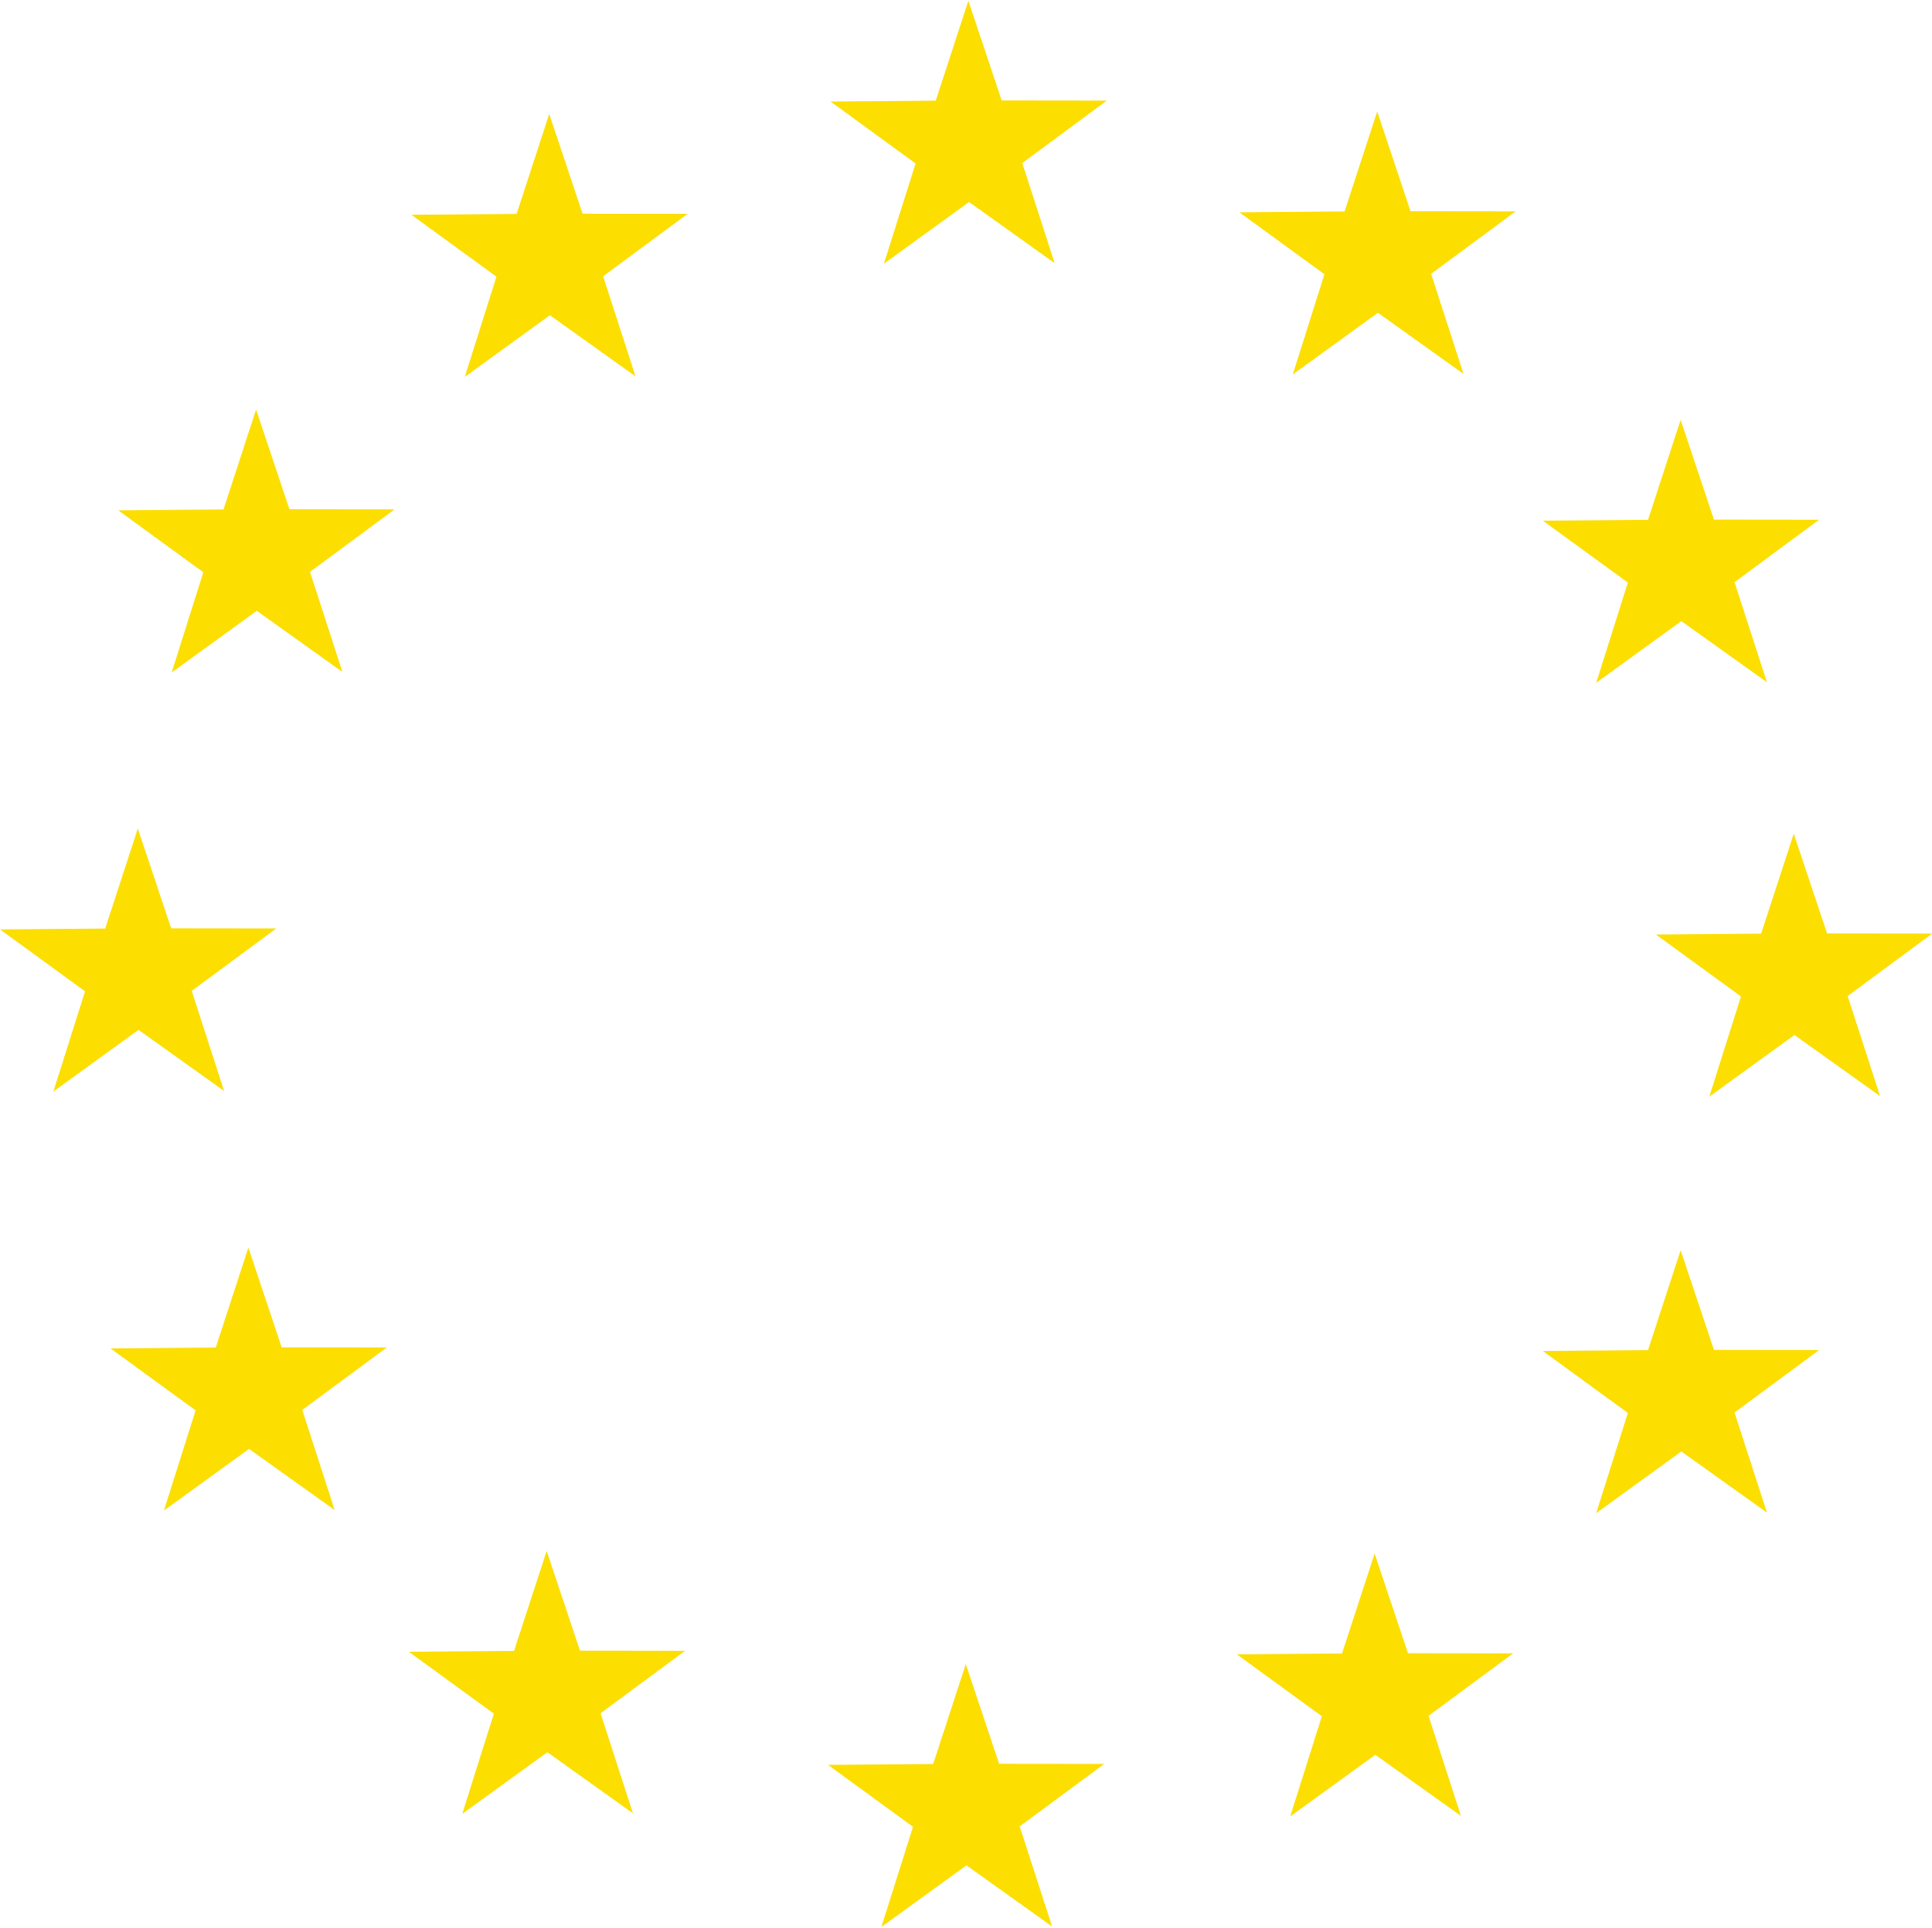


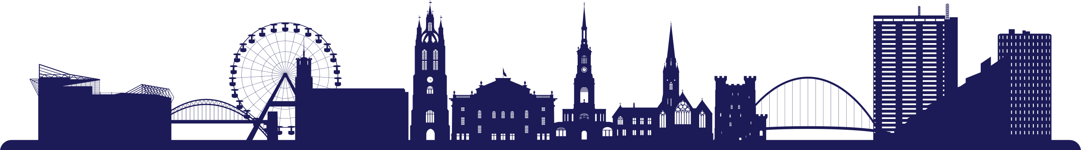
HAPPY
EUROPE
DAY
09/05/2024

Slide 2
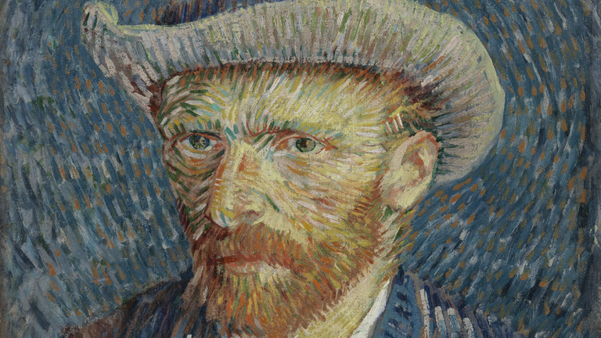
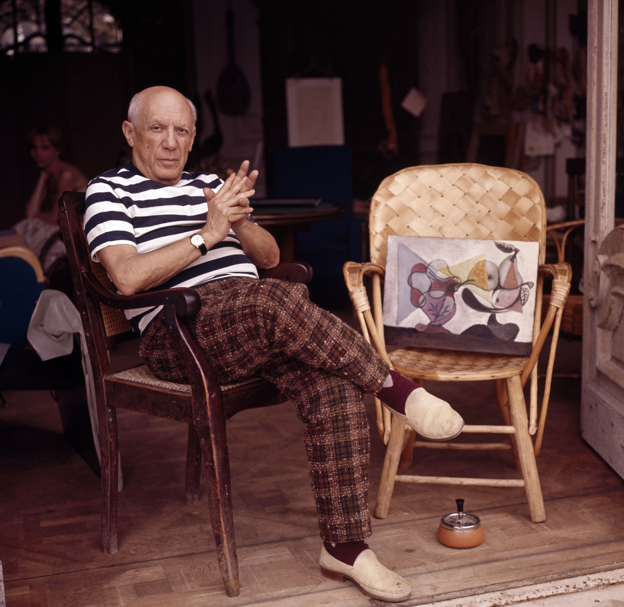
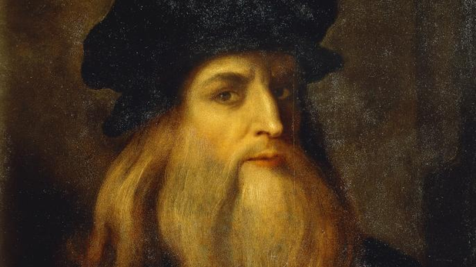
MATCH-UP
Match up the European artist with their name
LEORNARDO DA VINCI
VINCENT VAN GOGH
PABLO PICASSO

Slide 3
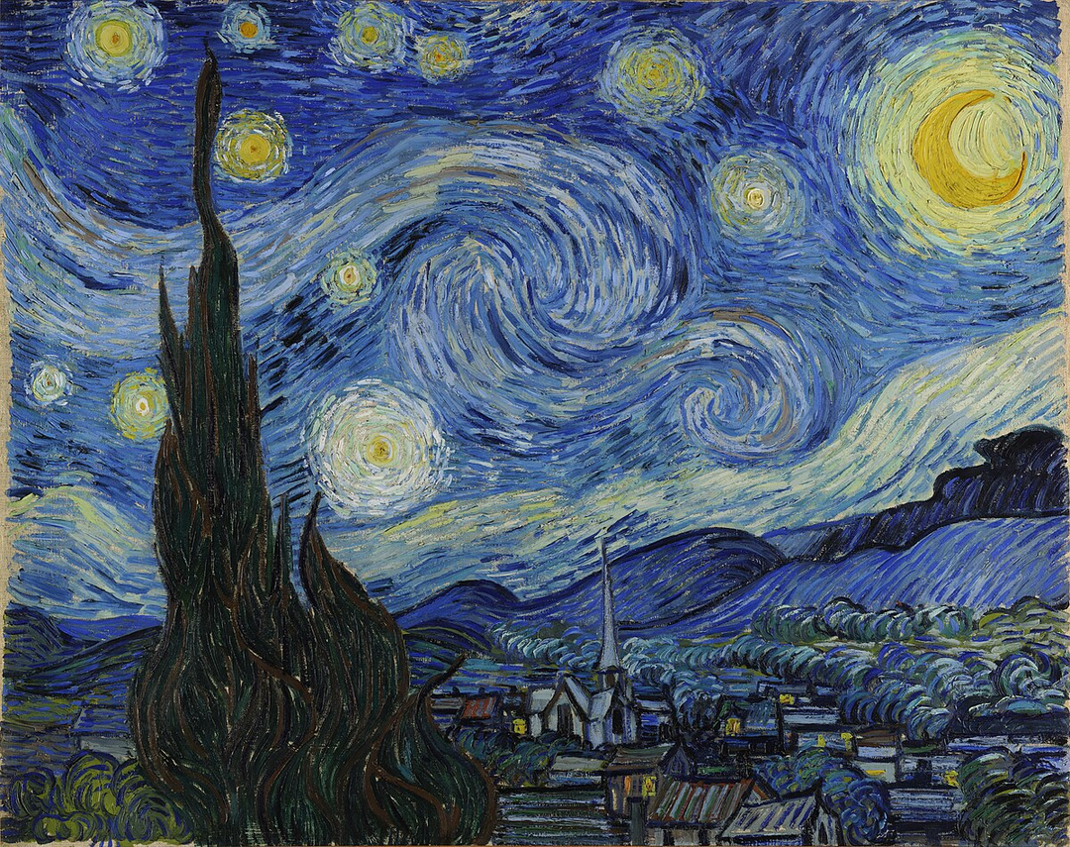
WHICH EUROPEAN ARTIST
MADE THIS PAINTING?
Da Vinci

Slide 4
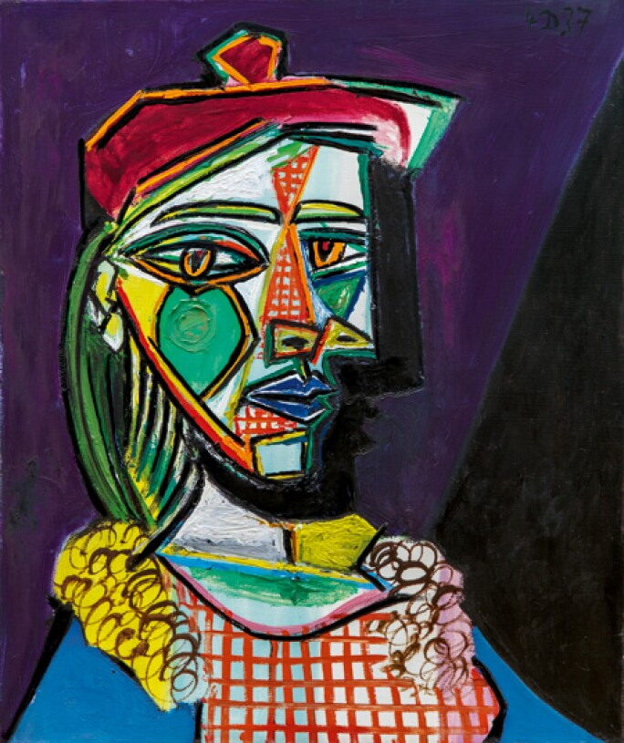
WHICH EUROPEAN ARTIST
MADE THIS PAINTING?
Picasso

Slide 5
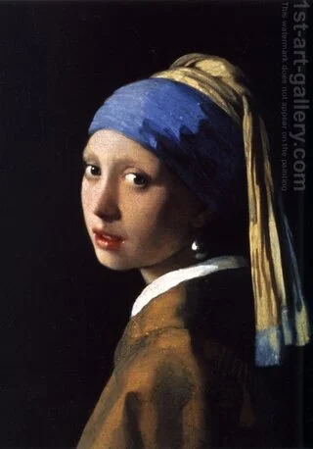
WHICH EUROPEAN ARTIST
MADE THIS PAINTING?
Claude Monet

Slide 6
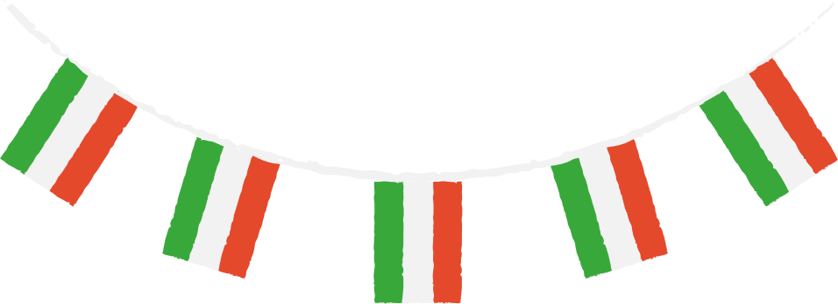
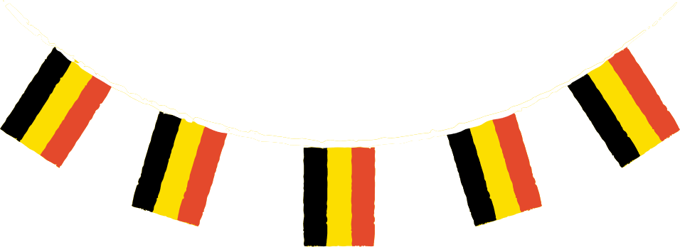

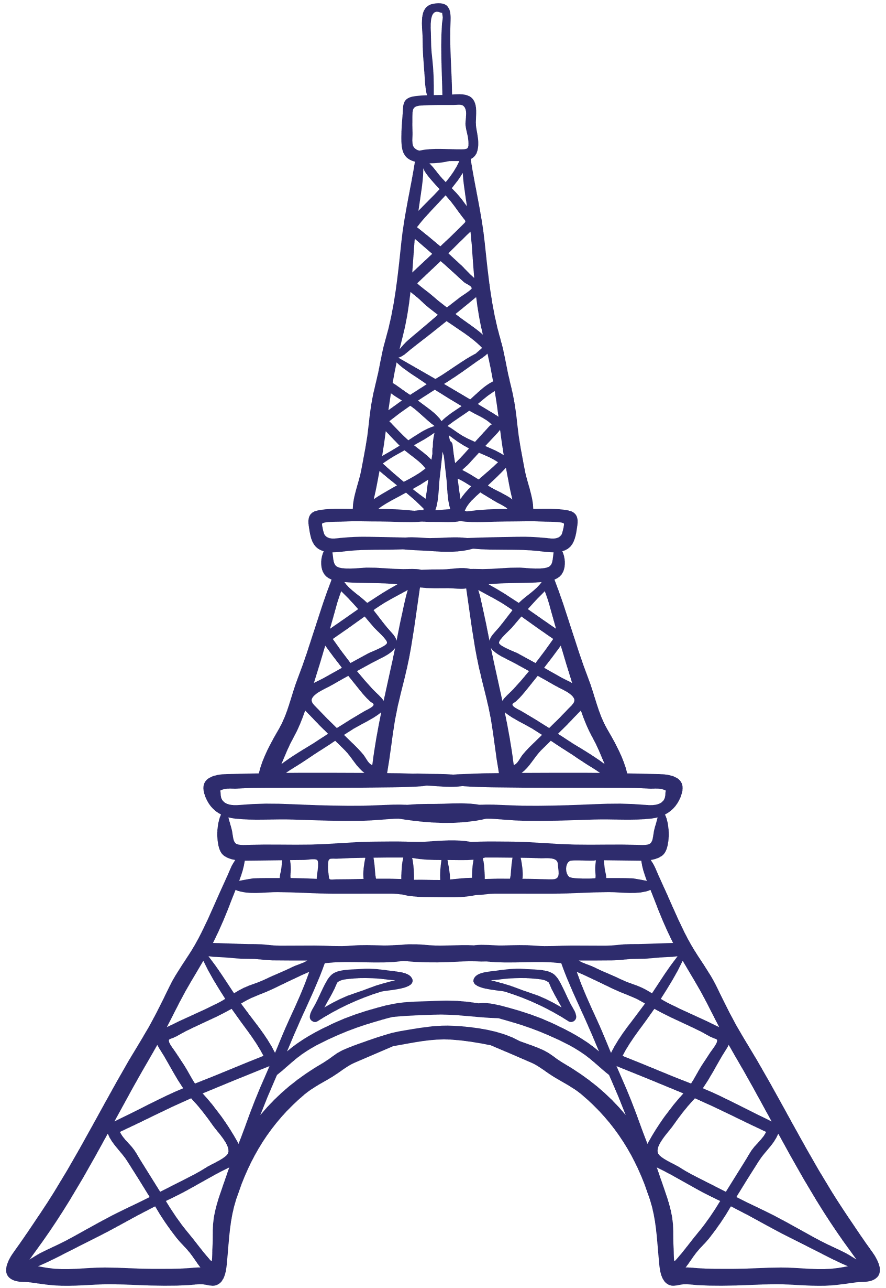
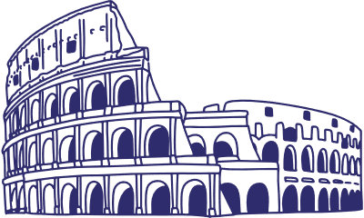
Why is Europe known for it’s art?
The art of Europe, also known as Western art encompasses the shared history in Europe.
European artists and paintings have produced some of the most iconic and enduring works of art in history.
Paris is a monumment to culture and artistry. From classical, to Baroque, you will find key artworks in every style.

